Slide 1

BITE-SIZE CLIL:
now available at your school!
Ana Serenčeš, Osnovna škola Odra, Zagreb
28th Annual HUPE Conference
online
14 November 2020

Slide 2
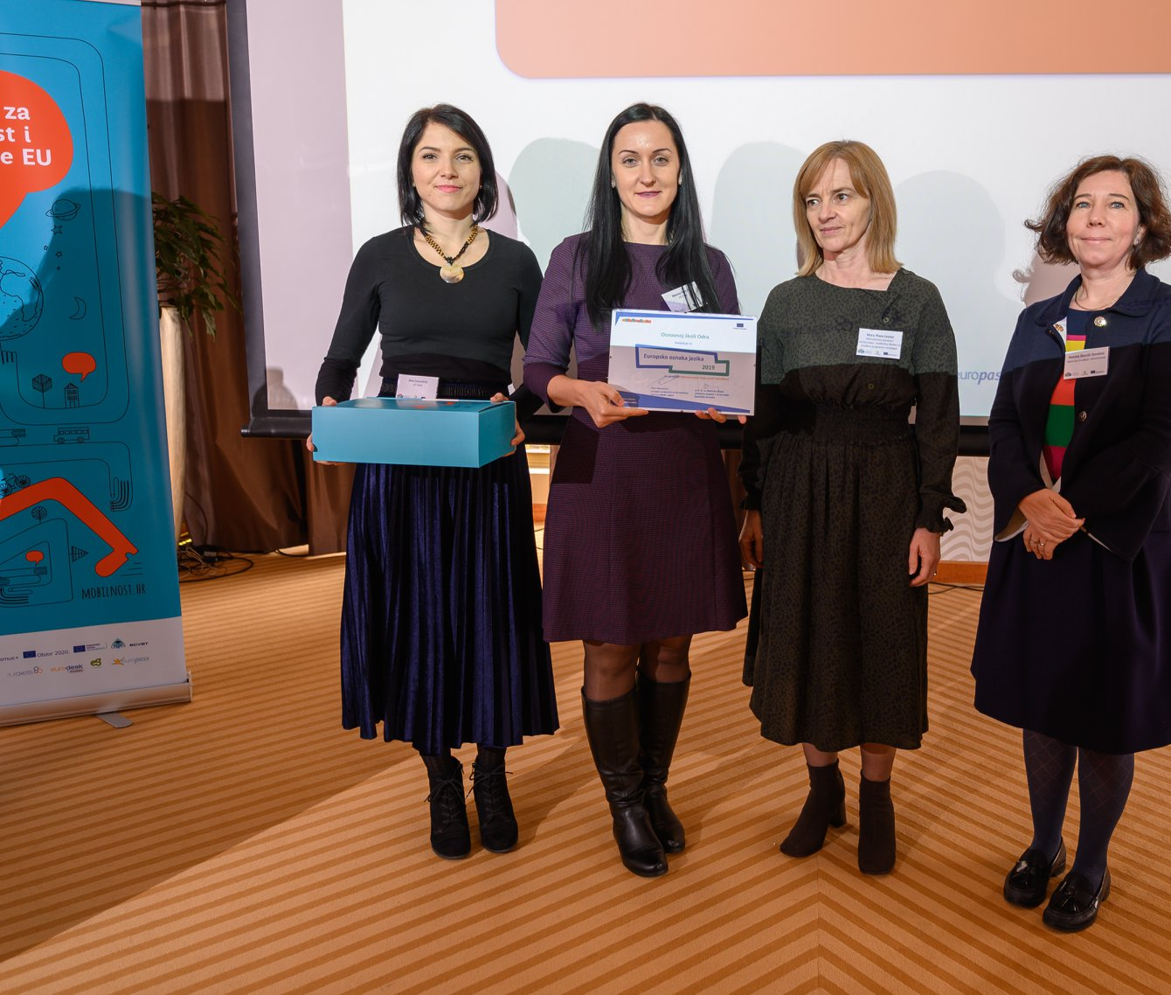
European Language Label awarded to our project at the Annual eTwinning Conference 2019

Slide 3
CLIL – Content and Language Integrated
Learning
an additional language is used for the learning and teaching of both content and
language
Coyle, D., Hood, P., & Marsh, D. (2010). CLIL: Content and language integrated learning.
Cambridge, UK: Cambridge University Press.
It is essential that the learner acquires new knowledge in a "non-language subject",
and a foreign language is taught indirectly through the learning of the underlying
subject. Methodologies and approaches are related to the subject area, not the language of teaching.
„Seminar za nastavnike u dvojezičnim školama”. Agencija Za Odgoj i Obrazovanje, https://www.azoo.hr/index.php?view=article&id=1997&naziv=seminar-za-nastavnike-u-dvojezinim-kolama-

Slide 4
Erasmus+ KA1
project: Education That Follows
Trends

Slide 5
The CLIL part of the project
the science teacher held two CLIL workshops at school for the teachers of
HISTORY,
GEOGRAPHY,
COMPUTER SCIENCE,
MATHEMATICS.
as a result, these teachers, together with the SCIENCE teacher, organized CLIL activities during their regular lessons
6 lessons per subject in each grade they teach (10 in science) -> cca. 136 i.e. 272 lessons in total with integrated CLIL activities held in schoolyear 2018/2019

Slide 6
The CLIL part of the project
teachers more proficient in English were chosen
they had the freedom to choose the topics to be taught applying CLIL
methodology and did not have to make their own materials if they didn’t feel
confident
they were educated on the possible solutions by the science teacher
they were provided with linguistic and methodological support from the
English teacher
students were not graded for their performance in English, unless the teacher wanted to reward someone for their effort
And… here’s what they came up with ☺

Slide 7
The practice - your opinion
Take a look at some of the materials and think:
Is the material appropriate for the students’ age?
Is it purposeful for acquiring new vocabulary and improving reading
comprehension?
More materials: https://www.os-odra.com/obrazovanje-koje-prati-trendove-ka1

Slide 8
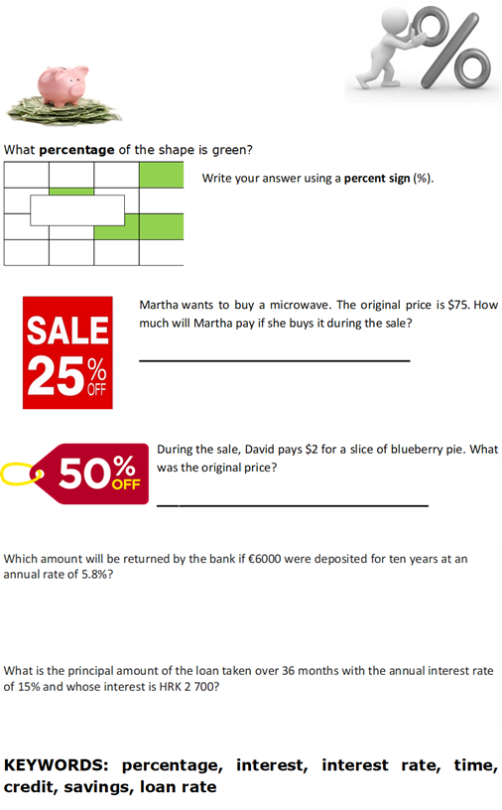
7th grade, maths

Slide 9
7th grade, maths

Slide 10
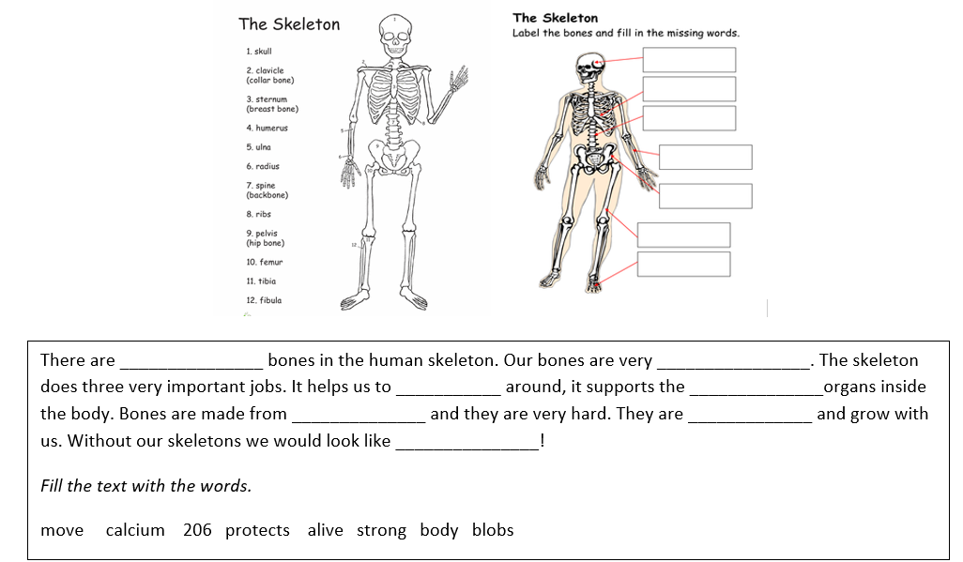
8th grade, biology

Slide 11
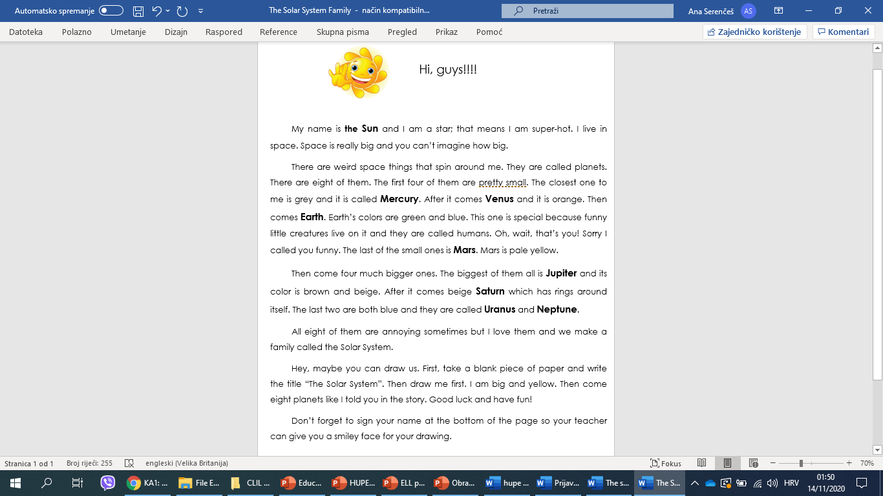
5th grade, geography

Slide 12
5th grade, geography

Slide 13
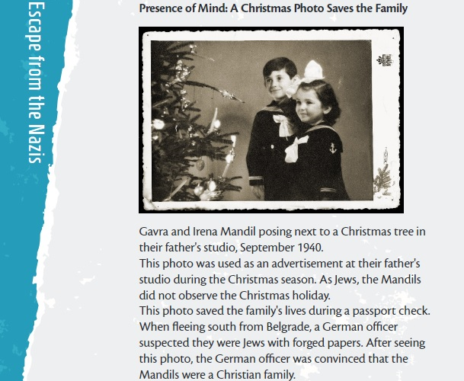
8th grade, history

Slide 14
Students’ impressions
Here are some comments from the students’ evaluation of the project:
I liked that we didn’t have to memorize a lot of stuff; there were always
some games
I like that we learn the keywords both in English and Croatian
I like that we learn English because we’ll need it in future
I liked that I got a B in my next English test
It’s easier to memorize new words this way

Slide 15
Please, do me a favor ☺.
Fill in a very short evaluation survey at bit.ly/hupeclil
Any questions?
Feel free to contact me at ana.serences1@skole.hr
THANK YOU!

