Slide 1

Transmedia Storytelling in the ESL Classroom: Developing Literacy across Media
Mateja Žerjav
Jelena Škoda
Online HUPE Conference November 21, 2020

Slide 2

Transmedia storytelling - presenting a story “across multiple delivery channels for the purpose of creating a unified and coordinated entertainment experiences. Ideally, each medium makes its own contribution to the unfolding of the story” [1]
CHARACTERS/CONVENIENCE/COMMUNITY [2]

Slide 3
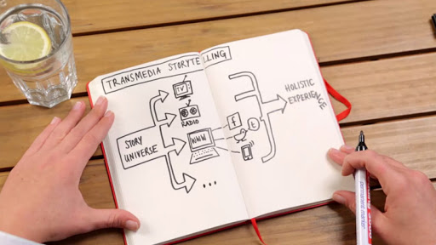

Slide 4
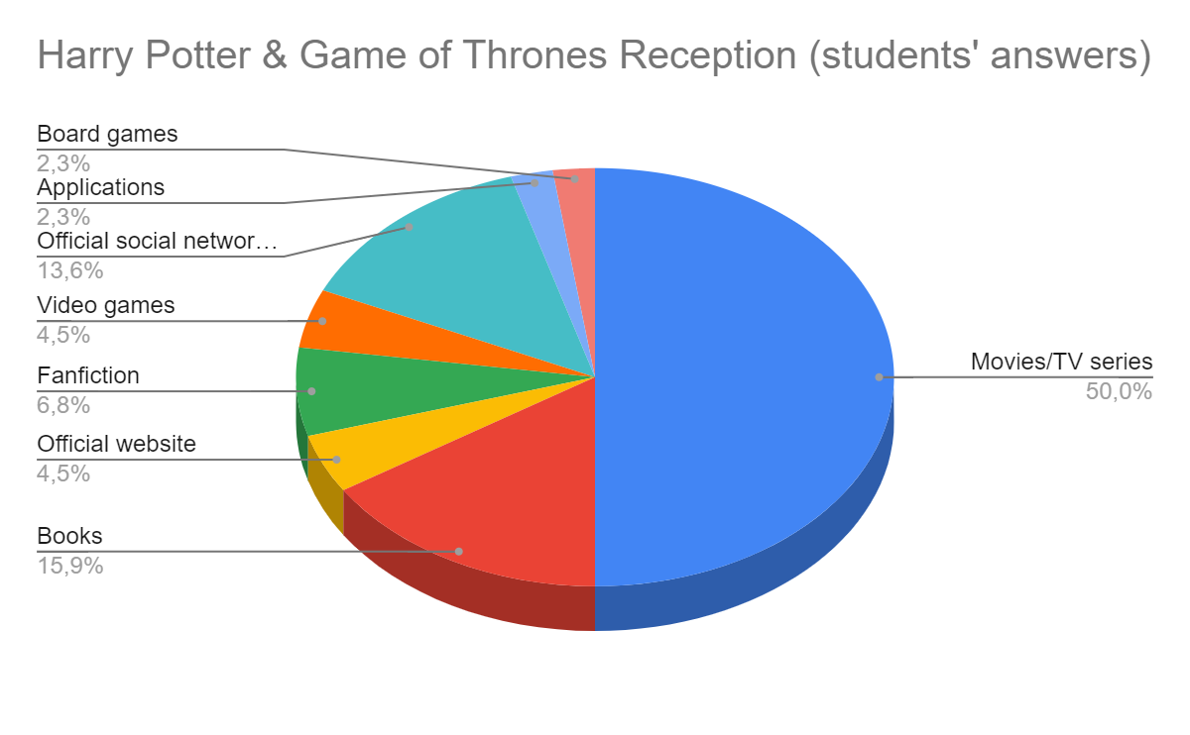

Slide 5

Transmedia literacy
“a set of skills, practices, values, priorities, sensibilities, and learning/sharing strategies developed and applied in the context of the new participatory cultures”[2]

Slide 6
Transmedia literacy
 | Literacy | Media literacy | Transmedia literacy
Subject interpellation | As an illiterate | As a passive media consumer | As a prosumer
Learning environment | Formal (schools) | Formal (schools), no formal and informal | From informal to formal (schools)
Role of the teacher | Knowledge authority – Mediator student/text | Knowledge mediator - Creator of learning experiences with the media | Knowledge facilitator – Cultural translator [3]

Slide 7

Tom Hanks
Welcome to Mars (Uncommon Type)

Slide 8

Place your screenshot here

Slide 9
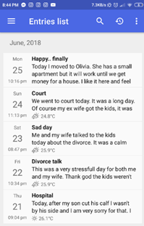
Place your screenshot here

Slide 10
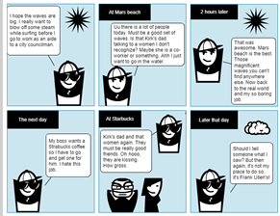
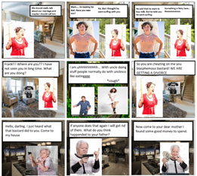

Slide 11
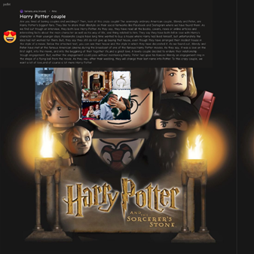
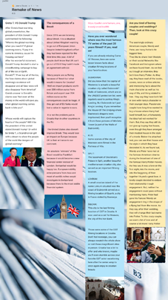
News article

Slide 12

Transmedia literacy
USA PRESIDENTIAL ELECTION SIMULATION 2020
in association with
Croatian American Society (CAS)

Slide 13



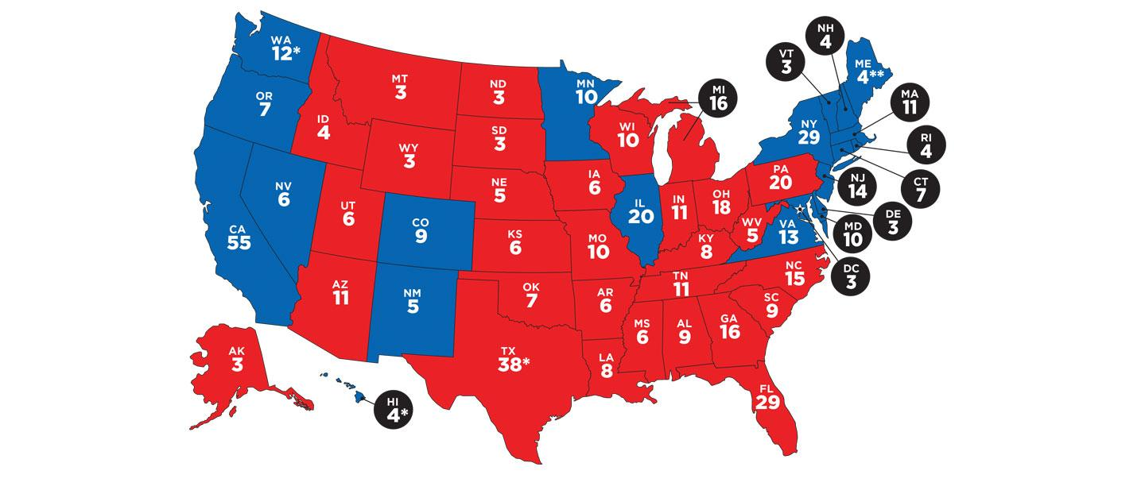
- learn about the election process and the voting system in America
- compare the elections in Croatia and the USA

Slide 14



How did we do it?
36 schools in Croatia
the information week and the the voting week
YouTube links used in preparing students to vote
official ballot printed out

Slide 15
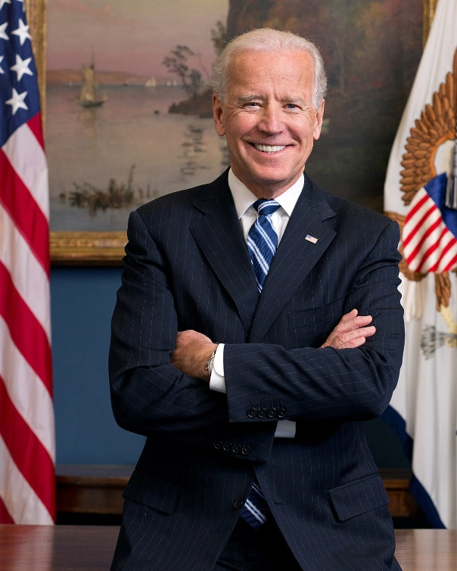









What was used?
Actionbound
Padlet
Mentimeter
Instagram
Facebook
Online newspapers
YouTube links…

Slide 16
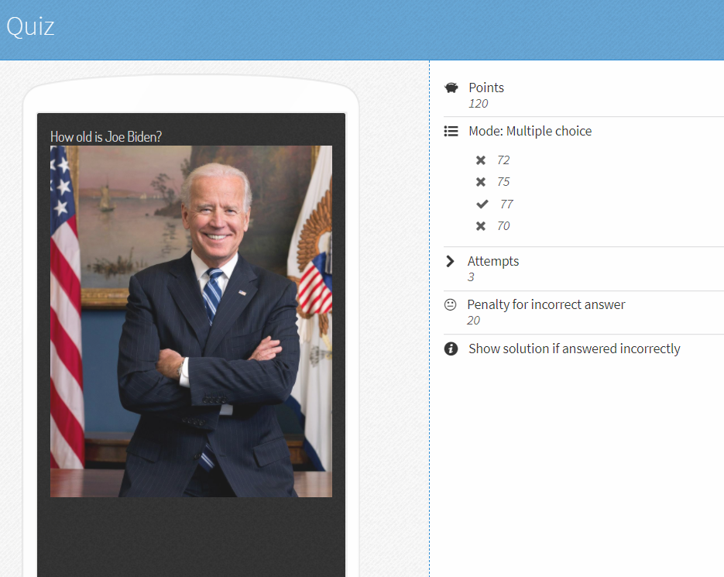
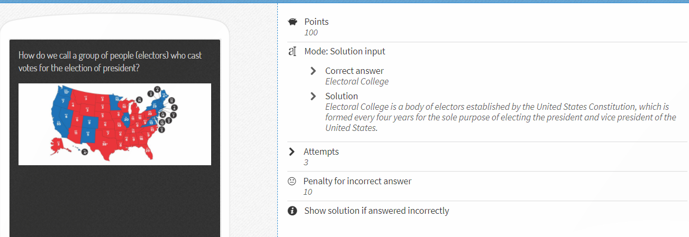
Actionbound

Slide 17
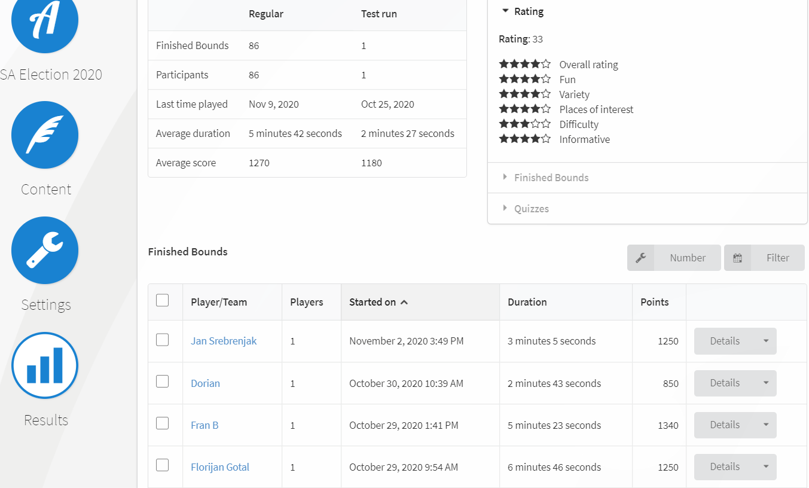

Bound's web page https://actionbound.com/bound/USAElection2020

Slide 18
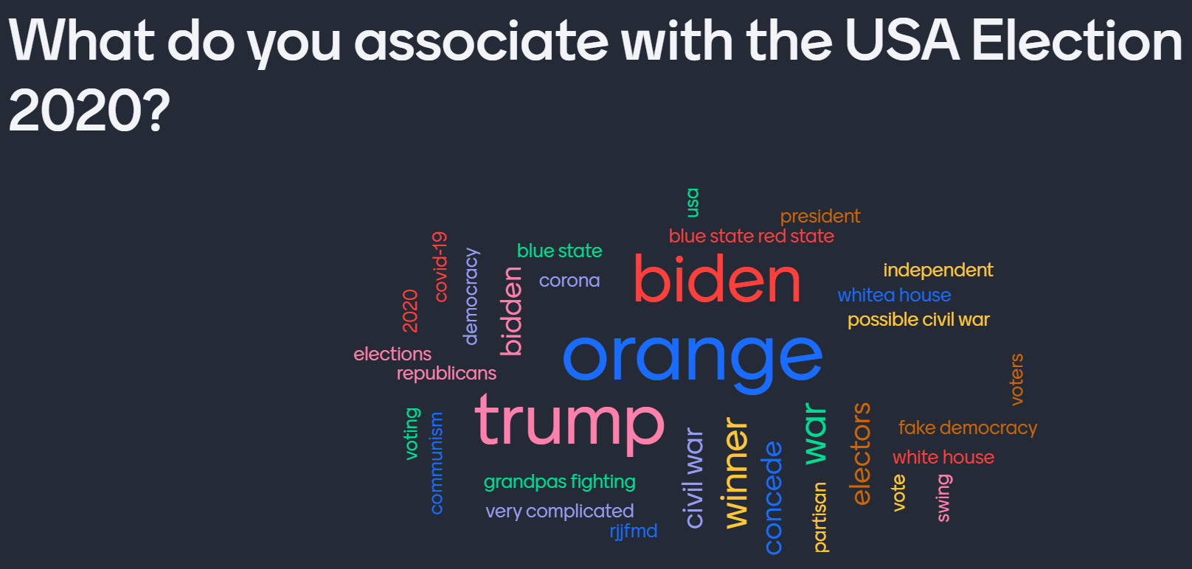
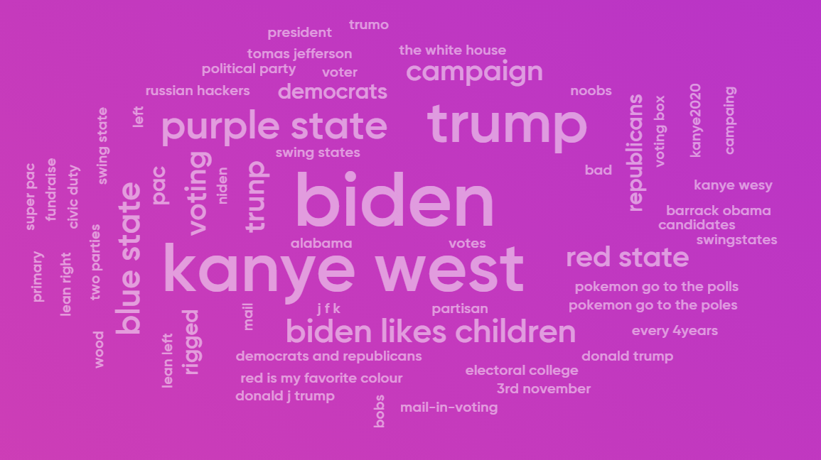
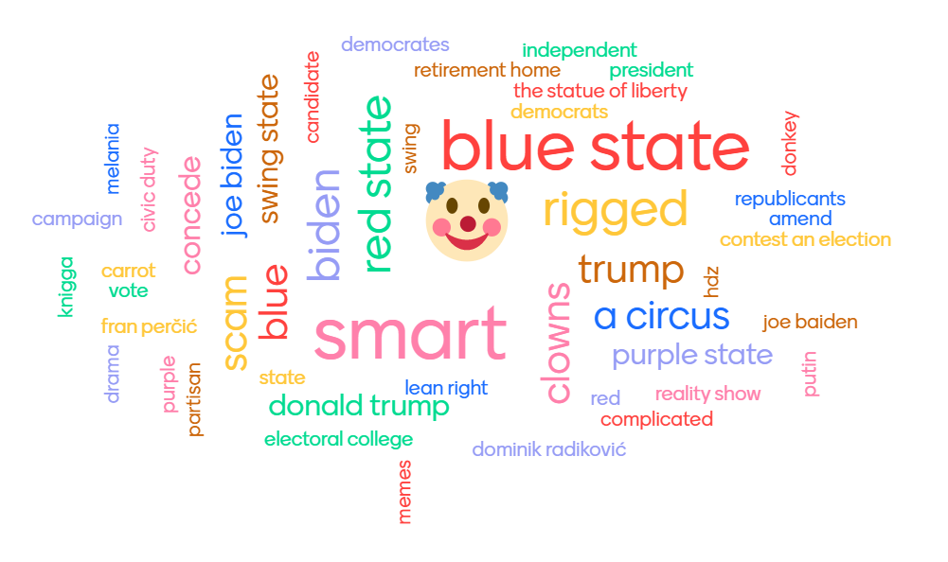
Mentimeter

Slide 19
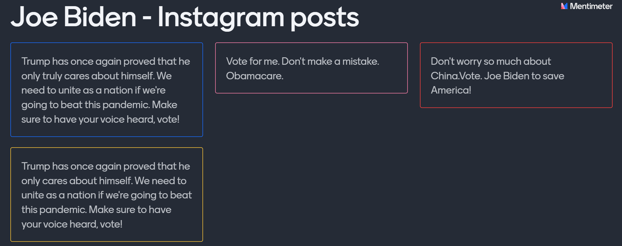
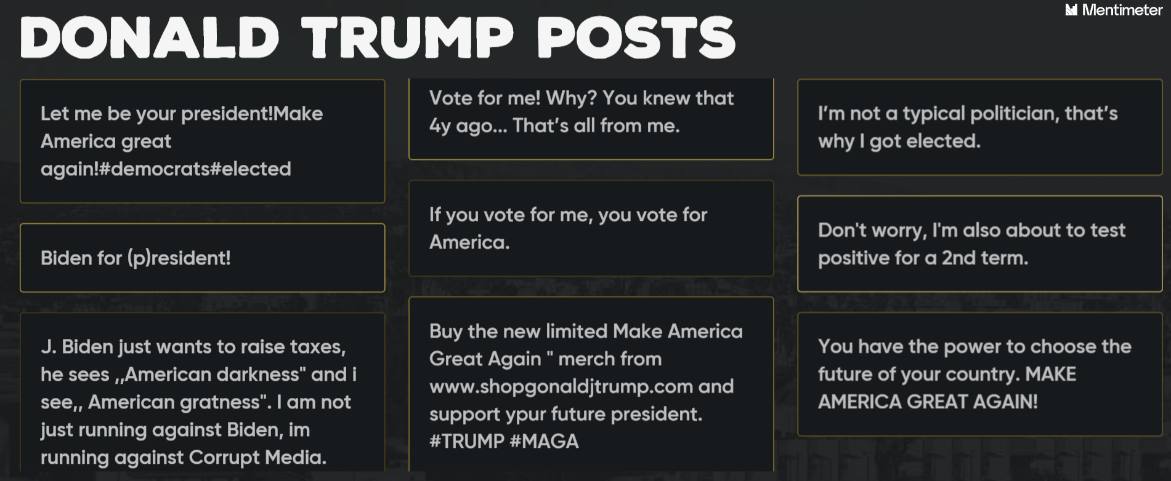

Slide 20
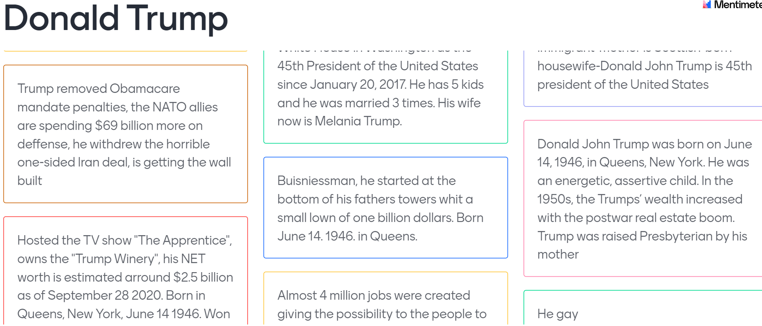
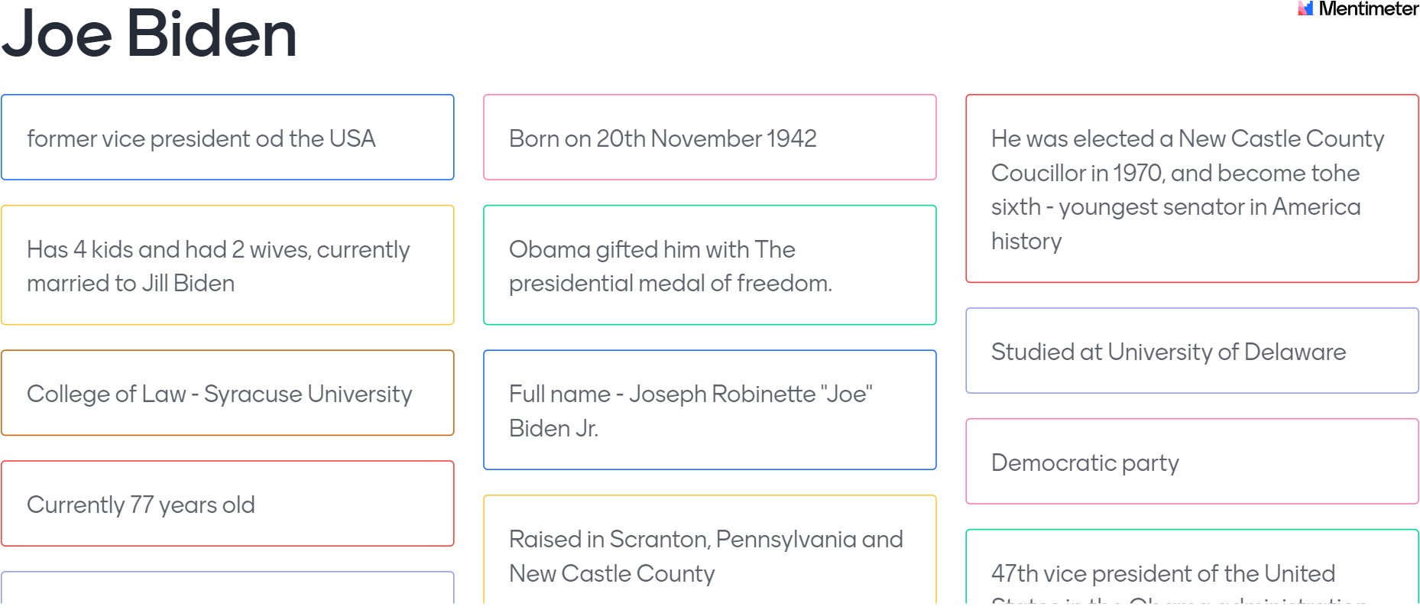

Slide 21
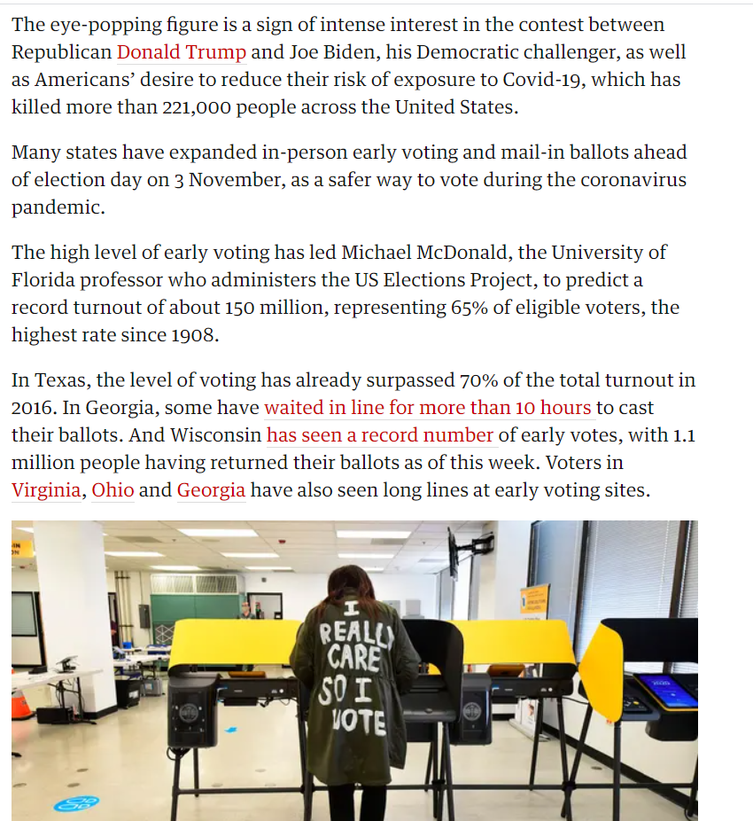
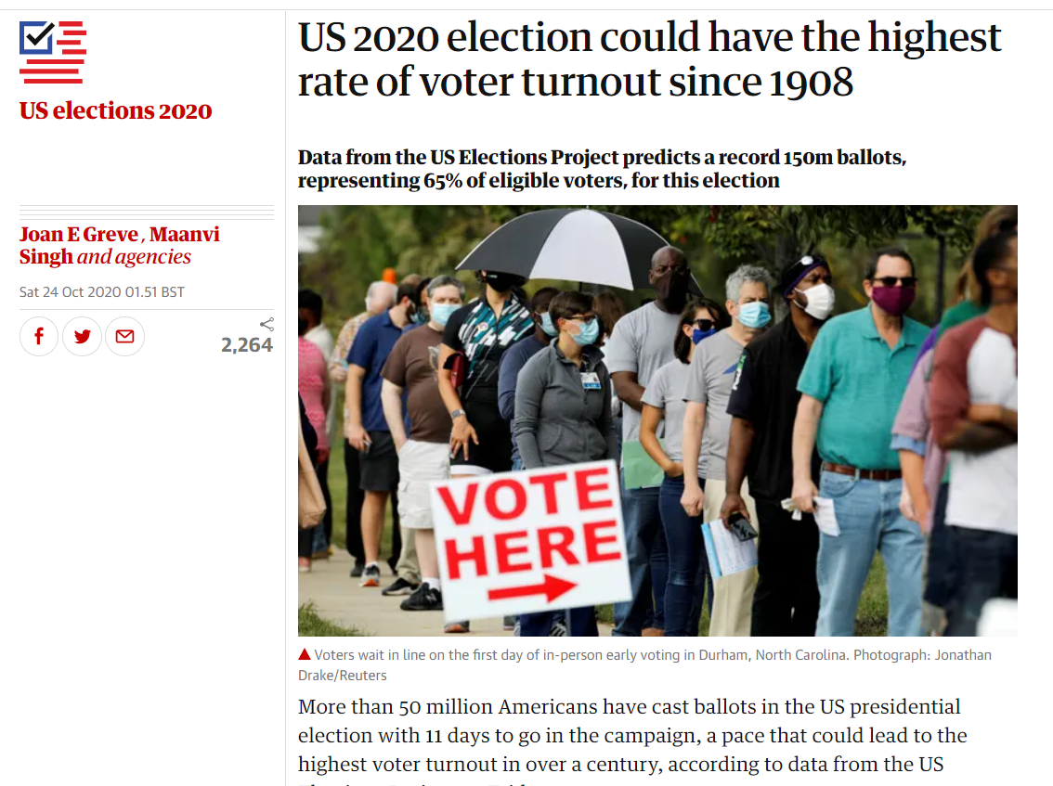
Online newspapers (The Guardian, Time…)

Slide 22
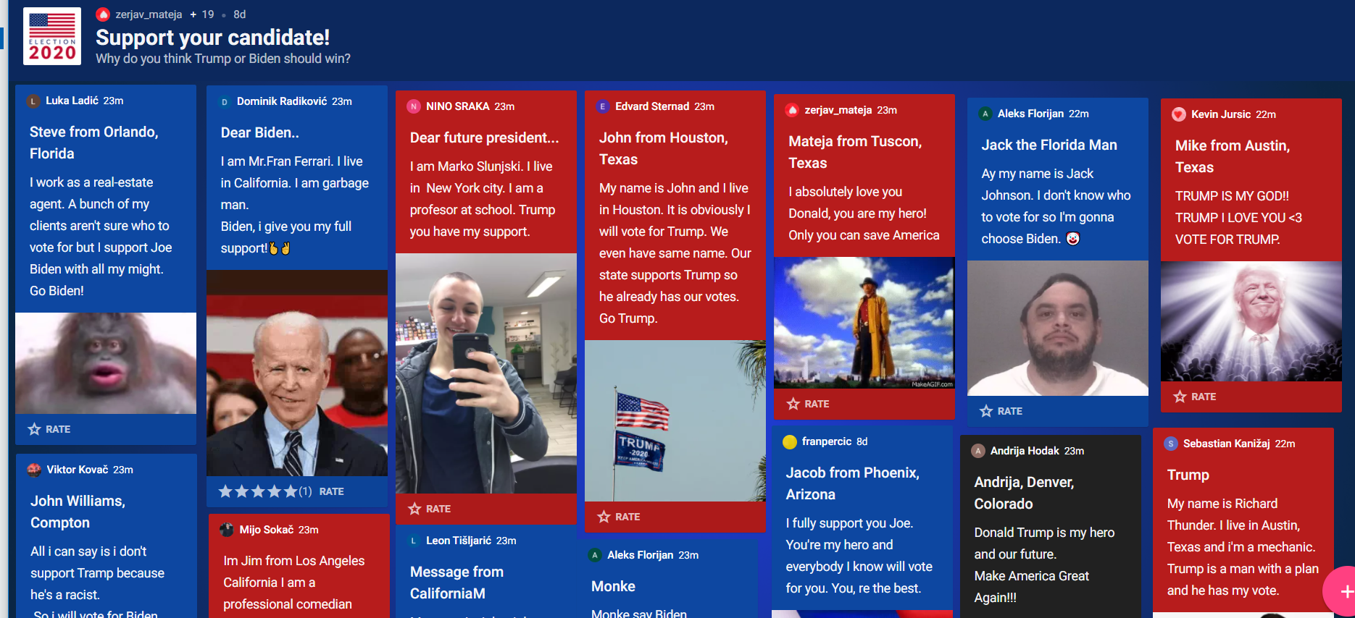
Padlet

Slide 23
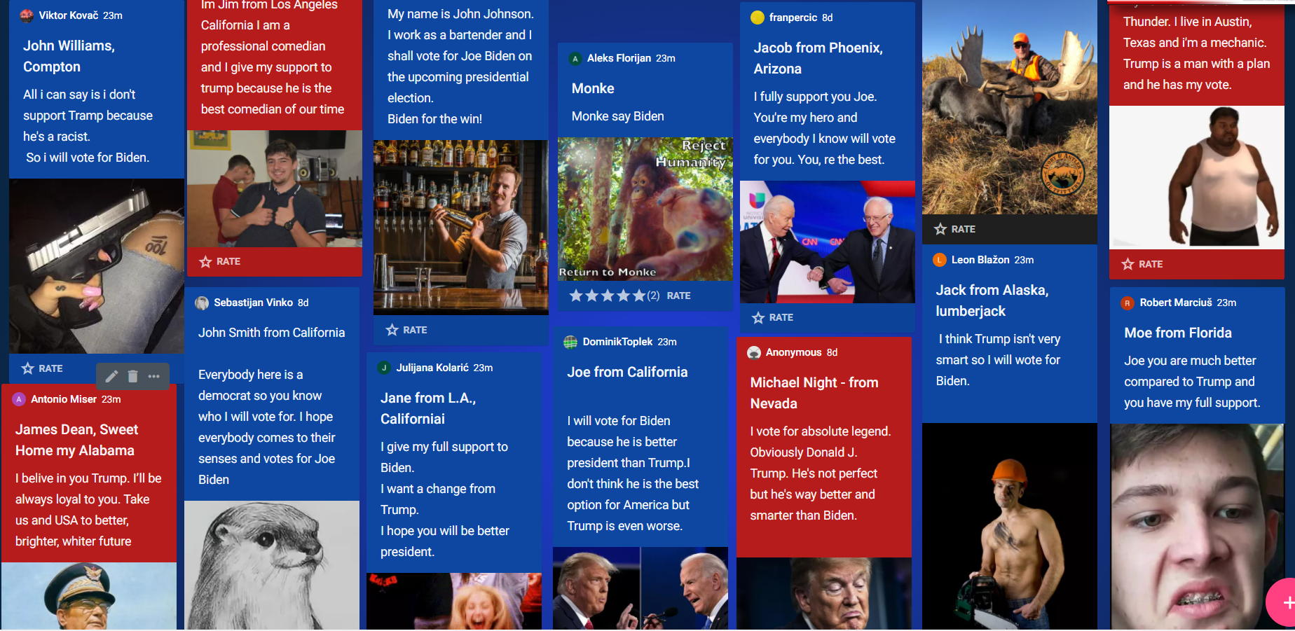

Slide 24
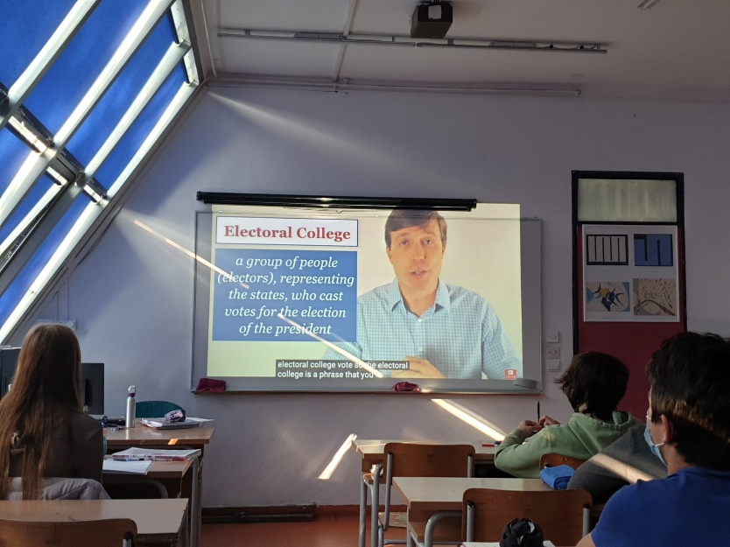
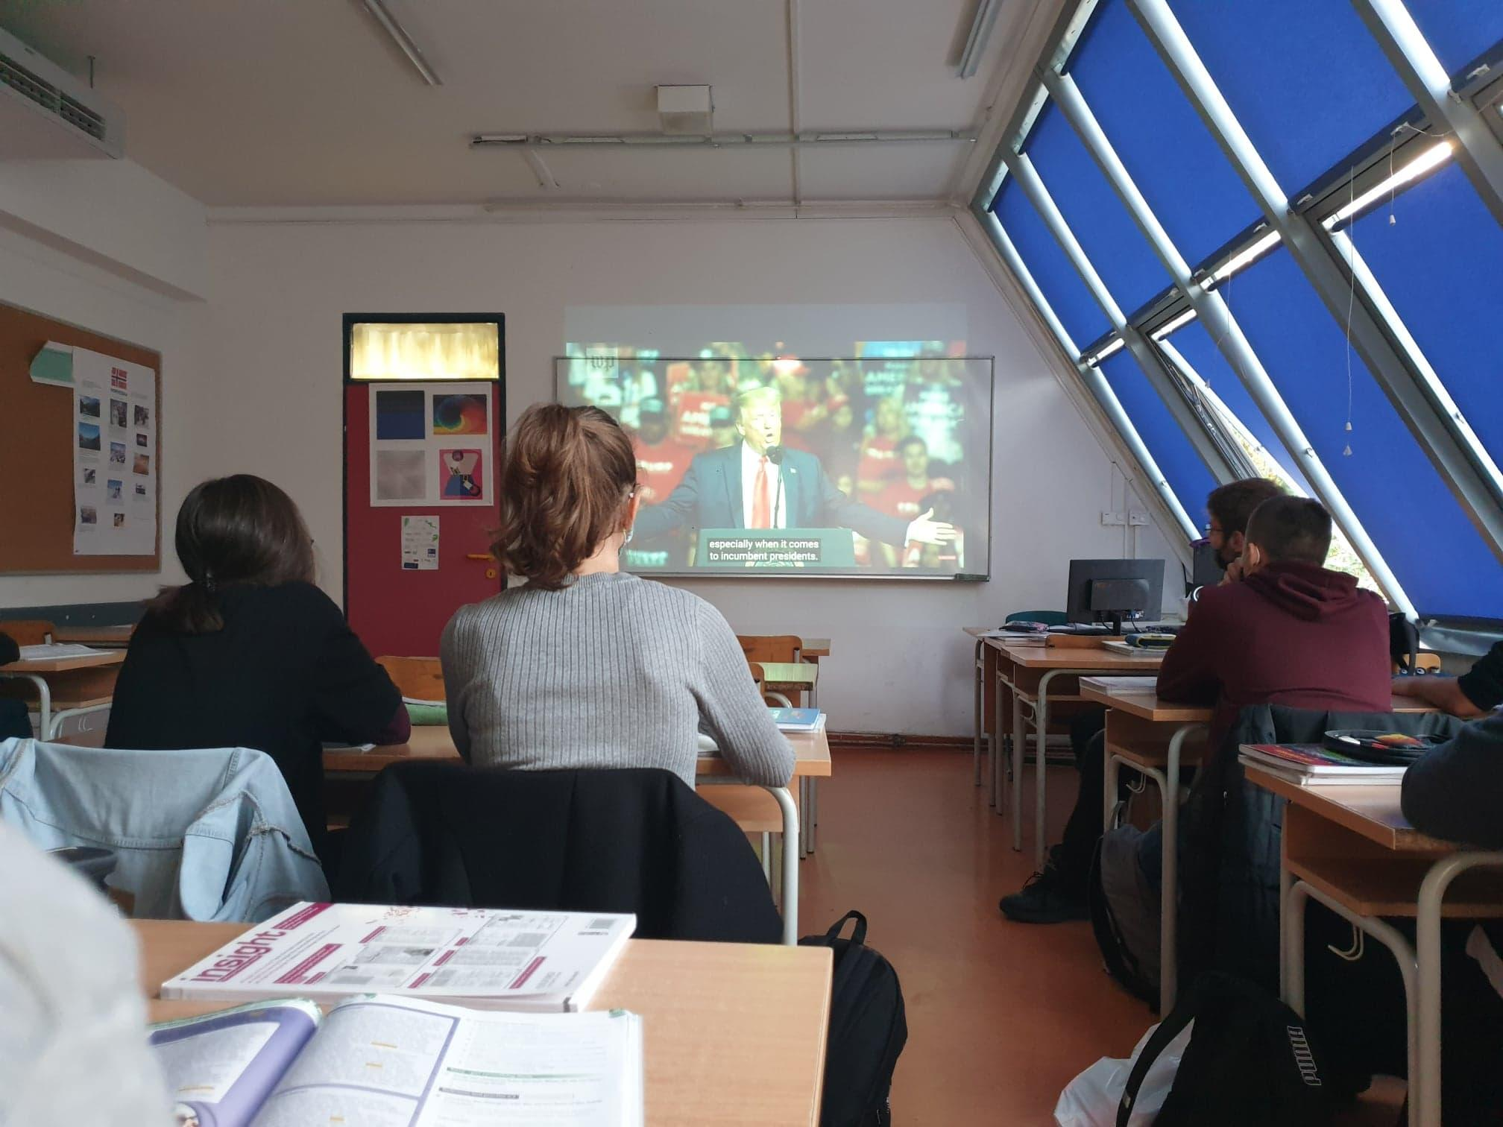
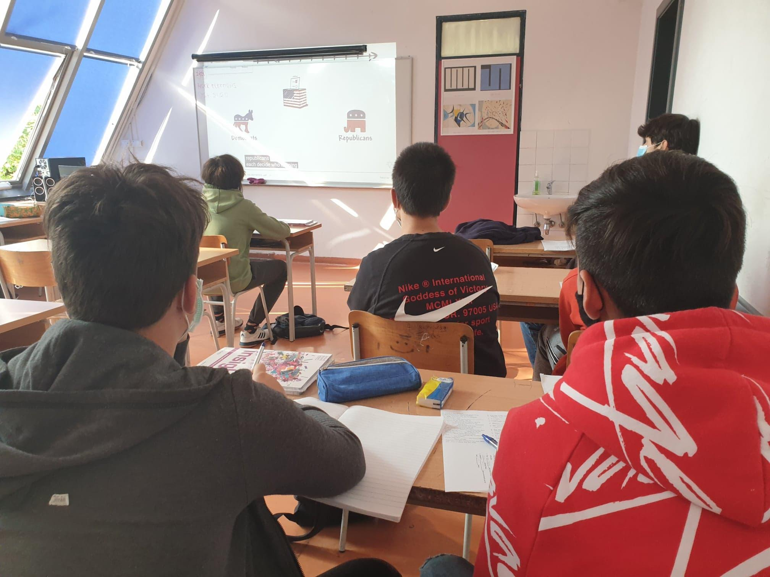
Watching the YouTube links:

Slide 25
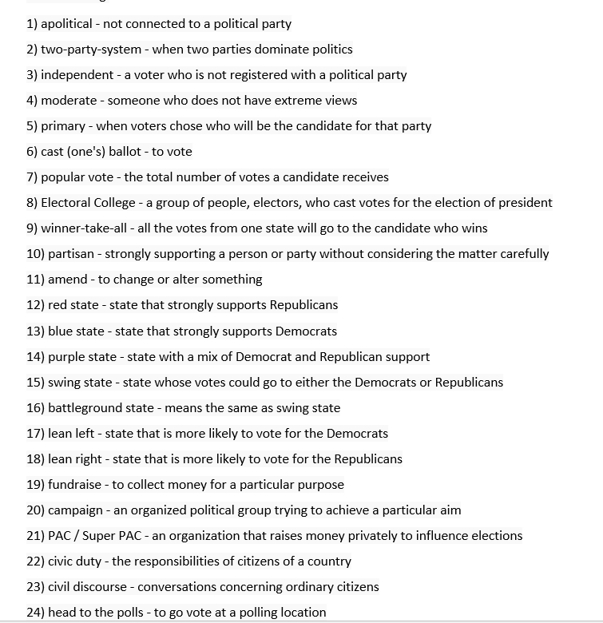
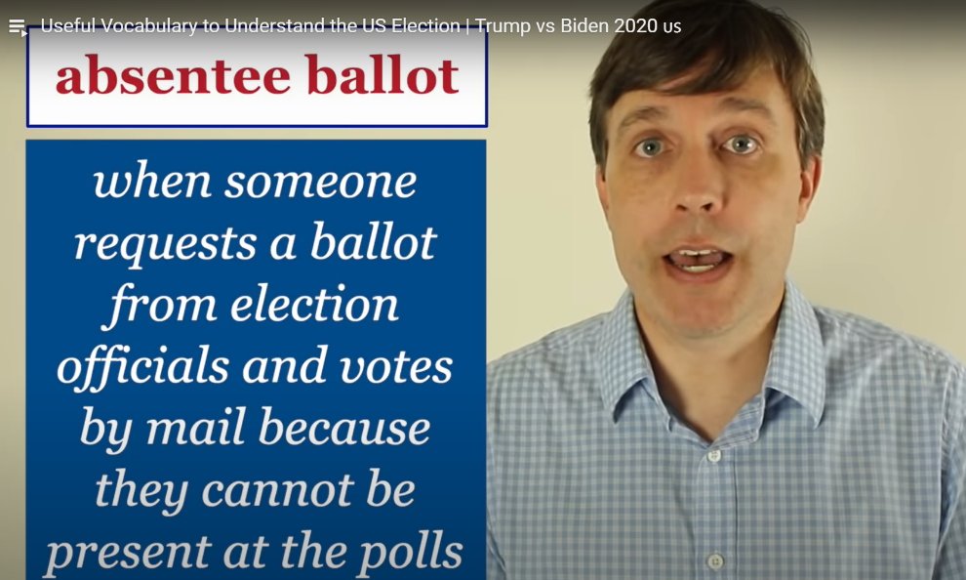
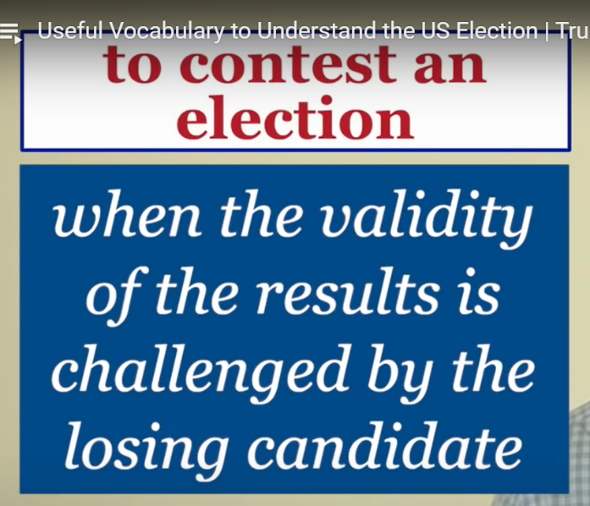
Learning new vocabulary (revise with crosswords, kahoot, quizlet…)

Slide 26
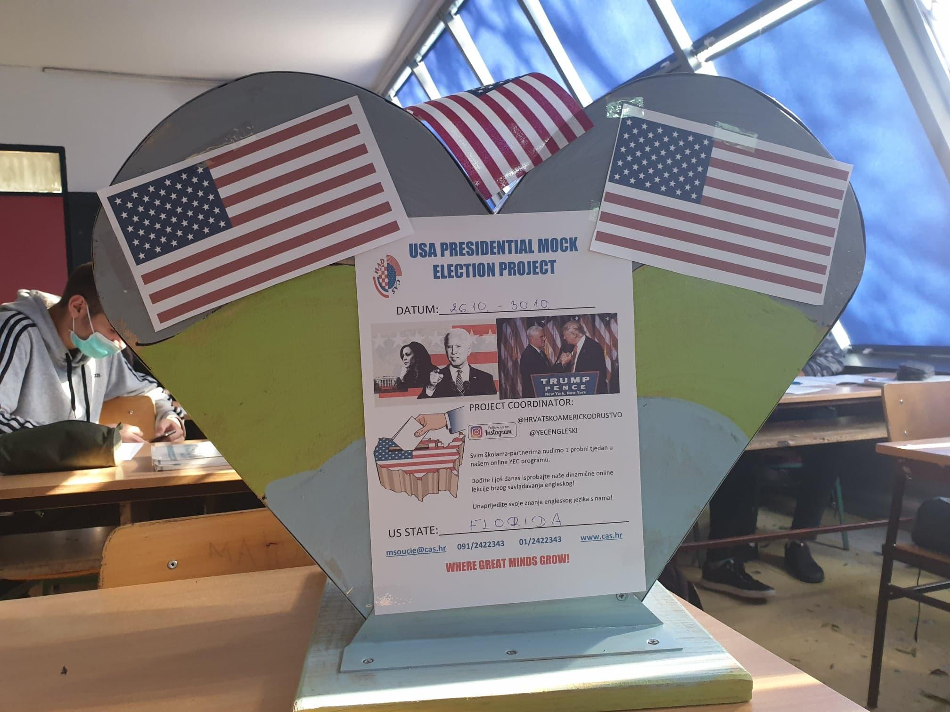

Slide 27
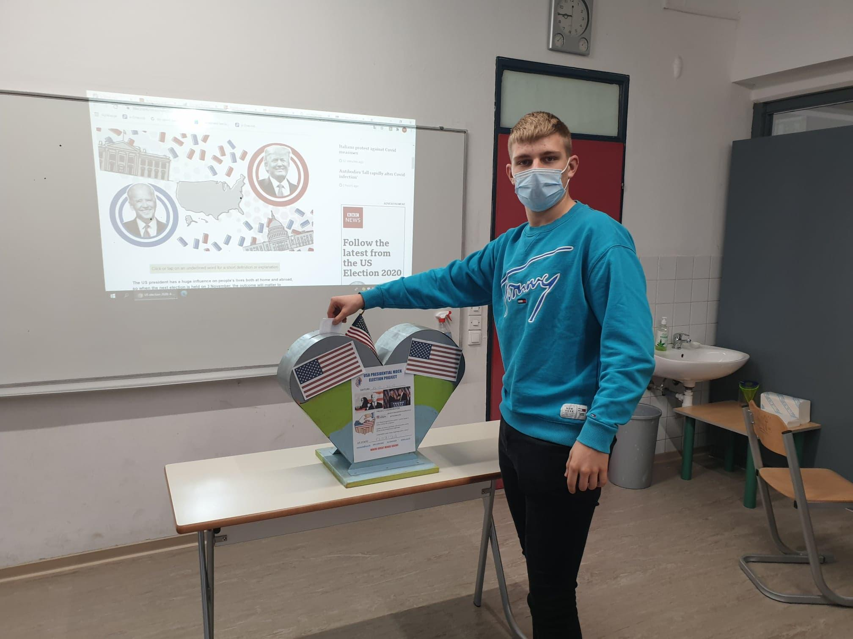
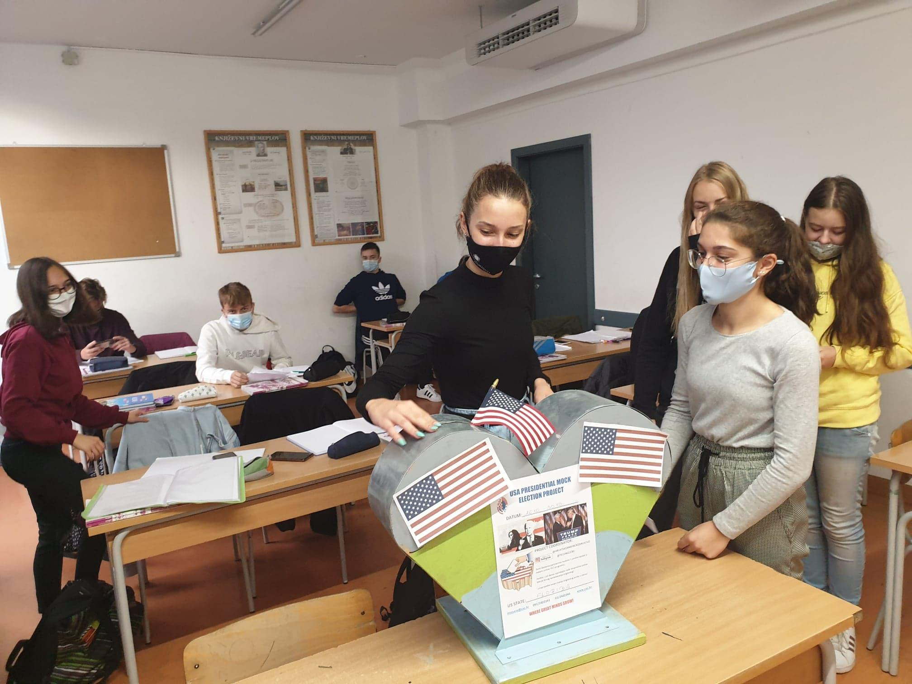
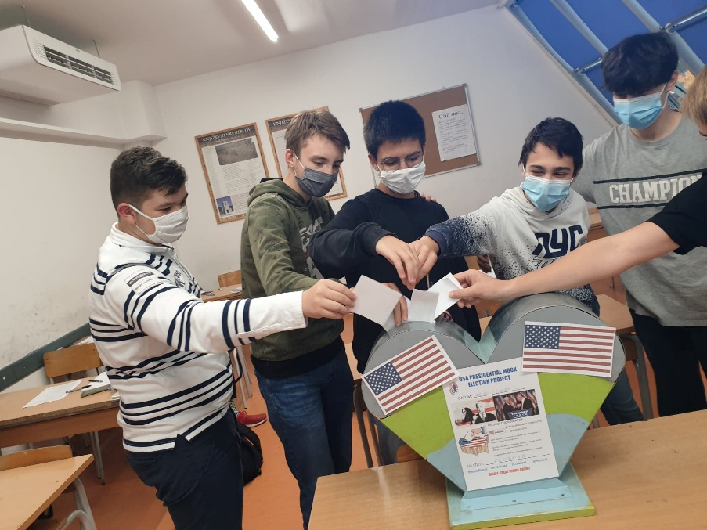
Voting:

Slide 28
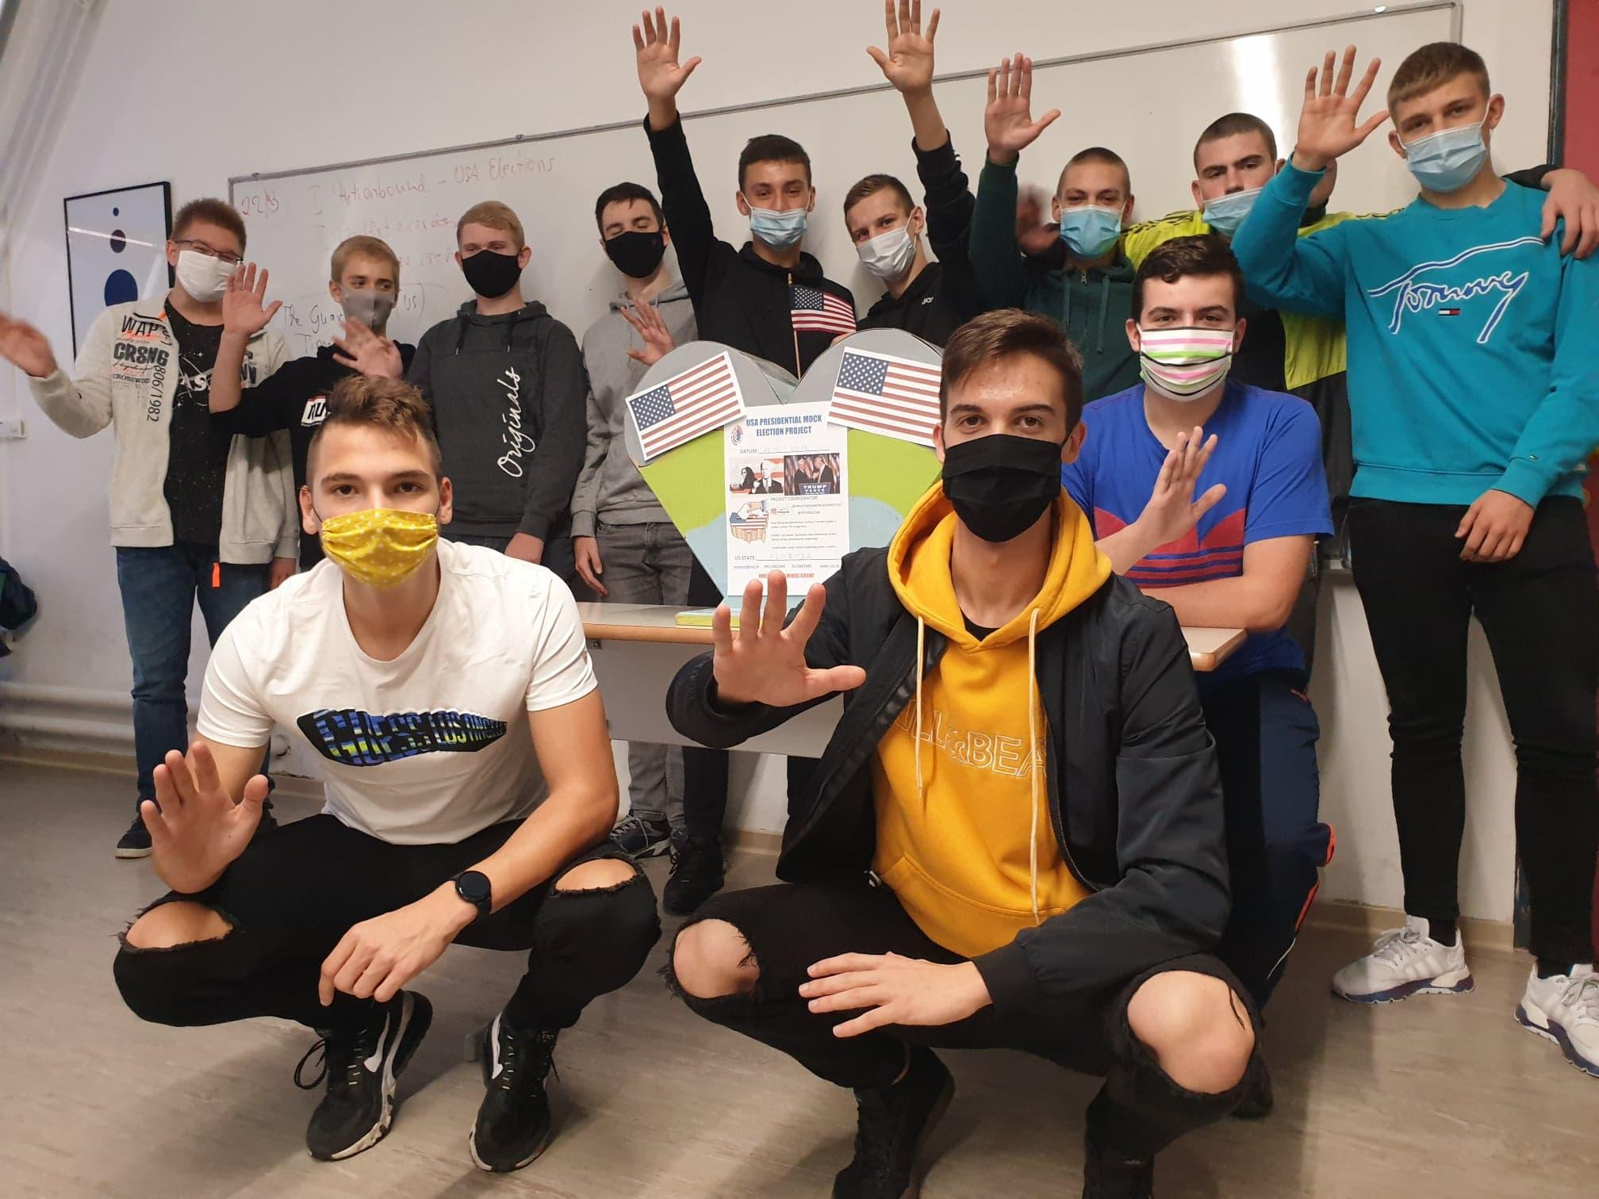
Greetings from Čakovec!

Slide 29
CONSLUSION
develops different forms of literacy
supports autonomous learning
encourages emotional engagement
creativity, innovation and entrepreneurship

Slide 30
Thank you!
Any questions?
zerjav.mateja@gmail.com
jelenaskoda7@gmail.com

Slide 31
Literature:
[1] Jenkins, H. (2006) "Confronting the Challenges of a Participatory Culture
(Part Six)", Confessions of an Aca-fan, http://henryjenkins.org/
2006/10/confronting_the_challenges_of_5.html.
[2] Pratten, R. (2015) Getting Started in Transmedia Storytelling: A Practical Guide for Beginners
[3] Scolari, A.C. (2018) Teens, Media and Collaborative Cultures. Exploiting Teens’ Transmedia Skills in the Classroom. http://transmedialiteracy.upf.edu/sites/default/files/files/TL_Teens_en.pdf

