Slide 1
Real or fake - are you media literate?
Jelena Spasić HUPE 29th International Conference
ELTA Serbia 28th November, 2020

Slide 2
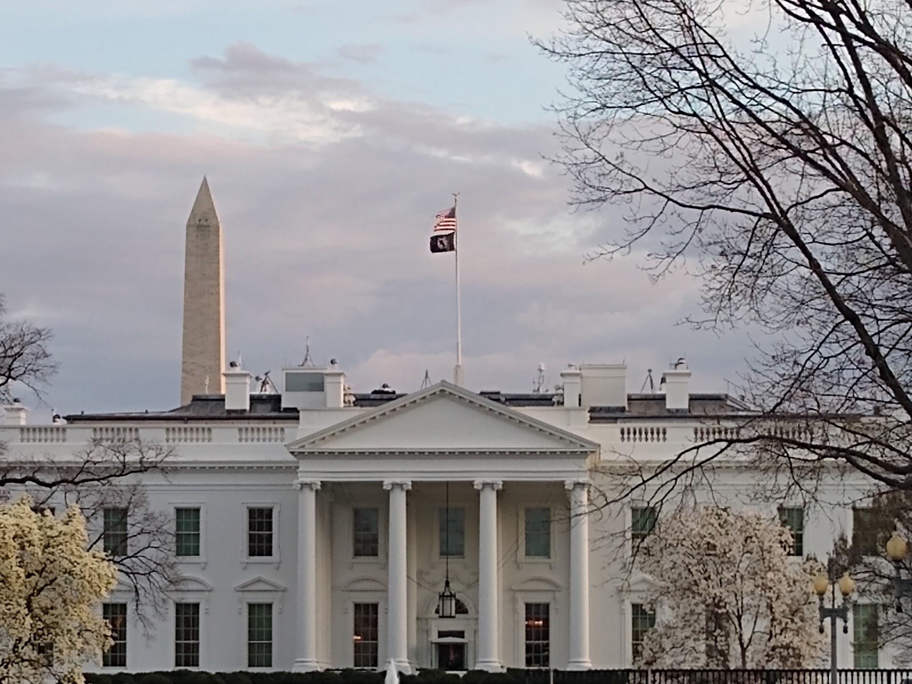
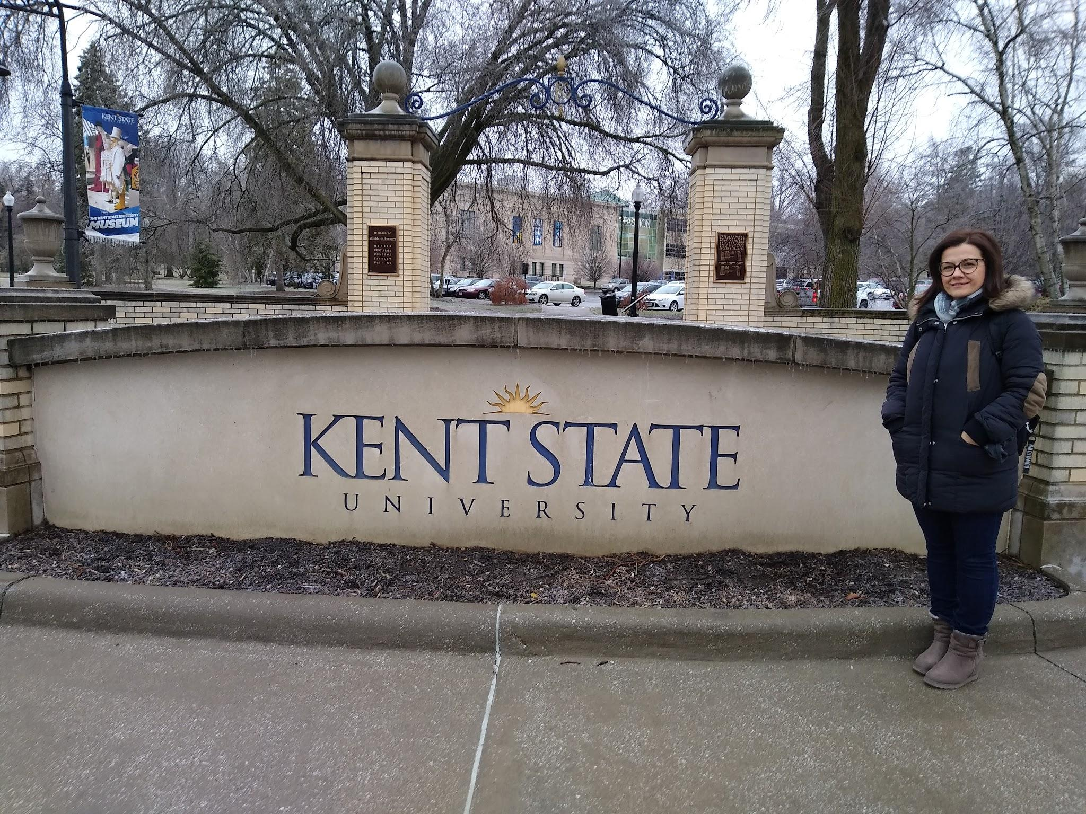
Fulbright Teaching Excellence and Achievement Program https://www.fulbrightteacherexchanges.org/programs/#intl
Notes:
.

Slide 3
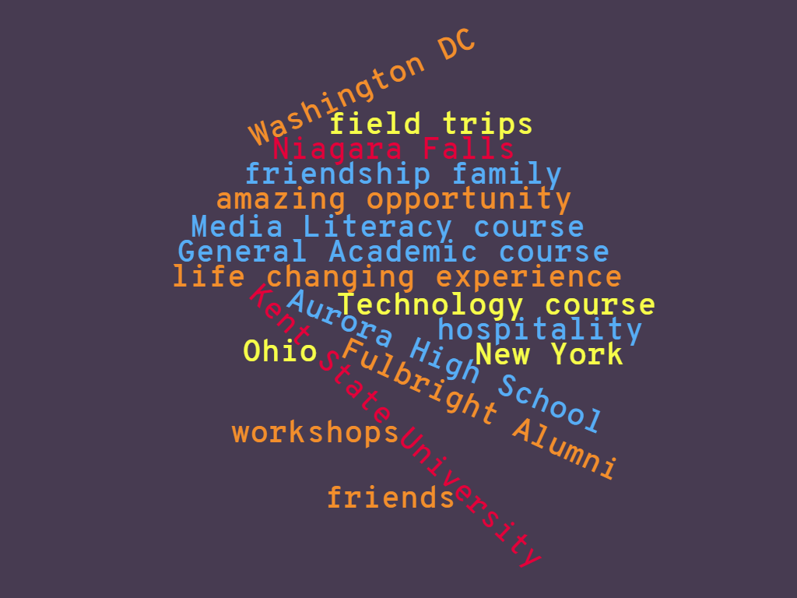
Fulbright TEA Program

Slide 4
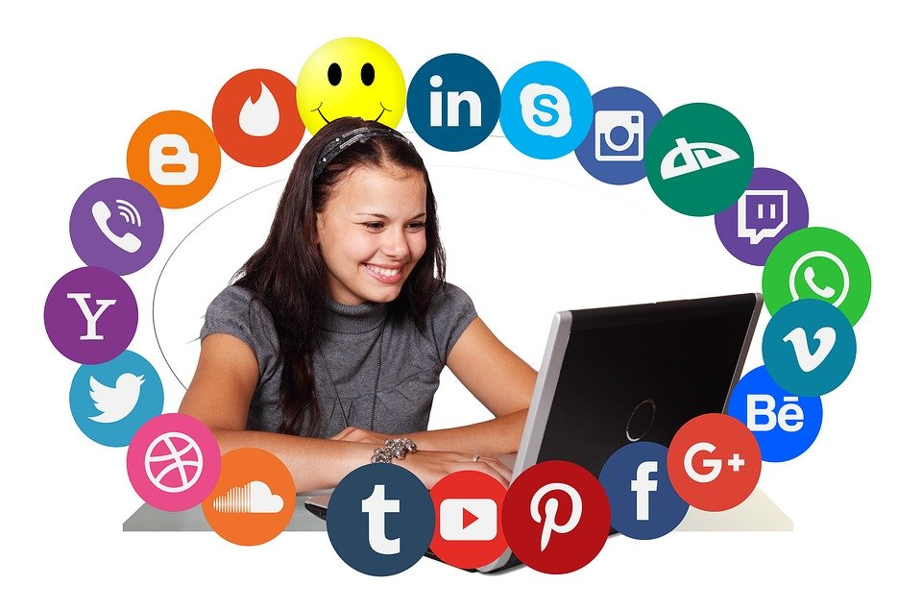
How much do you
consume media?
Let`s go to
www.menti.com
and use the code 7054749
or click on the link in the chat box: https://www.menti.com/kfkha16xd3

Slide 5
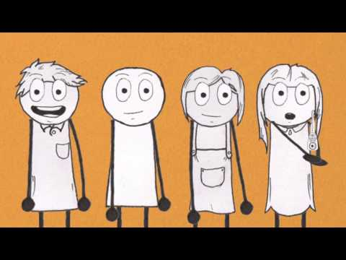
What is Media Literacy?

Slide 6
Five key questions:
Who created this message?
What creative techniques are used to attract attention?
How might different people understand this message?
What lifestyles, values and points are represented?
Why is this message being sent?

Slide 7
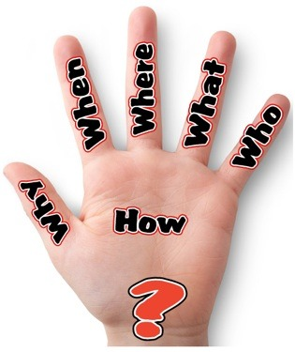
How about a tweet or two?

Slide 8
Media literacy is the ability to:
Access (equality and equity)
Analyse (examine)
Evaluate (research)
Create (produce)
Share (consume)

Slide 9
31% of kids who shared a news article online later found out it was inaccurate or wrong.
According to a 2016 Stanford University study of 7,804 students from middle school through college, 82% of middle-schoolers could not distinguish between an ad labeled “sponsored content” and a real news story on a website.
22 million young people will be eligible to vote in 2020 & we need to prepare young people to be critical consumers of the news.

Slide 10
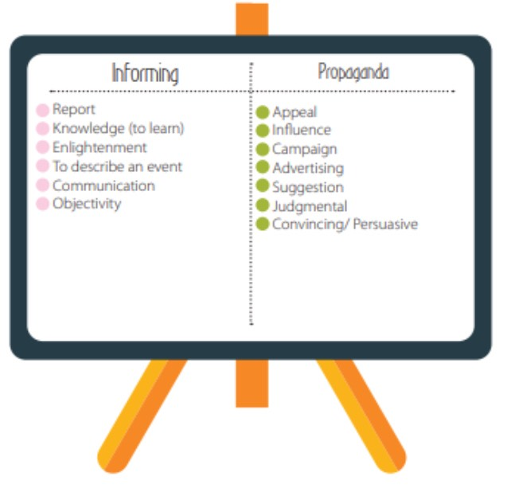
Notes:
Well done, all of you. Here are the correct definitions, just to check. And here is a nice video, which shows how fake news spread, and you can use it with your students to further discuss the question of how fake news spread.

Slide 11
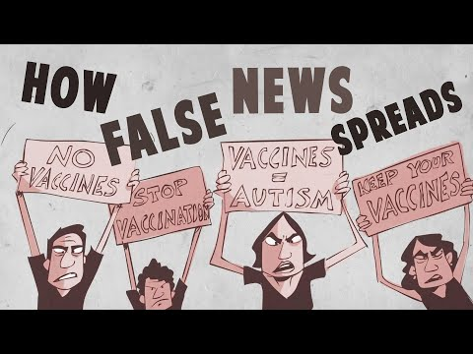
Real vs Fake news

Slide 12
Thank you!
If you want to contact me, my email is: spasicjelena73@gmail.com.

