Slide 1

Challenges of Assessment
in Secondary Education:
three monsters in the closet of teaching
Katarina Ivanjek

Slide 2

What do we do?
ASSESSMENT FEEDBACK MEDIATION
Where? Why? How?
Who (with)?

Slide 3
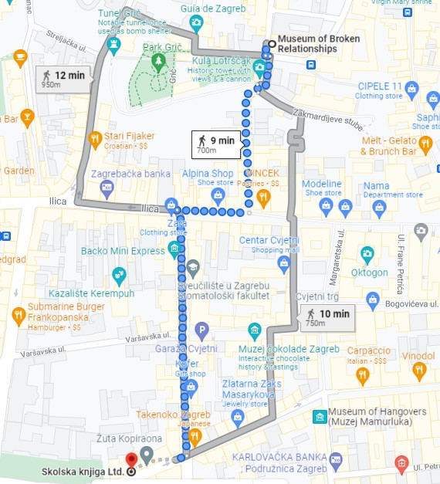
ASSESSMENT
PRINCIPLES AND PURPOSES
You’re here: diagnostic
How far I am: summative
Distance/progress, instructions how to get + alternatives: formative.
Assessment = information to make decisions
No change in learning or teaching = DATA
No activity is summative or formative in nature, even
summative is formative.

Slide 4


LOA - used to provide better learning
Proper assessment is about:
Rising awareness, fostering knowledge, motivation
Developig growth mindset & autonomy
=Assessment has to be actionable!
Common type questions
Mock test; Matura – many advantages
No mismatch between classroom learning and assessment* - Matura
Learners who take more responsibility make more progress
Support from AI: unit progress tests/ skills tests available which operate based on LOA:
3 personalized roadmaps in the Gradebook; extension!
WRITE&IMPROVE – solution to reluctance to engage in repeated tasks
Target certain learners for each activity – tune in
Position
Decide on you approach: immediate or delayed?
Which item are you going to listen for?
Success model - get representatives perform
Craig Thaine

Slide 5
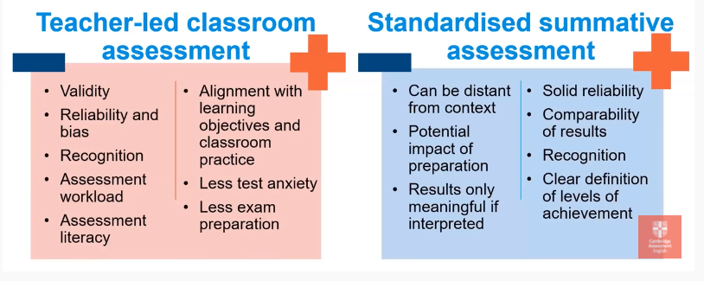
Testing inside out

Slide 6

FEEDBACK
Feedback is a two-way ticket
One of the most powerful influences on learning
Information a learner receives about their language learning and their language production
Can be summative (evaluation given by a score) or formative (continuously during learning)
aim: improve, motivate and develop autonomy
‘feed forward’

Slide 7

What is effective feedback?
… a conversation
Meaningful
Specific
Timely
Future-focused
Focused on the process, not the person
What in the message enables you to continue going & improve?
Learners have to understand HOW to improve – what success looks like?
Success ≠ 100% on the test
They have to participate + reflect on the outcome
Reinforce positive mindset (motivation) + positive identities (self-esteem)

Slide 8
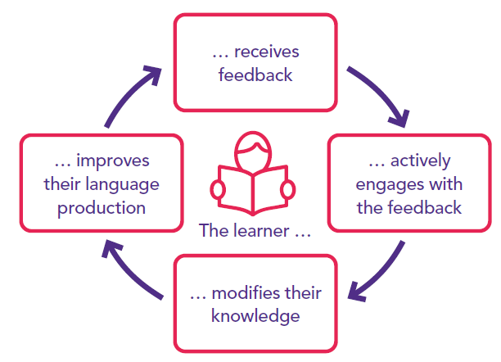
How to give effective feedback
It is about learning tasks – the way a learner has approached the task
It is specific and related to learning goals, not general
It is appropriately challenging – targets areas where improvement IS possible. What a L might be able to do better, than what a L needs to get right
It calls for the active involvement of the L to have greater autonomy
It is a combination of POSITIVE and negative – develop non-threatening, supportive environment

Slide 9

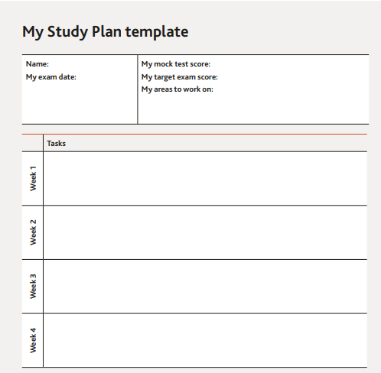
S.M.A.R.T. control and confidence
SPECIFIC
MEASURABLE
ACHIEVABLE
RELEVANT
TIME-BASED

Slide 10

Corrective
Corrective
Focus on errors – can promote learning but will not necessarily do so
Content and accuracy are equally important – best results when
combined
Errors: global (big), local (small), frequent, stigmatizing (offensive),
specific interaction (formality), can be self-corrected, recently studied
Direct feedback – more common with lower-level students
When, to whom, how – questions are interrelated
Why immediate/delayed feedback
Techniques for corrective feedback: direct---indirect
Focus on errors – can promote learning but will not necessarily do so
Content and accuracy are equally important – best results when
combined
Errors: global (big), local (small), frequent, stigmatizing (offensive),
specific interaction (formality), can be self-corrected, recently studied
Direct feedback – more common with lower-level students
When, to whom, how – questions are interrelated
Why immediate/delayed feedback
Techniques for corrective feedback: direct---indirect

Slide 11
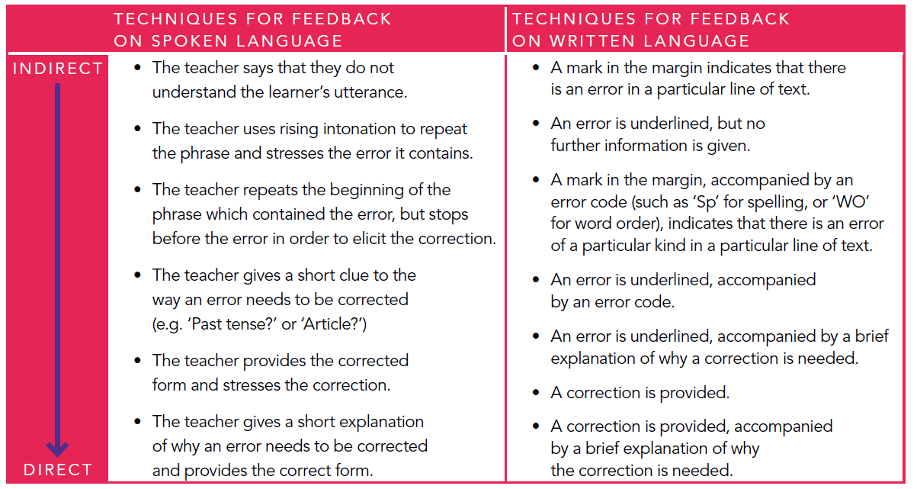

Slide 12
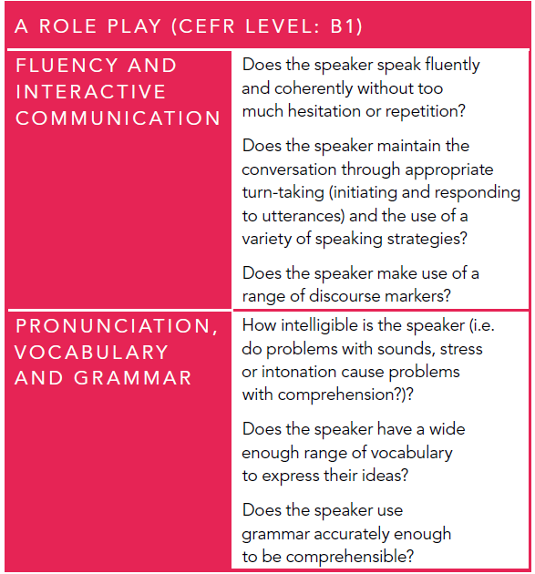
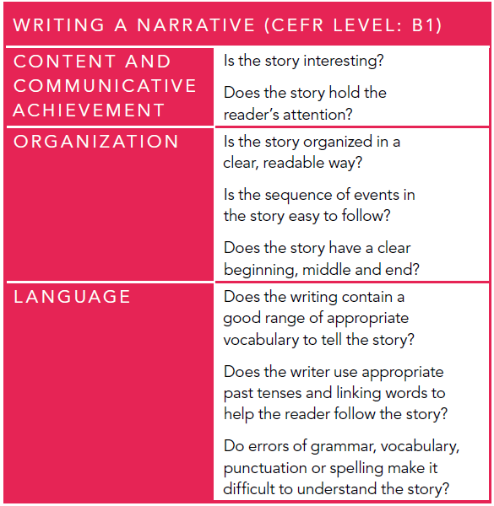

Slide 13

Peer feedback
Benefits the giver and receiver – listen to others more
Fosters independence
T provides the model
Collaboration (writing) – all elements
RESPONSE to feedback
Some learners are not receptive to feedback
from their peers
Some learners may be reluctant to offer
peer feedback for fear of giving offence
Tendency to focus on grammatical accuracy
Peer feedback is of greater value when it focuses on the content and organization
Affective differences: MotivationAnxiety Beliefs
Feedback strategies will work only if Ts believe they can work
The better Ts & Ss know each other – more likely that the reaction to F will be the one that is hoped for
Cannot be forced – there should be conditions for learning; best when integrated

Slide 14
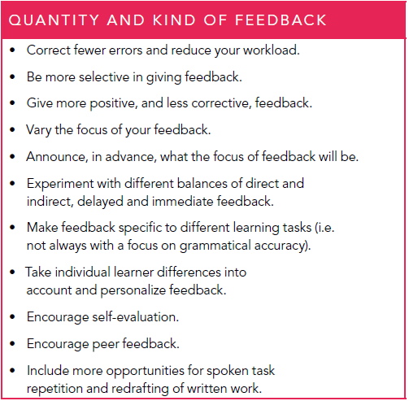
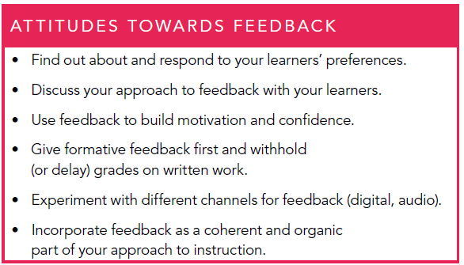

Slide 15

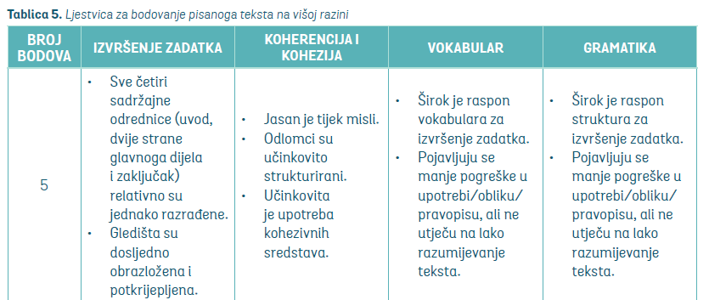
Criteria – how they can help?
Show students success criteria
A2 Level
TASK Speaking: Describe a picture
Success criteria: describe where people are, use 3-7
prepositions, what clothes people are wearing, use
4-8 verbs in Present Continuous.
Give (action) feedback based on the criteria
B2 Level
.

Slide 16
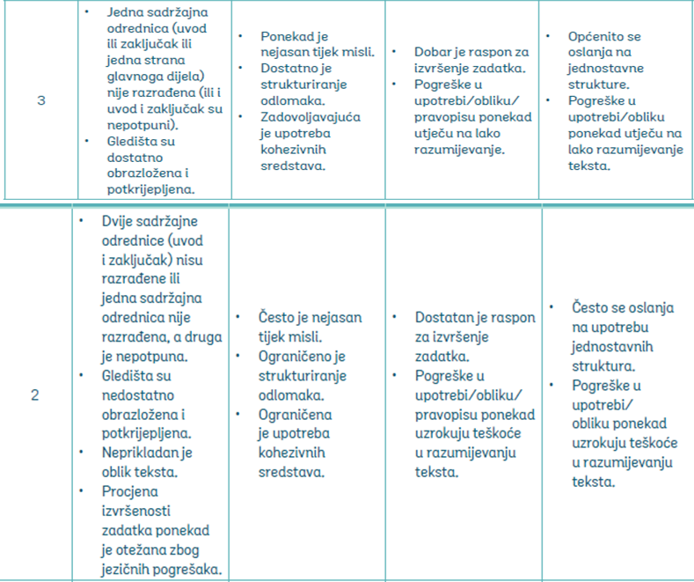
Give (action) feedback based on the
criteria: B2 Level
Your student got 2/3 points on the mock matura Exam for their essay.
In pairs/groups choose 1 element and give 2-3-sentence- feedback with specific suggestions on how to improve:
1 sentence positive feedback
1-2 actionable Feedback.
Share examples ☺
.

Slide 17

MEDIATION
how we use the four skills and how often we integrate them
Recently updated in CEFR; it describes four ‘modes’ to better reflect how communication occurs in real life:
Reception: comprehension in reading and listening
Production: formulating something new
Interaction: engaging in conversation or written communication
Mediation: adjusting the message for the recipient
Mediation is not the fifth skill.
Emily Levine

Slide 18
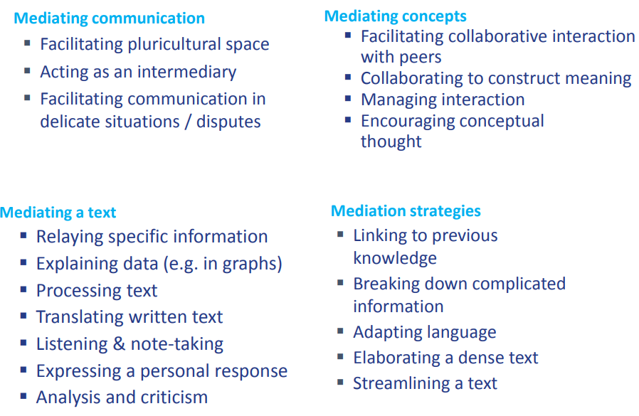

Slide 19

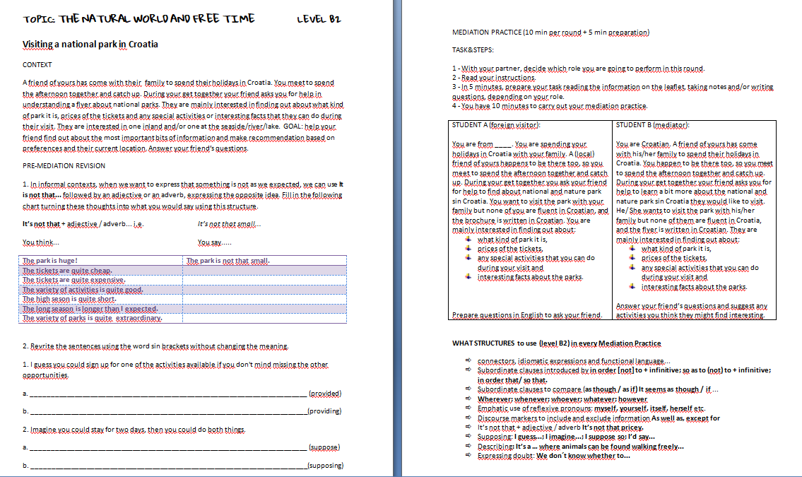
National parks – an example of a mediation task

Slide 20

CONCLUSION
It’s good to have an end to journey toward; but it is the journey that matters in the end.
Ursula K. le Guin

Slide 21

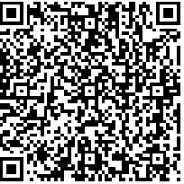

worksheets&ppt:
shorturl.at/lvFKS
katarina.ivanjek@skolskaknjiga.hr

