Slide 1

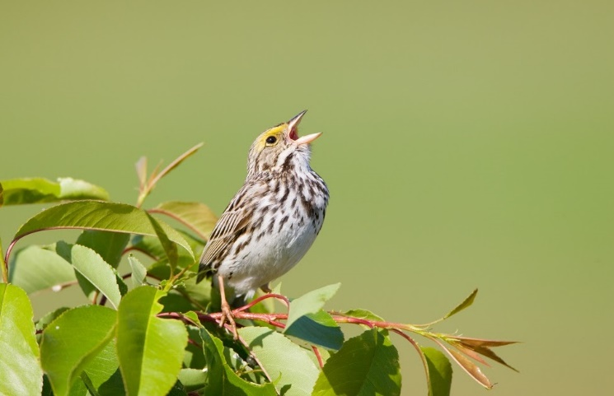


HUPE CONFERENCE 2021 Poreč

Slide 2
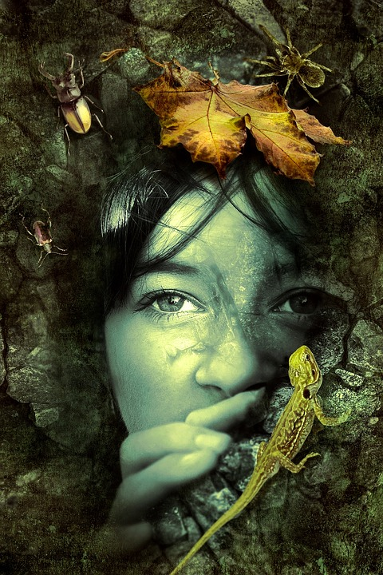

What’s in a song?
HUPE 2021
marinah1960@yahoo.com

Slide 3

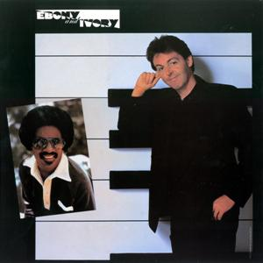
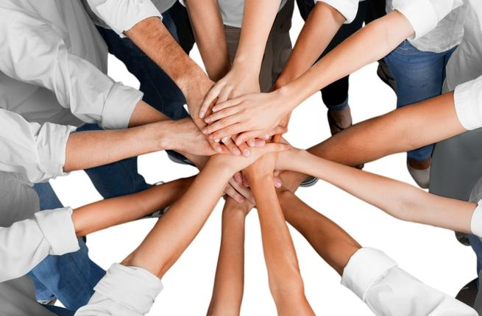
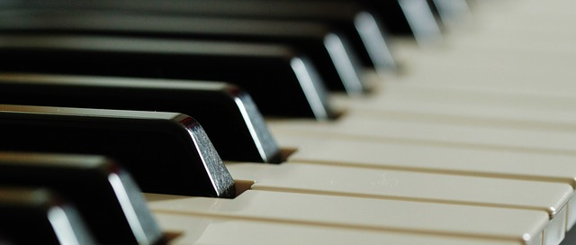
EBONY AND IVORY (Paul McCartney/Stevie Wonder)
Ebony and ivory live together in perfect harmony
Side by side on my piano keyboard, oh lord, why don’t we?
We all know that people are the same wherever you go
There is good and bad in everyone,
We learn to live, we learn to give each other
What we need to survive together alive.
Ebony and ivory live together in perfect harmony
Side by side on my piano keyboard, oh lord why don’t we?
Ebony, ivory living in perfect harmony
Ebony, ivory, ooh
We all know that people are the same wherever you go
There is good and bad in everyone,
We learn to live when we learn to give each other
What we need to survive together alive.
Ebony and ivory live together in perfect harmony...

Slide 4
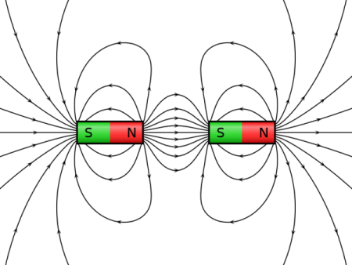
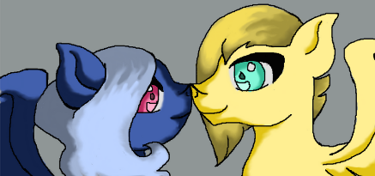
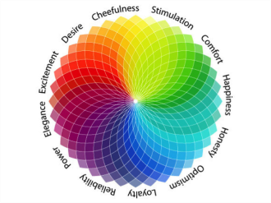
Opposites
- a word that expresses a meaning opposed to the meaning of another word, in which case the two words are antonyms of each other. Two words that can be interchanged in a context are said to be synonymous relative to that context.
Oxymoron comes from a Greek word whose literal translation is 'pointedly foolish'. An oxymoron is a figure of speech in which two apparently contradictory terms appear together. An oxymoron is a self-contradicting word or group of words - as in Shakespeare's line from Romeo and Juliet,
"Why, then, O brawling love! O loving hate!"
passive aggressive, living dead, bittersweet, original copy, small crowd, old news,
open secret, living dead, deafening silence, only choice, pretty ugly, awfully good
Some Differences Between Synonyms and Antonyms
There are many more words with synonyms than there are words with antonyms, since many things exist which do not have an opposite (There is no opposite of sandwich!).
Antonym is a much more recent addition to English than synonym - it first appeared in the 1860s (first known use in 1857), whereas synonym has been used for more than 500 years. Additionally, both nouns have adjectival forms: synonymous and antonymous. Synonymous, which is often used loosely ("She has become synonymous with good taste"), is the more common of the two.

Slide 5
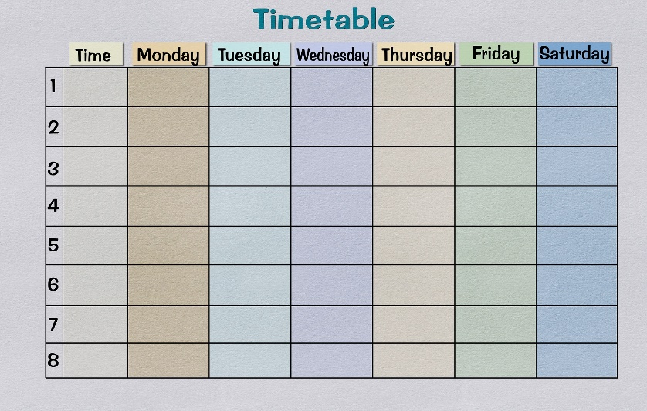
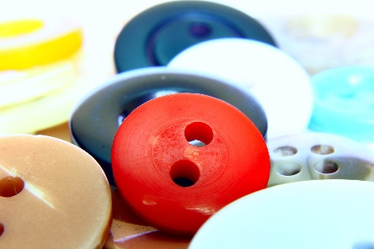

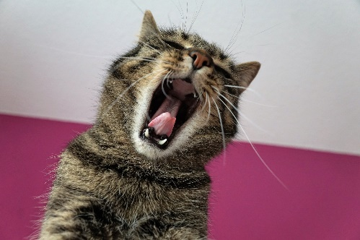
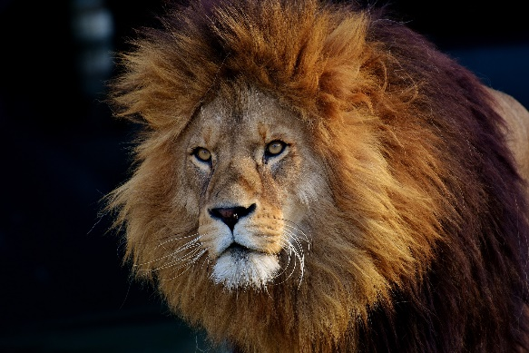
Phrasal Verbs
stand up -
go away -
cool down -
fall out -
fall behind -
go out -
pick up -
pick up -
put on -
speed up -
֍ What is for you the opposite of:
a button, a timetable, a carpet, to sing, a lion
sit down
come back
warm up
make up
catch up
stay in
put down
drop off
take off
slow down

Slide 6
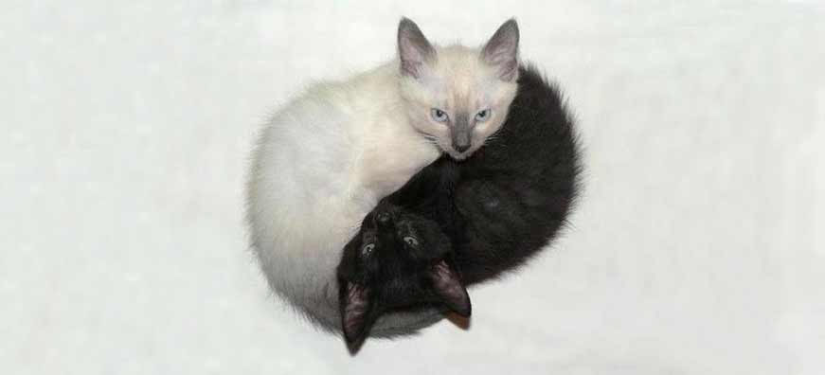
Rhyming Game
LEFT AND ____________
DARK AND ____________
BLACK AND ___________
DAY AND _____________
KISS AND _____________
WEIGHT AND __________
HORSE AND ___________
WRONG AND __________
Key: right, light/bright, white, night, fight, height, knight, right

Slide 7

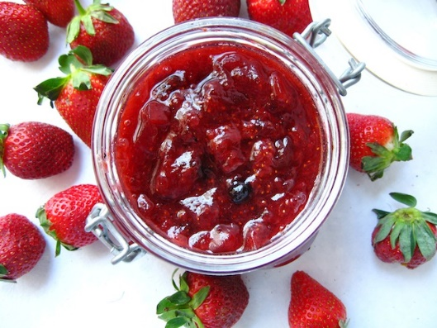
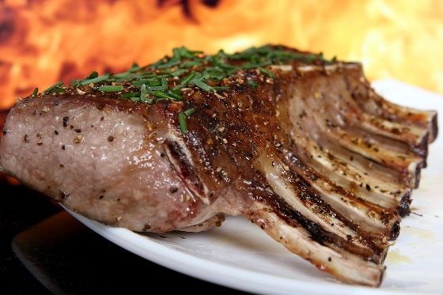
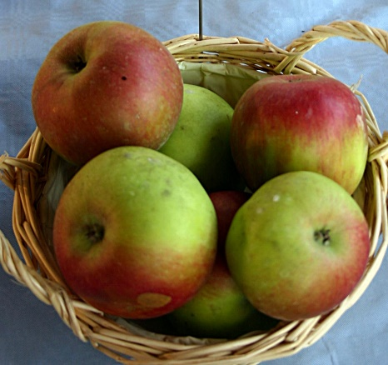
FOOD SONG
A I like pizza
You like jam
B I like cornflakes
You like ham
A I like coffee
You like tea
A & B I like you,
Do you like me?
A You like apples
I like meat
B I like salty
You like sweet
A & B We're so different,
Can't you see?
I like you
And you like me!

Slide 8
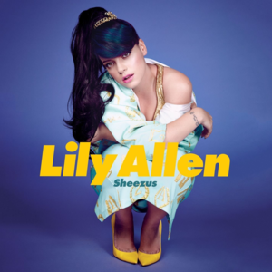
Lily Allen: HIM
[Verse 1]
Would you please take me away from this place?
I cannot bear to see the look upon your faces
And if there is some kind of God do you think he's pleased?
When he looks down on us, I wonder what he sees
Do you think he'd think the things we do are a waste of time?
Maybe he'd think that we are getting on just fine
Do you think he's skint or financially secure?
And come election time, I wonder who he'd vote for

Slide 9
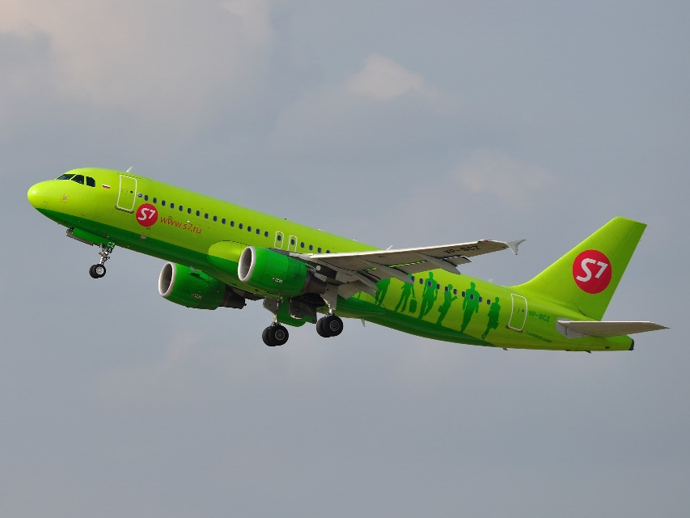
[Chorus]
Ever since he can remember, people have died in his good name
Long before that September
Long before hijacking planes
He's lost the will, he can't decide
He doesn't know who's right or wrong
But there's one thing that he's sure of
This has been going on too long

Slide 10
[Verse 2]
Do you think he'd drive in his car without insurance?
Now is he interesting, or do you think he'd bore us?
Do you think his favorite type of human is Caucasian?
Do you reckon he's ever been done for tax evasion?
Do you think he's any good at remembering people's names?
Do you think he's ever taken smack or cocaine?
I don't imagine he's ever been suicidal
His favourite band is Creedence Clearwater Revival

Slide 11
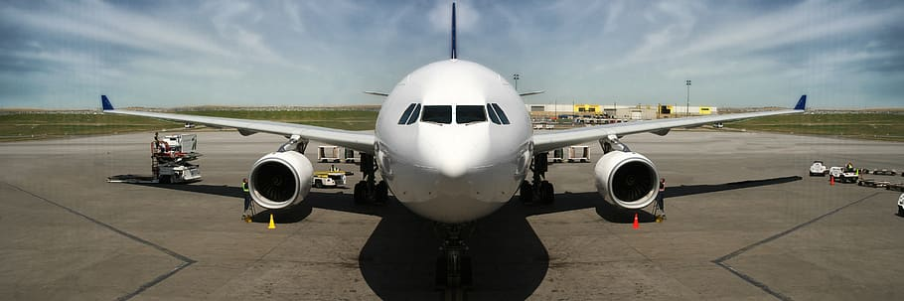
[Chorus]
Ever since he can remember, people have died in his good name
Long before that September
Long before hijacking planes
He's lost the will, he can't decide
He doesn't know who's right or wrong
But there's one thing that he's sure of
This has been going on too long

Slide 12
Match the words with the paraphrases.
1 skint ___ formal choice of a person for a political office
2 financially ___ unlawfully seizing an aircraft
3 election ___ be of the opinion, think
4 vote ___ having little or no money available (slang)
5 hijacking ___ the illegal non-payment or underpayment of tax
6 insurance ___ in a way that relates to finance, money
7 Caucasian ___ white-skinned; of European origin
8 reckon ___ heroin (slang)
9 tax evasion ___ choice between two or more candidates in election
10 smack ___ providing protection against a possible eventuality
Key: 3, 5, 8, 1, 9, 2, 7, 10, 4, 6

Slide 13
Match the words with the paraphrases.
1 skint 3 formal choice of a person for a political office
2 financially 5 unlawfully seizing an aircraft
3 election 8 be of the opinion, think
4 vote 1 having little or no money available (slang)
5 hijacking 9 the illegal non-payment or underpayment of tax
6 insurance 2 in a way that relates to finance, money
7 Caucasian 7 white-skinned; of European origin
8 reckon 10 heroin (slang)
9 tax evasion 4 choice between two or more candidates in election
10 smack 6 providing protection against a possible eventuality

Slide 14
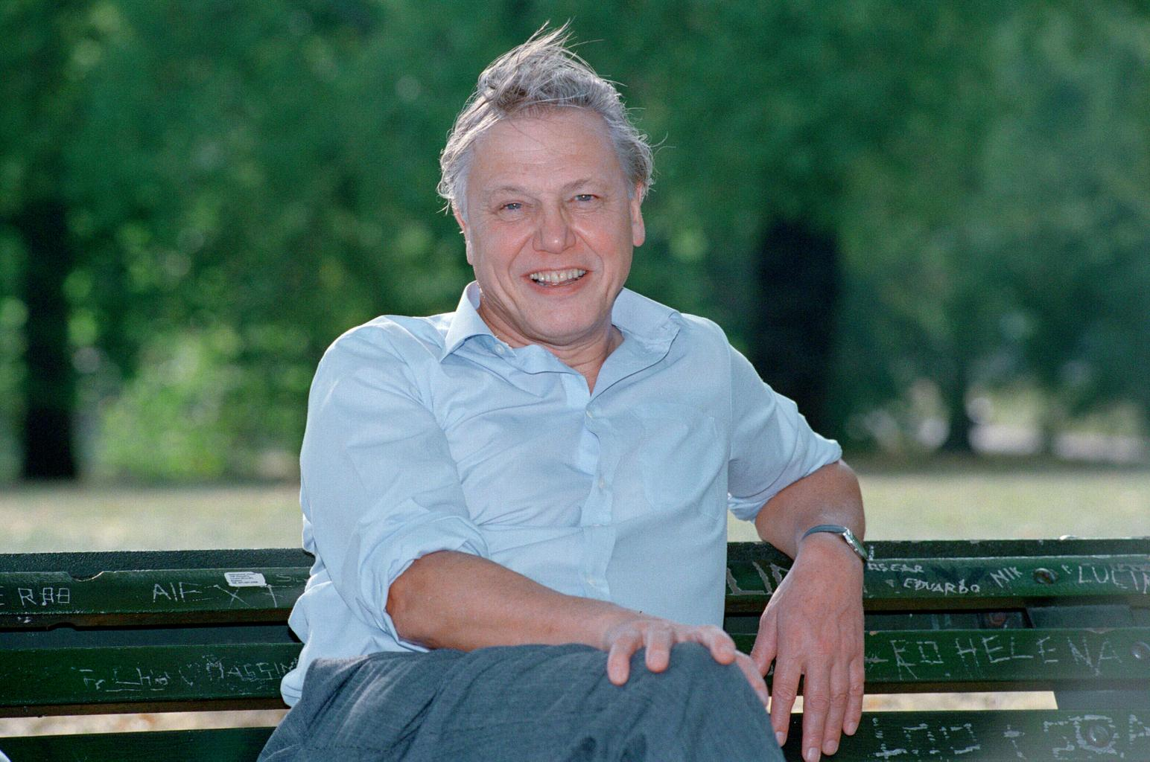
Discussion point
What has been going on too long?
What have we, people, been doing to other people?
What types of addiction do you know? Who can you turn to for help?
Follow up
What have we been doing to nature, the environment, animals?
How do we pollute the Earth?
What can we do to heal the world?
What songs do you know that deal with ecological issues?
Alyosha: Sweet People, Stevie Wonder: The Secret Life of Plants,
Michael Jackson: Heal the World, America: A Horse with no Name

Slide 15
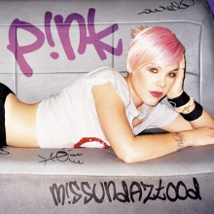
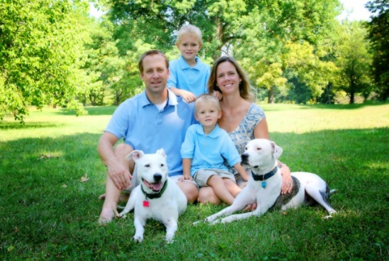
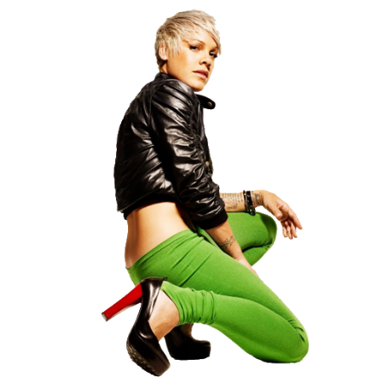
FAMILY PORTRAIT (PINK)
A very intimate and personal song, Pink reveals her family dysfunction in this track. She explained in Entertainment Weekly: "That was from a poem that I wrote when I was 9 when my dad left. My mom cried for four days when she heard it. I've seen my dad cry three times and that was one of them; that was awful. And then my stepmom cried. She's so strong - she was an Army nurse in Vietnam, and I’d never seen her cry. That was a song I wrote for me, and I didn’t realize how much it was going to hurt them."
Even though Pink's parents got divorced when she was 9 years old
and she wrote the original poem at the time, she didn't record
the song until she was 21. "I tend to hold onto things," she says.
Sophie Muller directed the video, which shows the adult Pink struggling through
her day while her child self is singing the song.
This Photo by Unknown Author is licensed under CC BY-NC

Slide 16
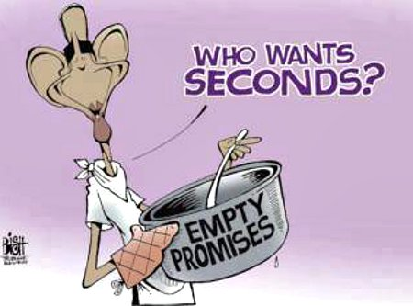

Future Simple for PROMISES – WILL/'LL + Inf.
What do you promise your parents/friends?
What do your teachers promise?
You want an A in English. What do you promise yourself to do?
What's the difference between the family portrait and real life?
What would you advise the girl in the song to do/not to do?
Use:
You should/shouldn't ...
If I were you, I would/wouldn't...

Slide 17

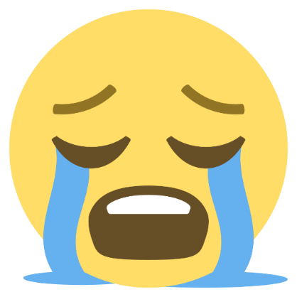
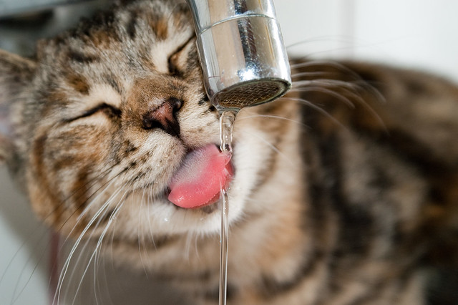
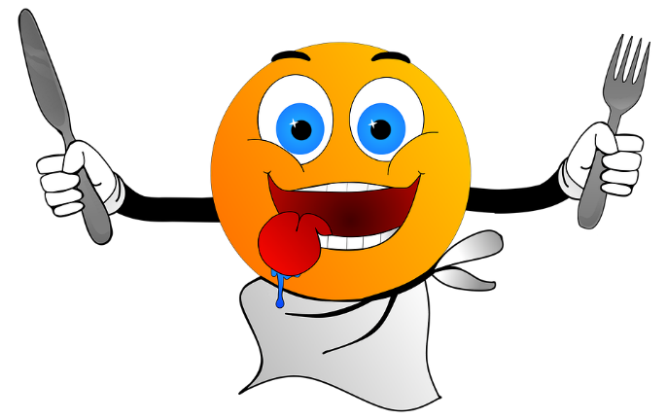
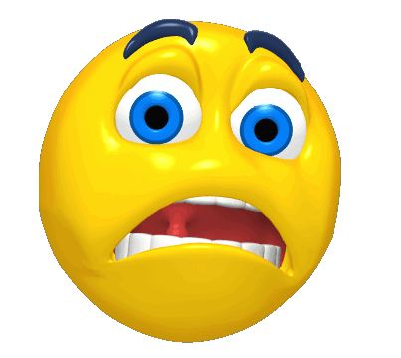

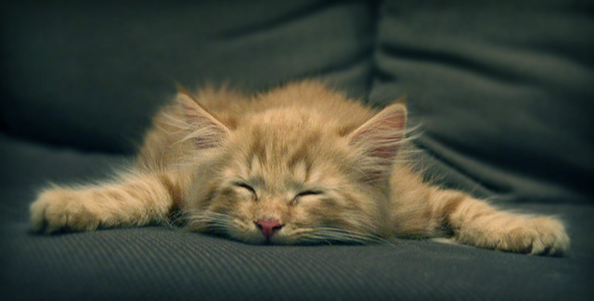
FEELINGS
JACK IS HAPPY
I am happy, happy, happy,
Yes, I am
I am sad, sad, sad,
Oh yes I am
I am thirsty and I’m hungry
I am scared and I’m angry
I am tired
I just want to go to bed!

Slide 18
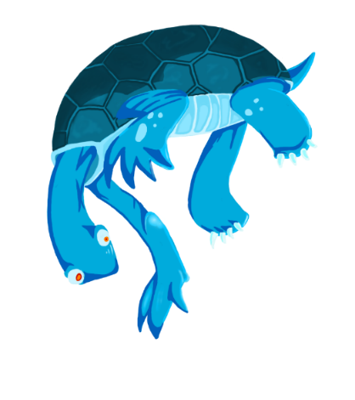

"Love Is the Seventh Wave" is the second single and second track from Sting’s 1985 solo debut album Dream of the Blue Turtles.
An anti war song about love being the seventh wave, or the strongest wave in a series of waves, thus wiping out any sort of problems.
The song concludes with a brief, self-mocking reference to Sting's biggest hit song with The Police, "Every Breath you Take", which is about the dark side of love that leads to sexual jealousy and obsession.
Every breath you take
Every move you make
Every cake you bake
Every leg you break

Slide 19
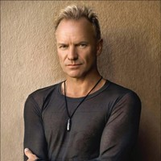
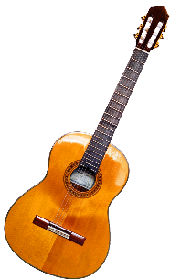
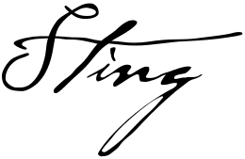
STING: LOVE IS THE SEVENTH WAVE https://www.youtube.com/watch?v=uXZistami3c
In the empire of the senses
You're the queen of all you survey
All the cities all the nation
Everything that falls your way
There is a deeper world than this
That you don't understand
There is a deeper world that this
Tugging at your hand
Every ripple on the ocean
Every leaf on every tree
Every sand dune in the desert
Every power we never see
There is a deeper wave than this
Swelling/Rising in the world
There is a deeper wave than this
Listen to me girl

Slide 20
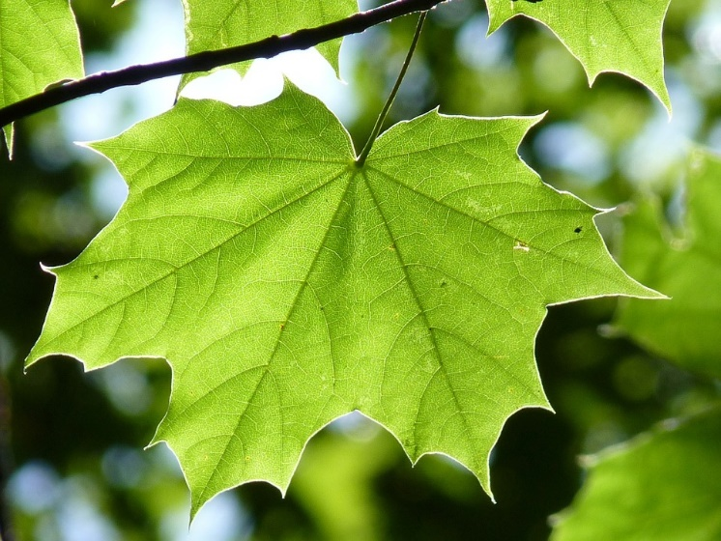
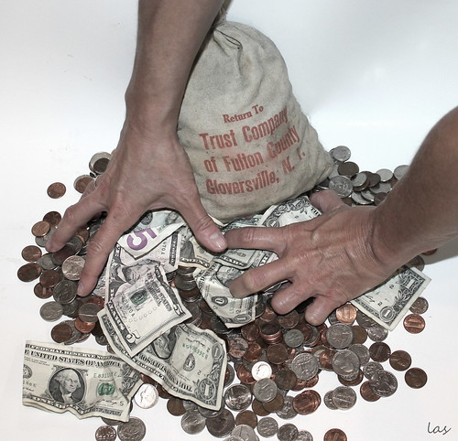
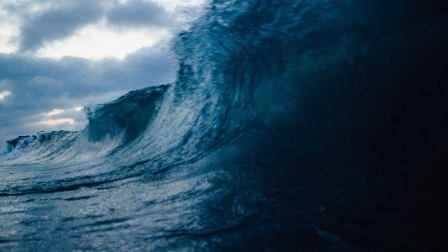
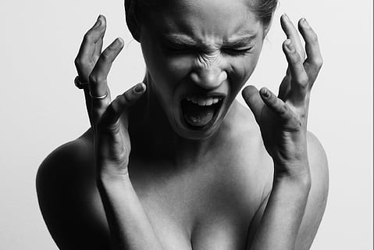
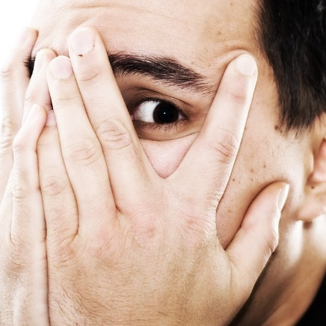
Fishing for words
Find in the song lyrics:
1 All the nouns in the plural form
2 A comparative form of an adjective
3 The opposite of ALWAYS
4 The word that means/the English word for - list, pohlepa, bijes, val, strah...
What is your favourite word in the song and why?
What is your least favourite word in the song and why?
11
deeper
never
leaf, greed, fury, wave, fear...

Slide 21

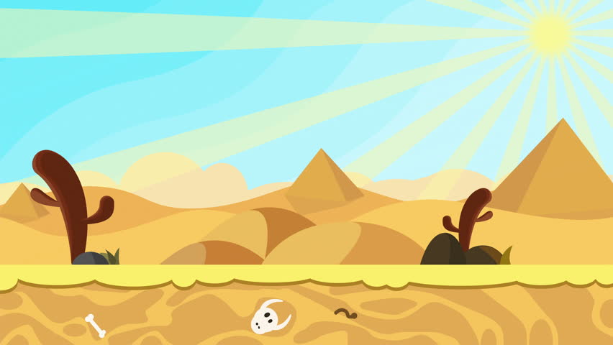
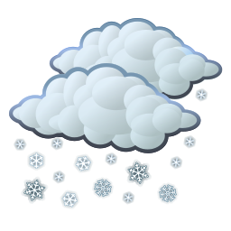
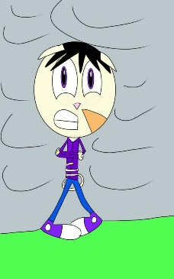


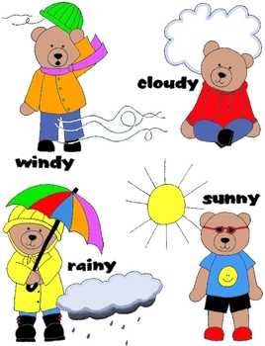

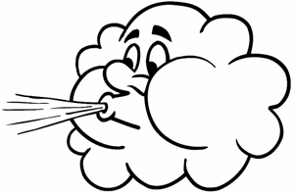
The Weather Song
What’s the weather like today?
It’s sunny. It’s hot. It’s sunny. It’s hot.
It’s sunny. It’s hot, hot, hot, hot.
What’s the weather like today?
It’s snowing. It’s cold. It’s snowing. It’s cold.
It’s snowing. It’s cold, cold, cold, cold.
What’s the weather like today?
It’s raining. It’s wet. It’s raining. It’s wet.
It’s raining. It’s wet, wet, wet, wet, wet.
What’s the weather like today?
It’s cloudy. It’s windy. It’s cloudy. It’s windy.
It’s cloudy. It’s win – win – windy. Huuuuuuu...
This Photo by Unknown Author is licensed under CC BY-ND

Slide 22

Days of the Week
Monday
Tuesday
Wednesday
Thursday
Friday
Saturday
Sunday

Slide 23
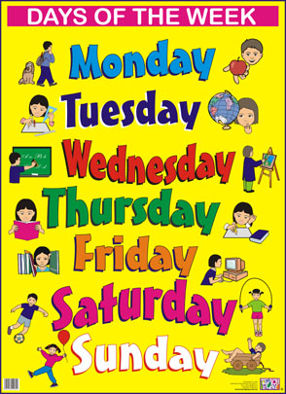
Days of the Week

Slide 24
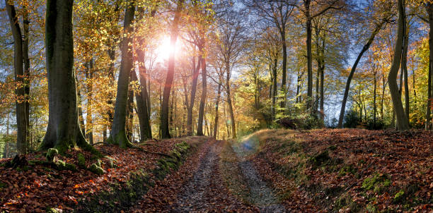
Image Credits
Creative Commons
Pixabay
Unsplash

Slide 25
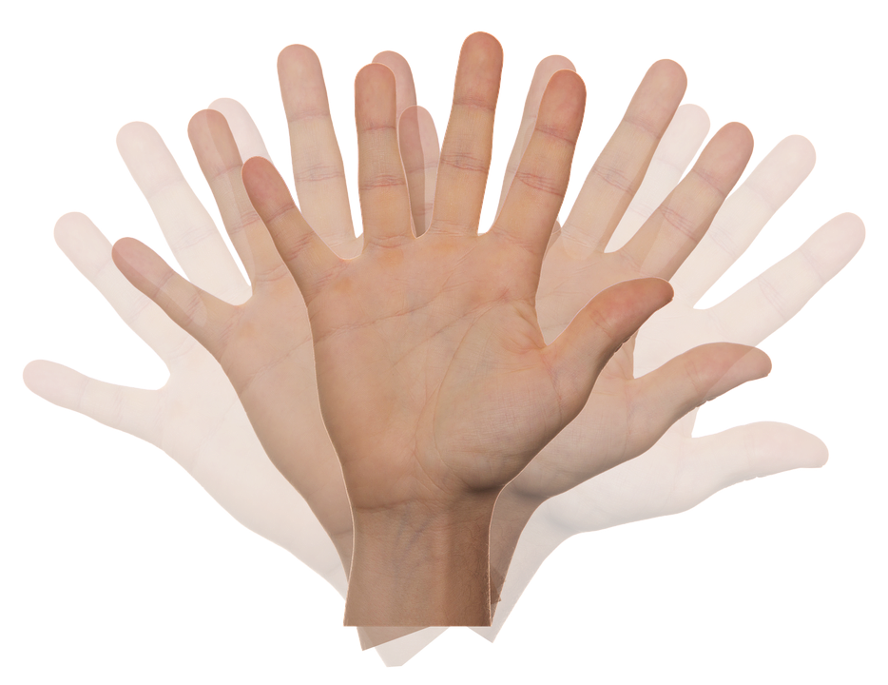
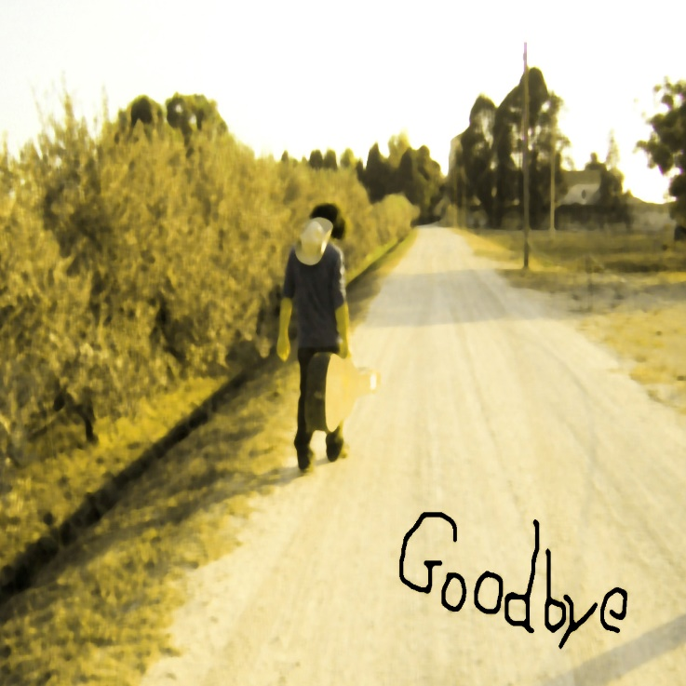
Hvala na pažnji!

