Slide 1

Revive the Fading Art of Reading
Mirta Kos Kolobarić

Slide 2
The year 2021 - a Year of Reading in Croatia

Slide 3
Do you use longer texts in teaching?
Short stories
Graded readers
Books?

Slide 4
The activity itself
2020 – online teaching period
Reading comprehension test

Slide 5
TOPICS TO BE COVERED TODAY
Reading skill – how to teach it?
Where do we go wrong?
A practical example
Students’ feedback
Assessment and grading
Over to you
Other reading activities

Slide 6
1.
TEACHING READING AS A SKILL – BC and AC
(before and after the new curriculum)

Slide 7
CONTEXT
BEFORE
- lektira/assigned reading – graded readers
- students’ reactions
- book analysis
- not so prominently graded until now
NOW
- separately graded skill
- the choice of tasks
- grading/assessment itself
THE SAME OLD PROBLEMS
- neglected skill in students’ lives in general
- motivation
- the choice of topic

Slide 8
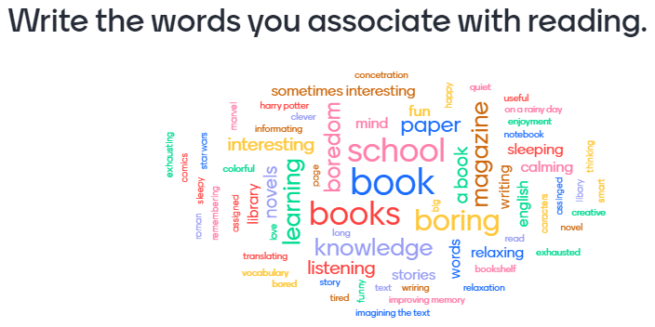
What do students say about reading in general?

Slide 9
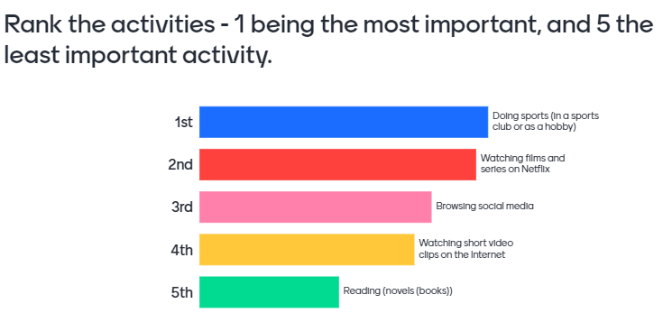
What do students say about reading in general?

Slide 10

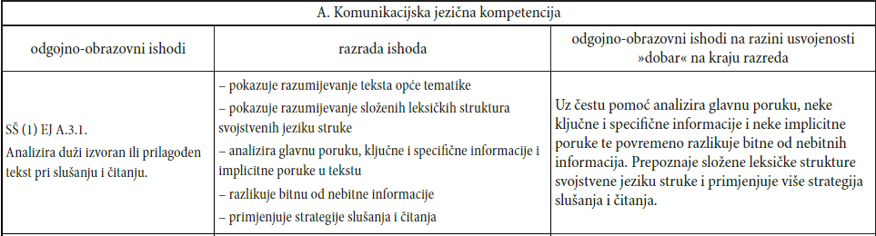
THE CURRICULUM – VOCATIONAL SCHOOLS

Slide 11

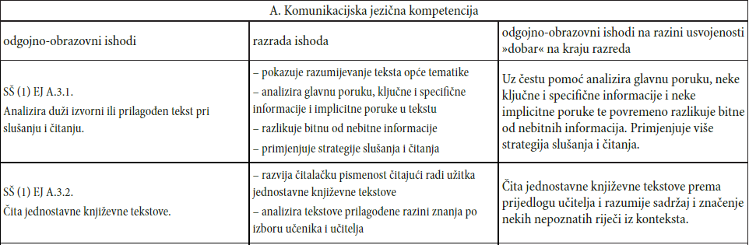
THE CURRICULUM – GRAMMAR SCHOOLS

Slide 12
THE CURRICULUM – GRAMMAR SCHOOLS
The length of the text:
„U djelatnostima slušanja i čitanja vrlo kratak tekst ima do 100 riječi, kratak tekst između 100 i 300 riječi, srednje dug tekst ima između 300 i 600 riječi, dok dug tekst ima više od 600 riječi.”

Slide 13
Common reading comprehension task types
Multiple choice
Transformation
Gap-filling
Cloze
True / False
Error correction
Vocabulary in a text
Open-ended questions
Matching words and expressions with parts/meaning
Match the headings with the paragraphs
Put the paragraphs into the correct order
Put the missing sentences back into the text
Complete the sentences about the text
Plan, map, diagram or label completion
Summary, note, table or flow-chart completion
Short-answer questions - answer in the exact no. of words (3 words, for example)

Slide 14
2.
WHAT IS IT THAT WE AS TEACHERS MIGHT BE DOING WRONG?

Slide 15
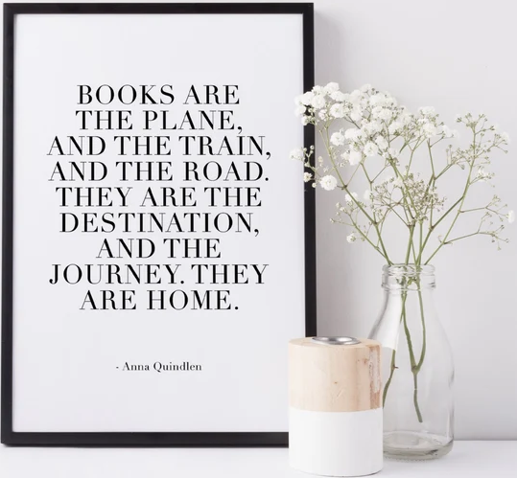
How to get to this stage, to encourage students to read for pleasure?

Slide 16
THE CURRENT STATE
‘’We tend to teach reading in a very industrial way in the United States.
We focus on giving kids ‘tools’ and ‘strategies’ to ‘make’ sense of a text. To ‘take the text apart’. To look for the ‘author’s purpose’—to bounce back and forth between a main idea, and the details that ‘support’ the main idea, as if the reading is some kind of thing that students happen upon by chance while on some purely academic journey.’’
(Why Some Students Think They Dislike Reading, by Terry Heick)

Slide 17
THE AIMED-FOR STATE
Encourage students to read stories and books in English without many tasks.
We should aim for the experience, not the grade.
Choose relevant topics (not easy), shorter stories or graded readers.
Discuss how the events and people can be compared to our everyday life.
Do not overanalyse!

Slide 18
3.
PRACTICAL EXAMPLES

Slide 19
HOW CAN ACTIVITIES MATCH THE ADVICE?
selection of story and topic – modern story (Cecelia Ahern: The woman who blew away)
relate the topic to our everyday life
put the story into a broader realistic context
give students choice (or ‘help’ them choose – catering for individual needs)
include the ICT component – multiple benefits:
1) gives them a feeling that the reading part is the secondary aim;
2) develops their ICT skills (suggested IT tools)

Slide 20
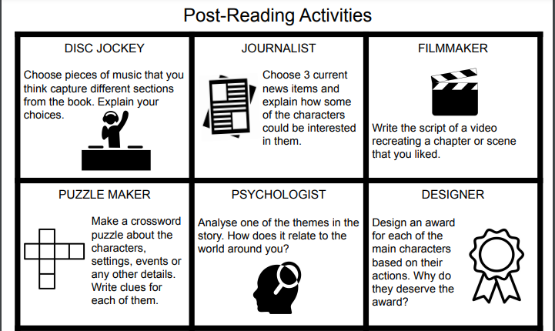

Slide 21
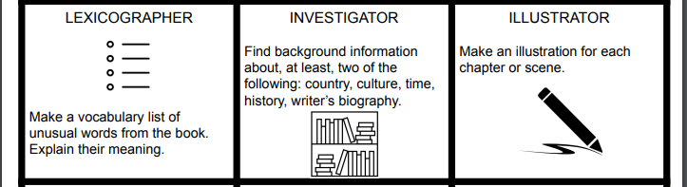

Slide 22
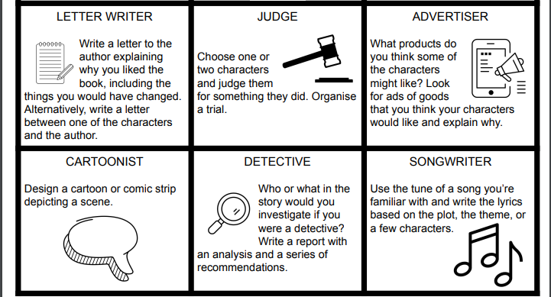

Slide 23
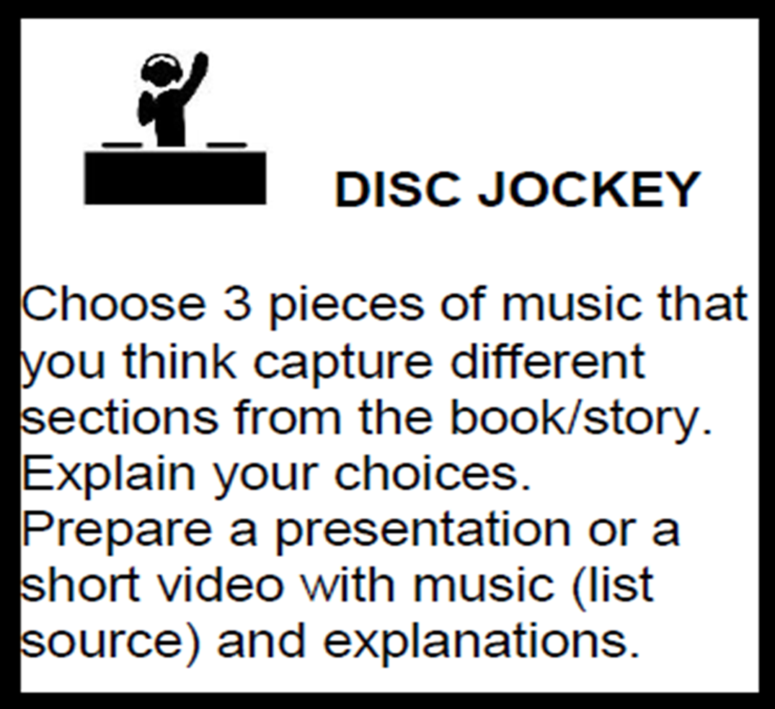
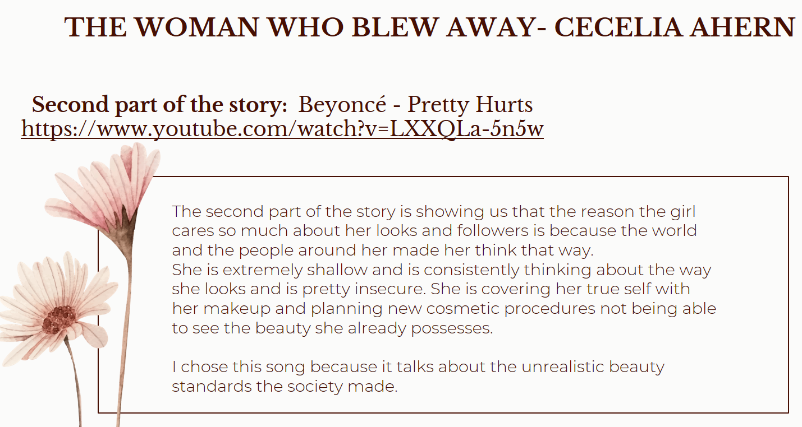

Slide 24
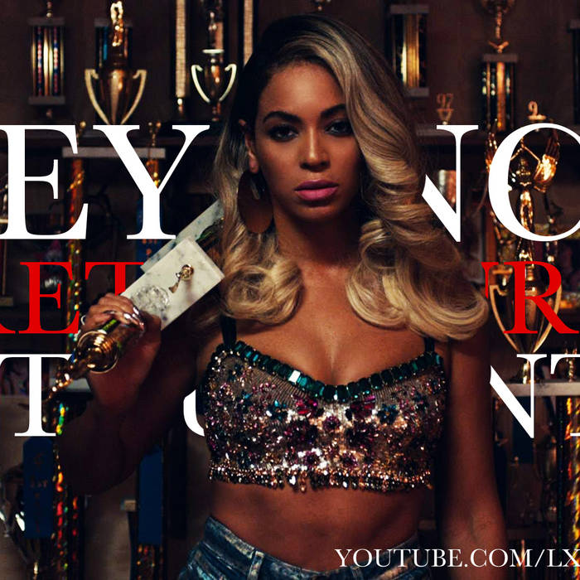
Pretty hurts, Beyonce
An interesting analysis of the video

Slide 25
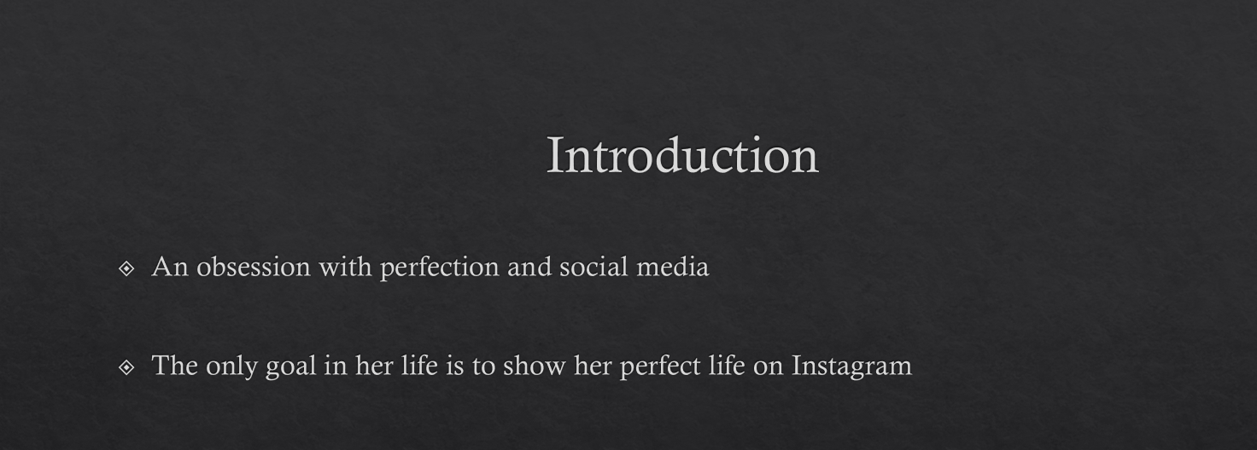

Slide 26
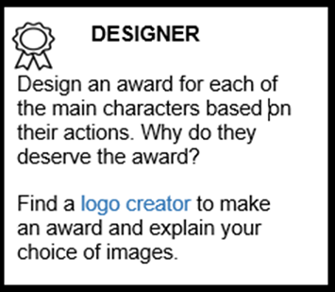
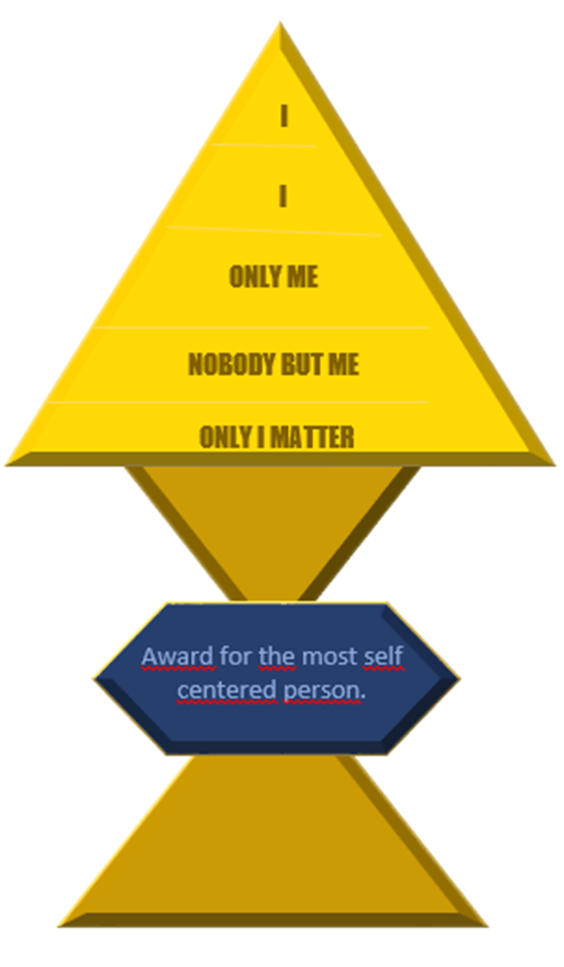
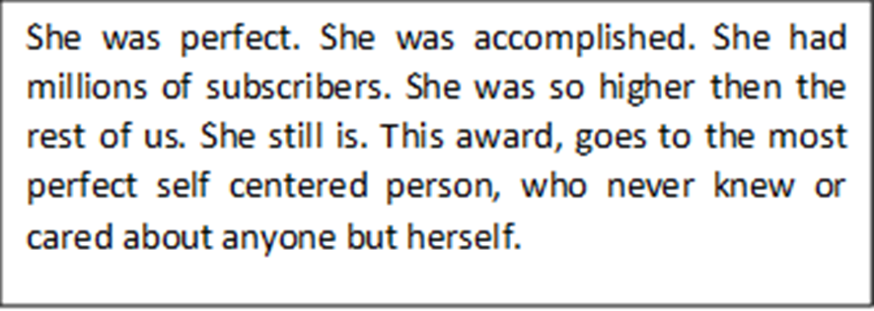

Slide 27
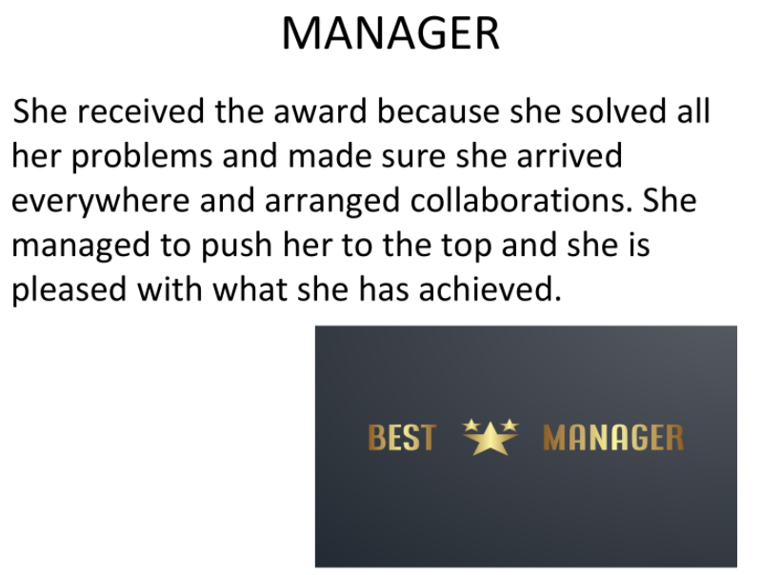
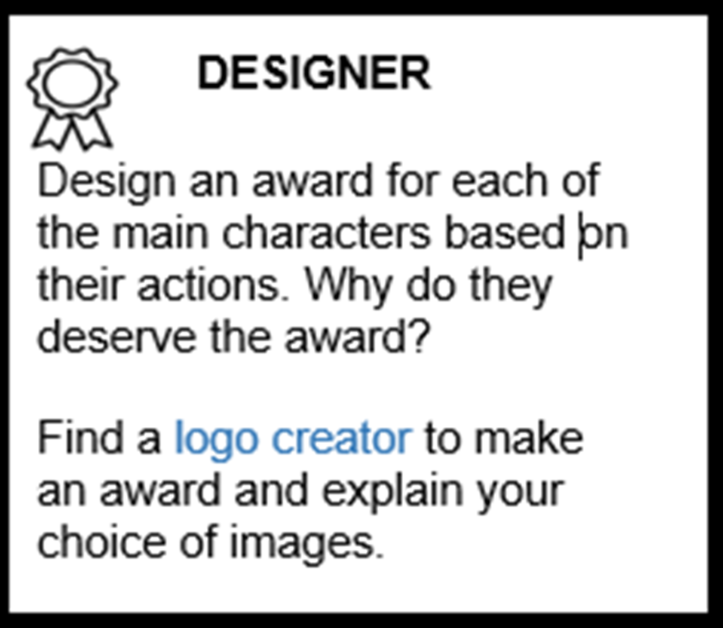

Slide 28
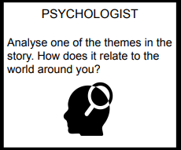
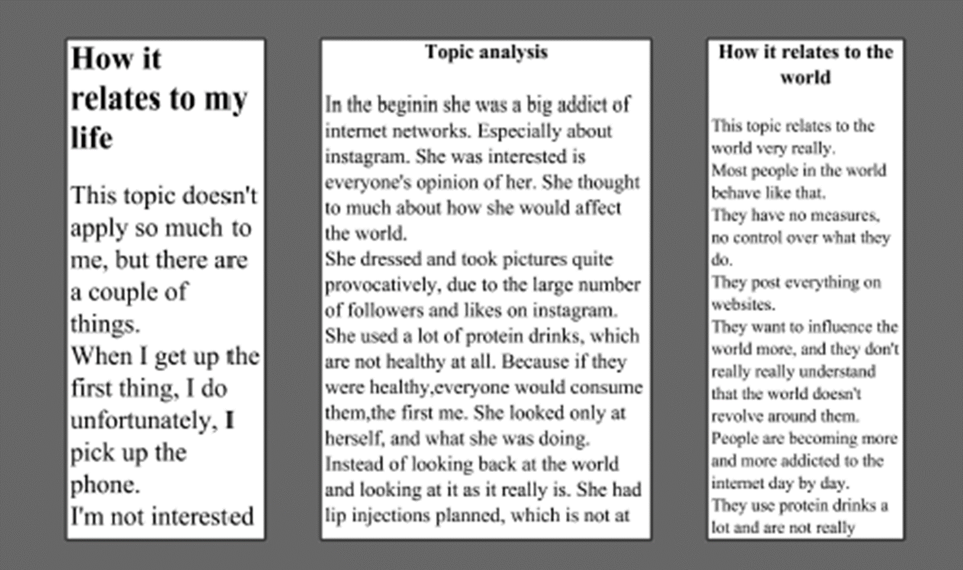
Newspaper template: Slidesmania

Slide 29
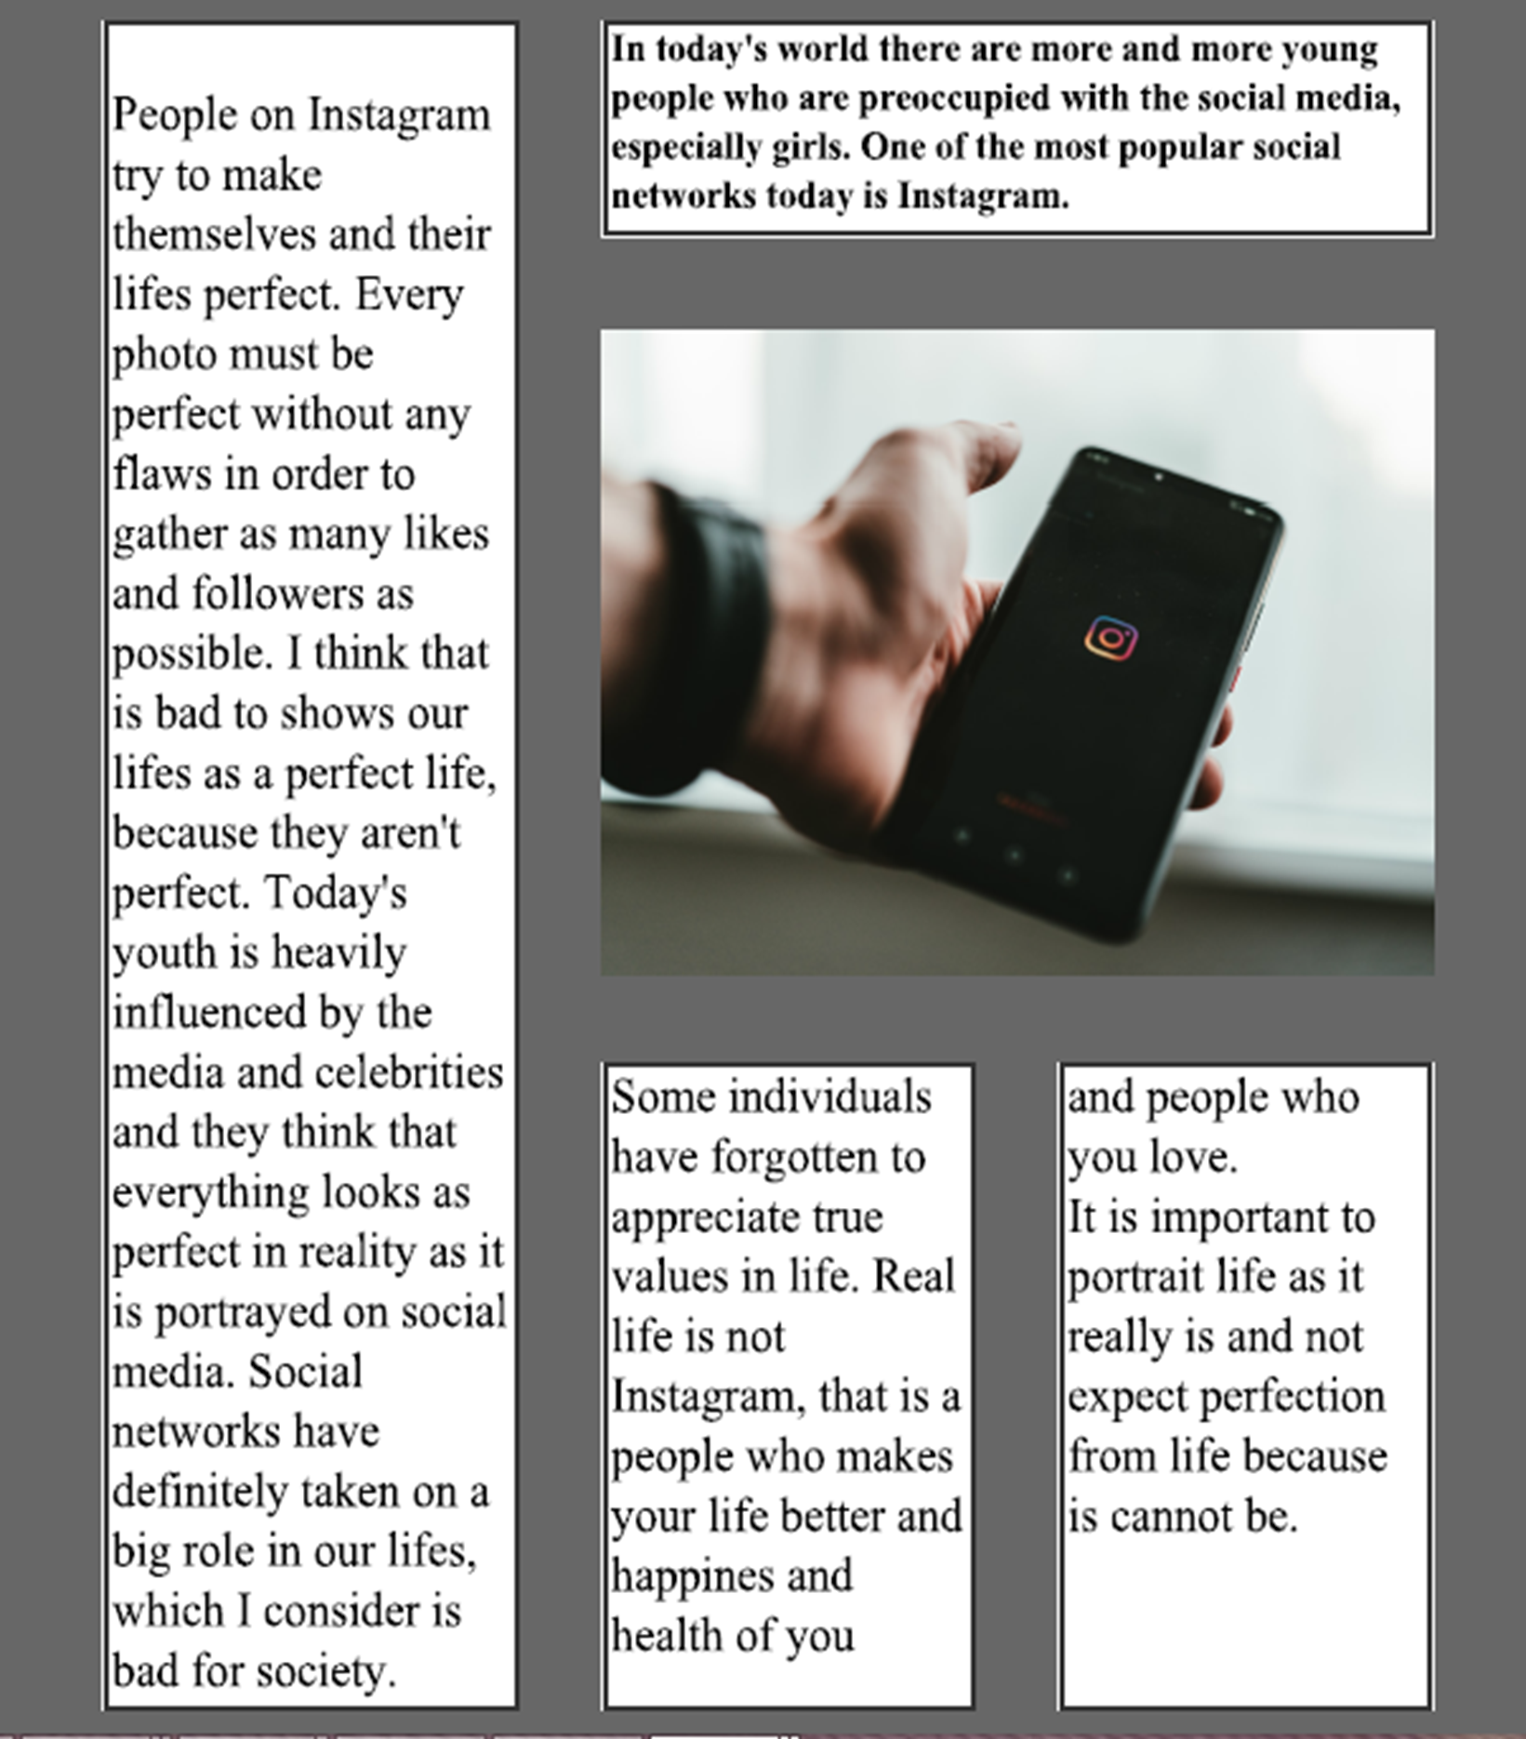

Slide 30
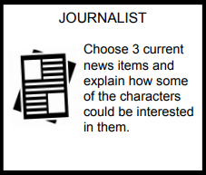

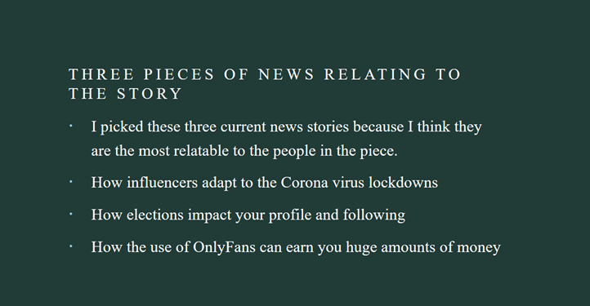


Slide 31
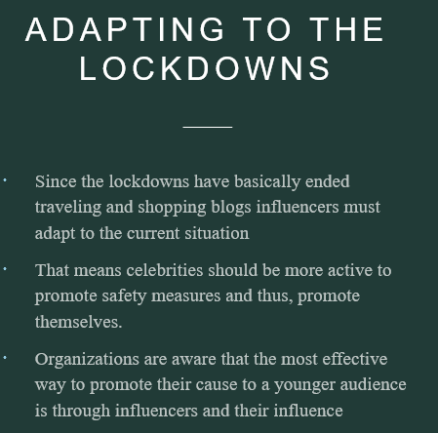

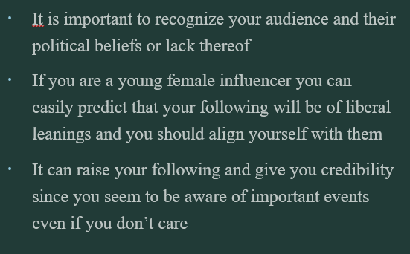

Slide 32
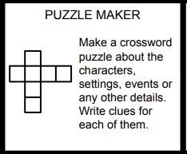
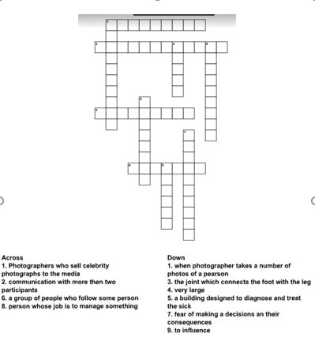

Slide 33
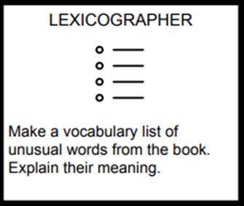
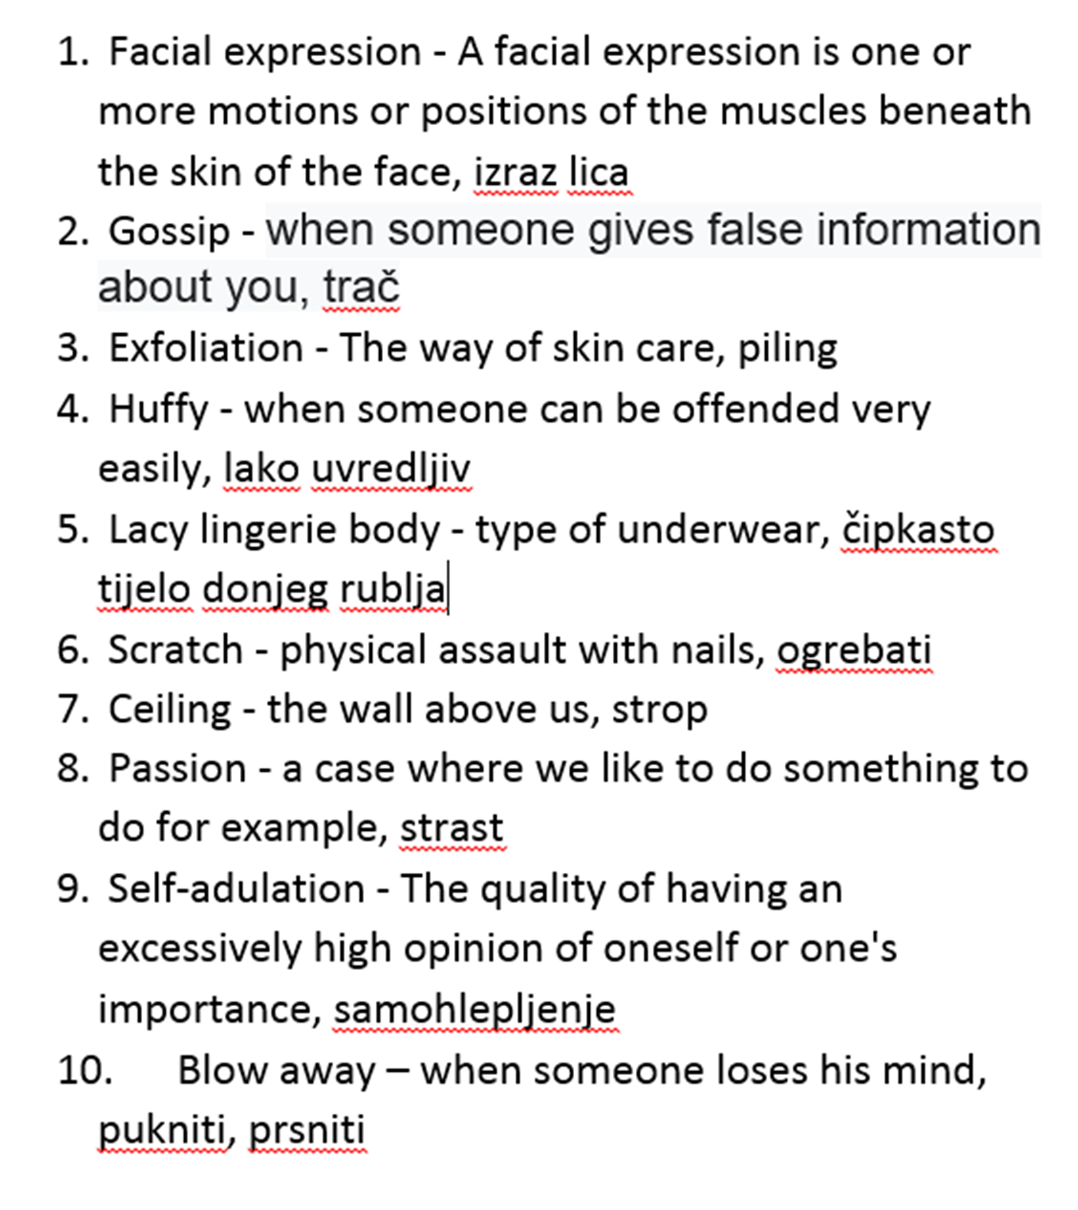

Slide 34

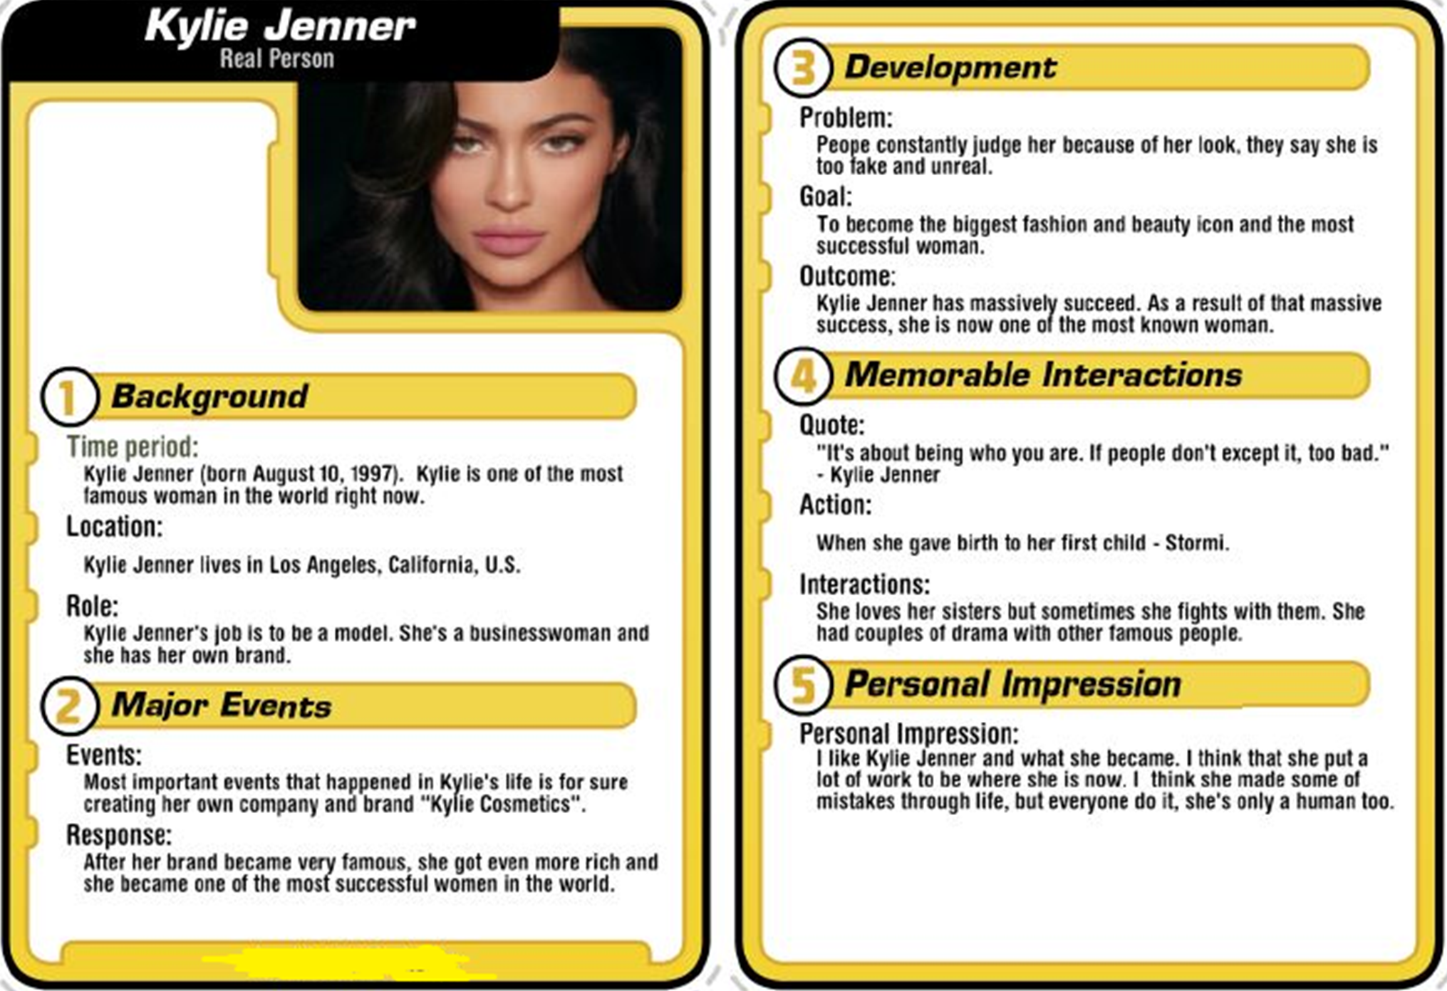
Trading cards
http://interactives.readwritethink.org/trading-card-creator

Slide 35
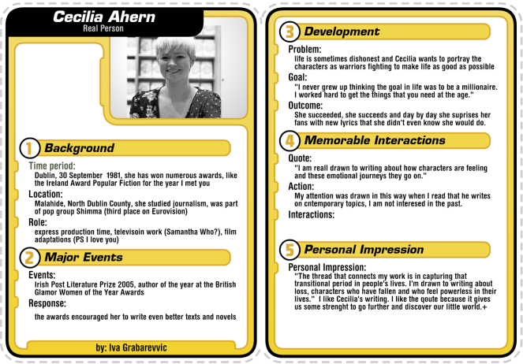
Trading cards
http://interactives.readwritethink.org/trading-card-creator

Slide 36
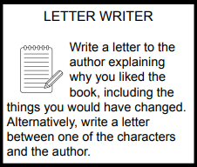
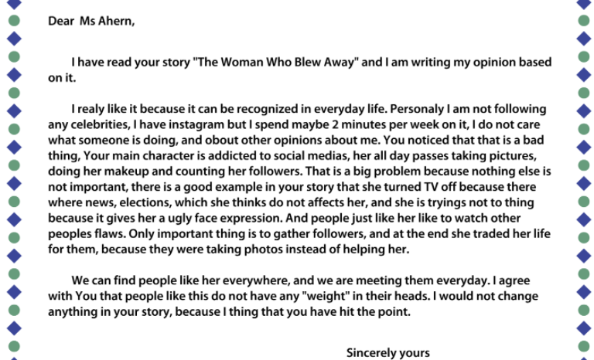
Letter (personal/formal) generator
http://interactives.readwritethink.org/letter-generator

Slide 37
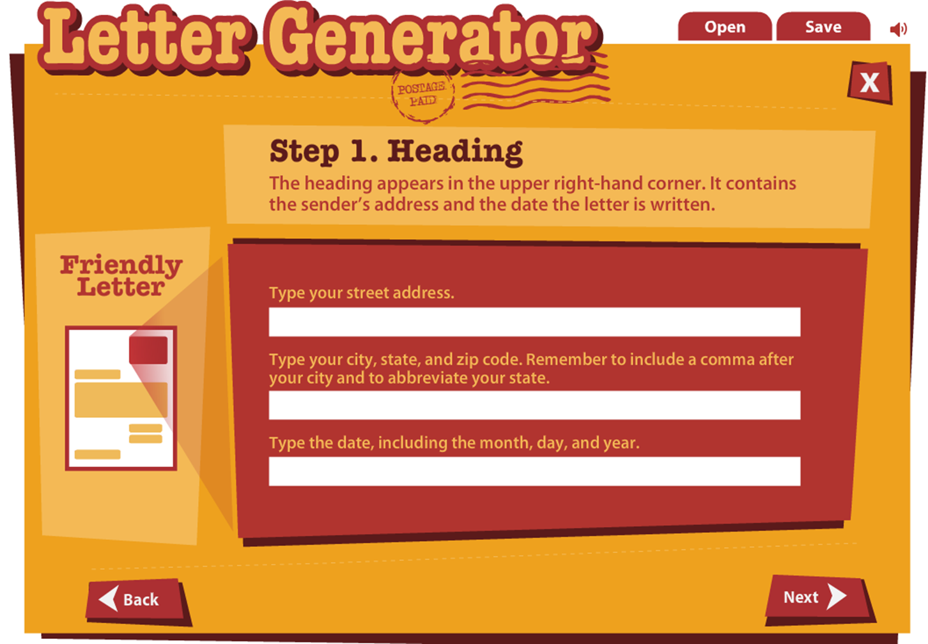
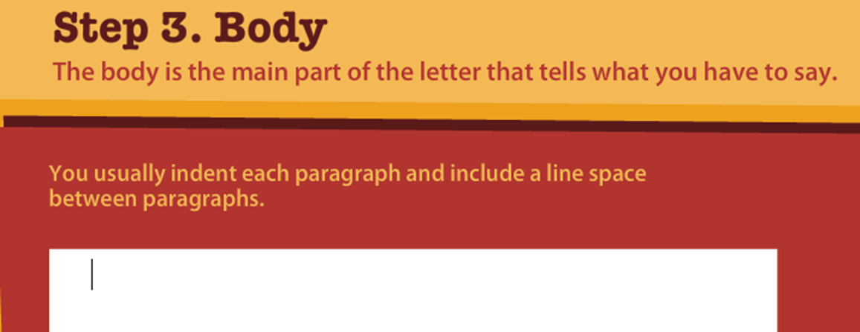
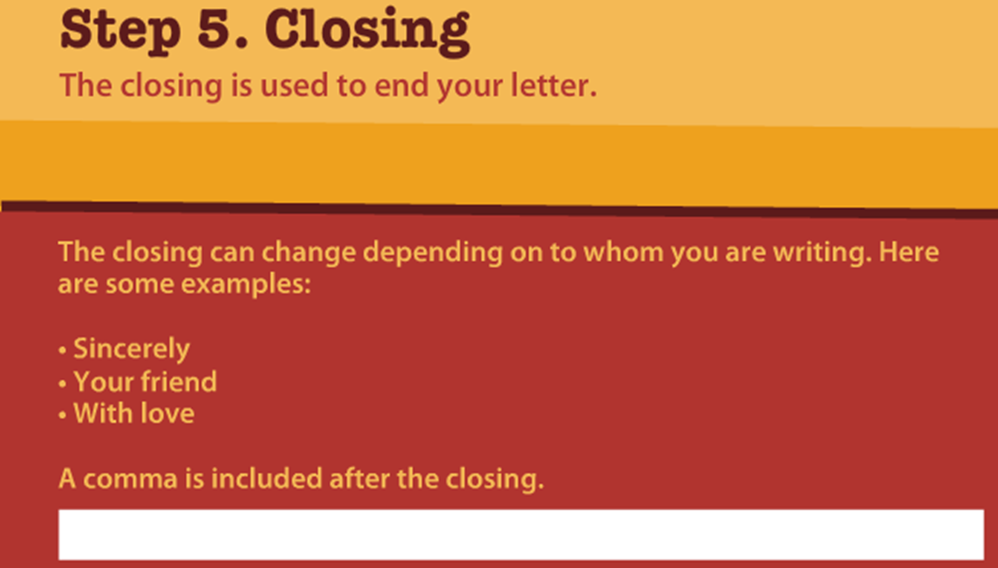
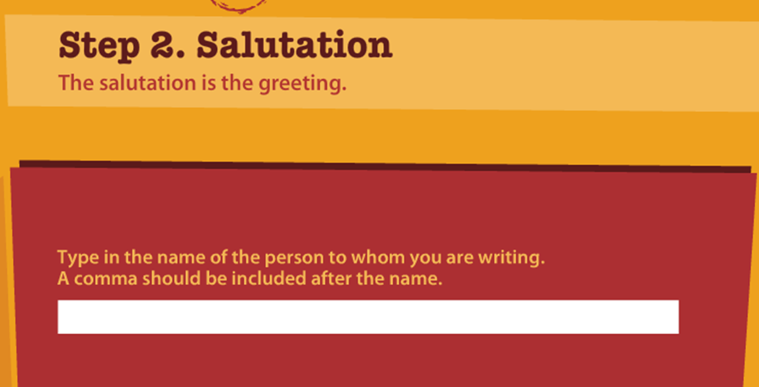

Slide 38
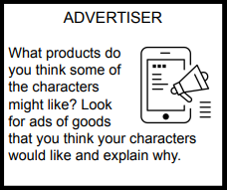

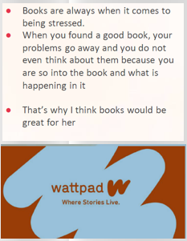
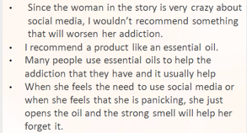
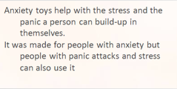

Slide 39
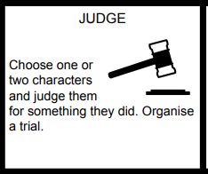
The woman who blew away
This girl is trying to be something that she isn’t. Her life is all about social media. She worries too much what will people think about her and her posts. She is hiding her insecurities. That is bad. That is not good example for girls. They will think they have to have perfect body, face and everything. Because of that they will compare too much themselves with girls like that woman who blew away. Girls will be too judgy about themselves. That’s why we shouldn’t let people like her to have social media - they will act and lie about a lot of things. What’s the point of that? That woman is lie. She is fake. Pretending to be something that you aren’t - it’s just not it. That can’t be someone’s role model. We are in 21st century and that’s why people should accept themselves who they are and everything. If you fake it, you are just harming yourself mentally. That is what this woman is doing, everything in her life is about looking perfect and doing plastic surgeries like butt implants... It’s all fake. You should embrace yourself and be proud of who you are. You are unique. Because of the way she acted, she ended up blowing away. I guess that’s what you get for not being yourself and fooling people around.

Slide 40
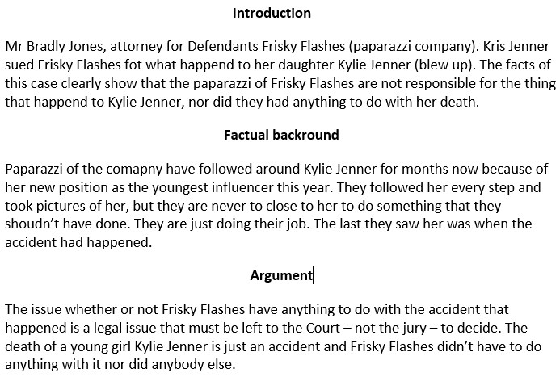

Slide 41
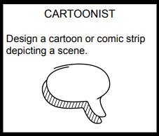
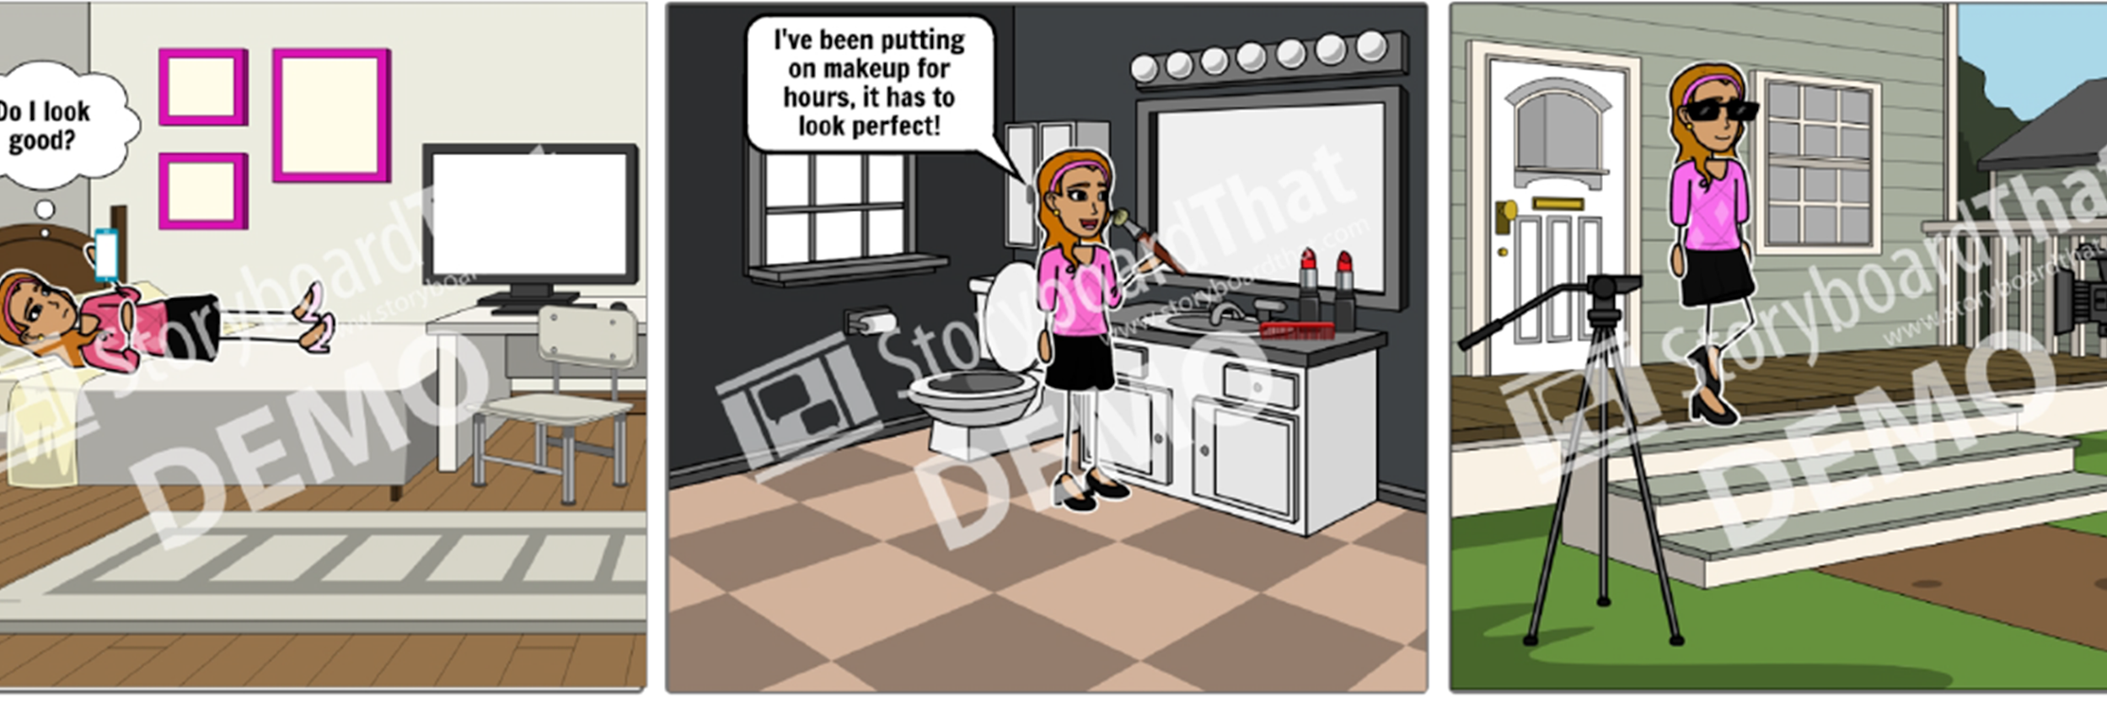

Slide 42
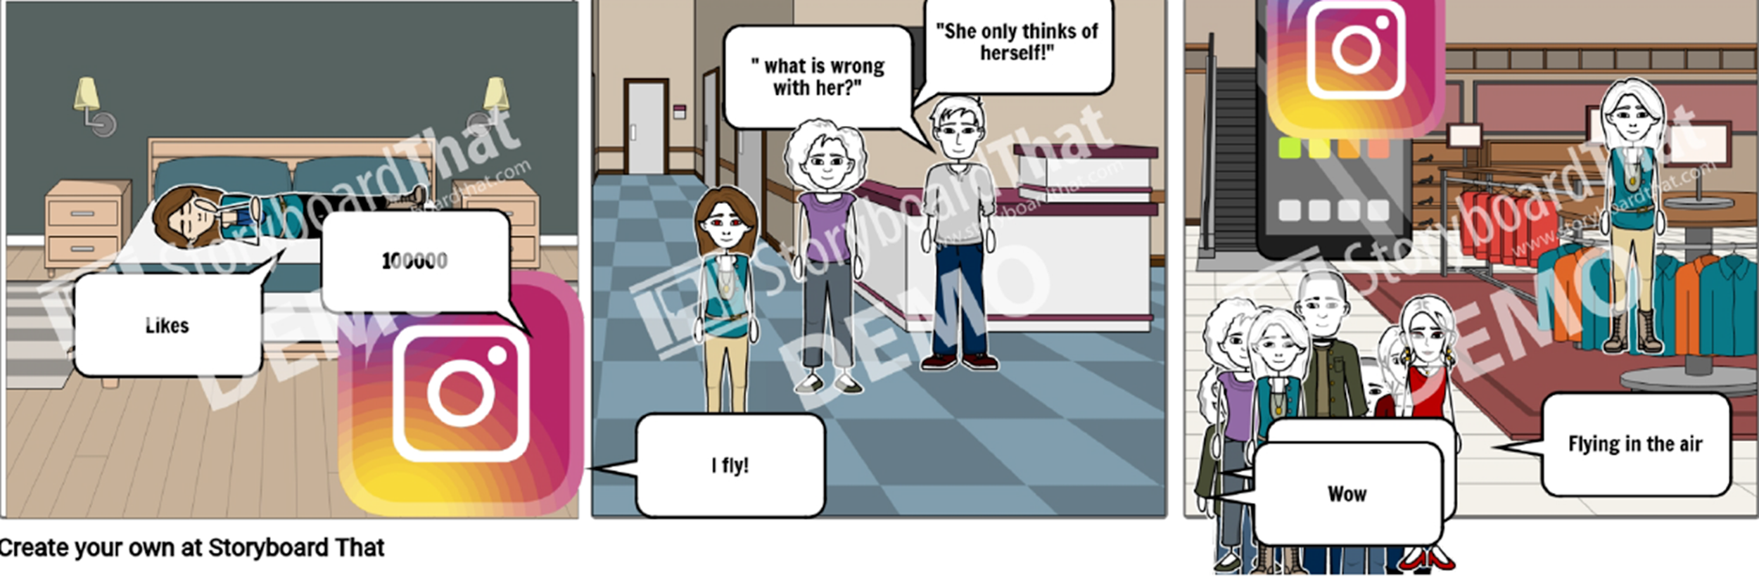

Slide 43
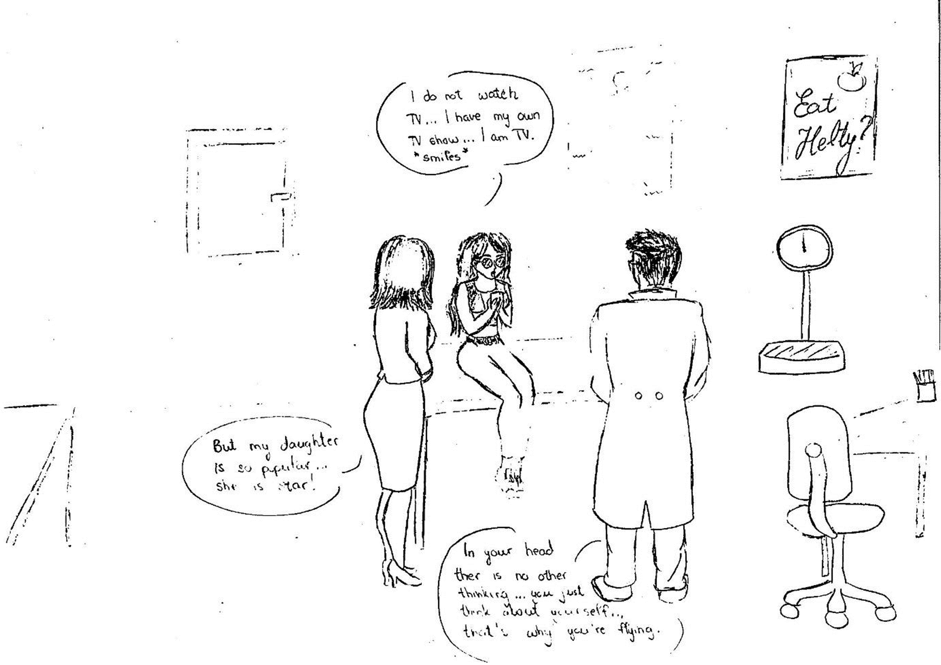
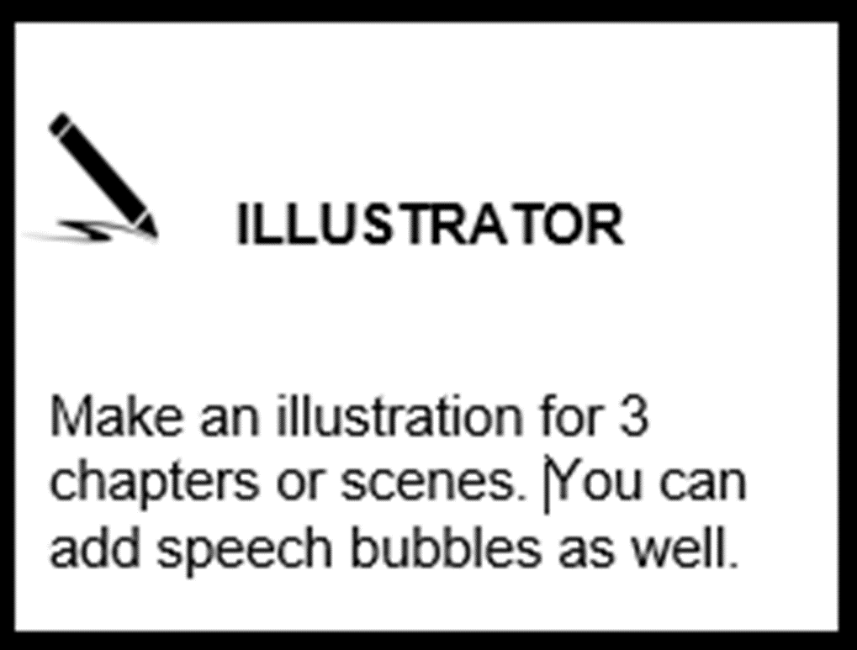
Any tool or by hand

Slide 44
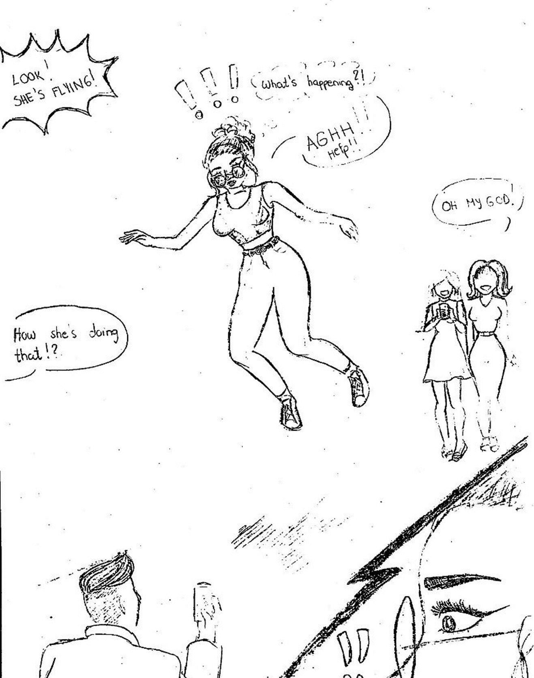
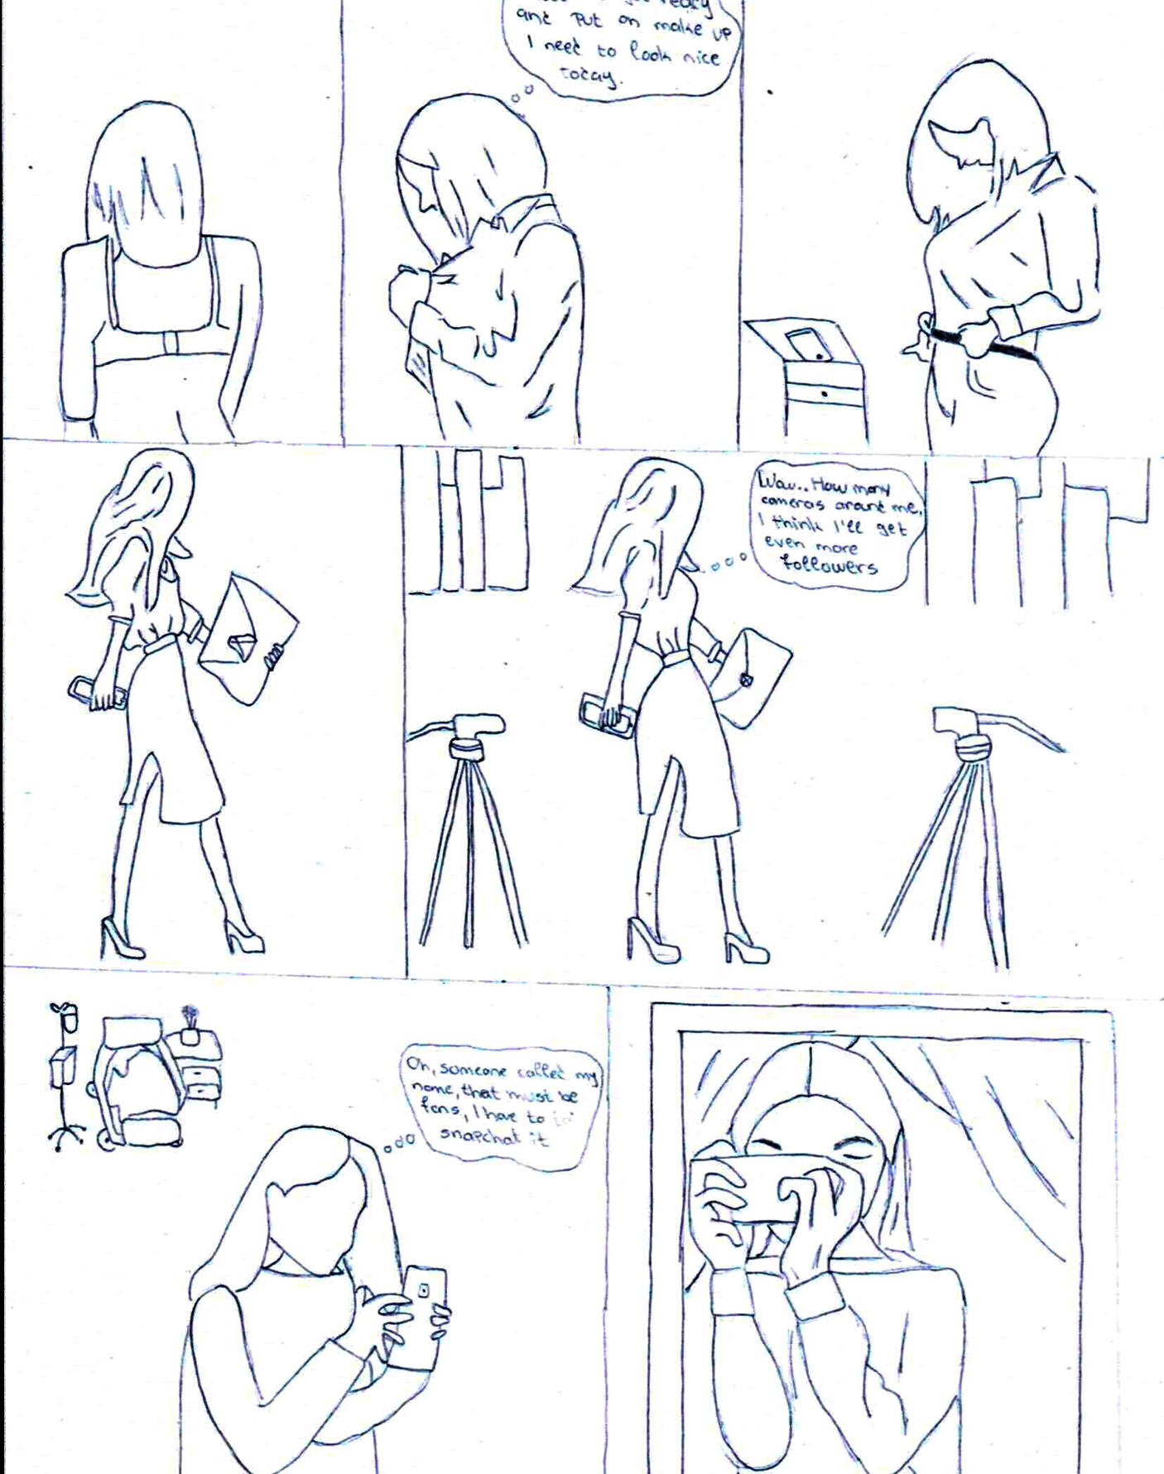

Slide 45
Other tools:
Character map
https://www.readwritethink.org/sites/default/files/CharacterMap.pdf
Cube creator (comprehension) https://www.readwritethink.org/sites/default/files/resources/30878_comprehension.pdf
Cubes: (bio, mystery, story, create your own)
http://interactives.readwritethink.org/cube-creator
Story/drama/character map
http://interactives.readwritethink.org/drama-map
Venn diagram
http://interactives.readwritethink.org/venn-diagram
Graphic map
https://www.readwritethink.org/classroom-resources/student-interactives/graphic
Plot diagram
http://interactives.readwritethink.org/plot-diagram
Timeline
http://interactives.readwritethink.org/timeline

Slide 46
Stapleless /folded book http://interactives.readwritethink.org/stapleless
Profile publisher https://www.readwritethink.org/classroom-resources/student-interactives/profile-publisher
Postcard creator
http://interactives.readwritethink.org/postcard
Compare and contrast map
http://interactives.readwritethink.org/comp-contrast-map
Book jacket creator
Canva, Adobe spark
Literary grafitti
http://interactives.readwritethink.org/graffiti
Essay planning http://interactives.readwritethink.org/essay-map
Persuasive writing
http://interactives.readwritethink.org/persuasion-map
Word matrix – vocabulary /lexicographer
https://www.readwritethink.org/classroom-resources/student-interactives/word-matrix

Slide 47
Essay map
http://interactives.readwritethink.org/essay-map
KWL chart
http://interactives.readwritethink.org/kwl-creator
Create your own poetry - Word mover app for poetry writing
http://interactives.readwritethink.org/word-mover
Word list alphabet organizer
http://interactives.readwritethink.org/alphabet-organizer
Acrostic poem
http://interactives.readwritethink.org/acrostic-poems
Fractured fairy tales
http://interactives.readwritethink.org/fractured-fairytale

Slide 48
4.
STUDENTS’ FEEDBACK

Slide 49
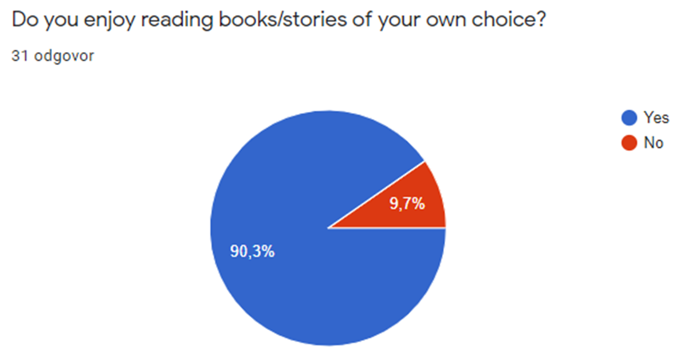


Slide 50



Slide 51



Slide 52


Slide 53
5.
ASSESSMENT AND GRADING

Slide 54
TO GRADE OR NOT TO GRADE?
Done during online teaching week, a scheduled test
Time consuming both for teacher and students
How to assess – a rubric is difficult
Final decision – reward the effort
Reading comprehension, mediation or both?

Slide 55
6.
OVER TO YOU!

Slide 56
THINK OF YOUR FAVOURITE BOOK/CHARACTER
Choose one of the activities on the Padlet.

Slide 57

https://padlet.com/mirtakk/mck15frqpi8qu18u

Slide 58
7.
OTHER READING ACTIVITIES

Slide 59



Book tasting – short stories by O’Henry

Slide 60
Book tasting – Black History Week – Toni Morrison
Book jacket with short plot (Jazz, The Bluest Eye, Beloved, Sula i Tar Baby)

Slide 61



In front of you there is a book jacket. The plot is provided at the back.
Read it and give your rating of the plot on the leaflet (Today’s special event) next to it.
Exchange the book jackets with your friends and read three plots altogether.
Choose one that you like best.

Slide 62


Creative task 1
Imagine yourself in the shoes of one of the characters. Write about 100-150 words about how he or she is feeling/felt at any point described in the plot. It can be a reflection on their own past, on other characters… whatever you feel like writing.
Creative task 2
Take crayons, pencils, felt-tip pens… and make an illustration of the front cover, now that you have thought about the plot and characters a bit more.

Slide 63
Book tasting – Black History Week – Toni Morrison
DISCUSSION
Have you ever heard about the writer of these novels, Toni Morrison?
What can you guess about her life judging by the characters and events described in her novels?
Do you think that the events described in the novels really happened to African Americans in the past?
What is your opinion on the novels the plots of which you have read?
Would you like to read any of them? Why?

Slide 64
Additional activity
How a book changed my life
Lesson plan (www.elt-resourceful.com)
The bookmobile

Slide 65

Evaluation
shorturl.at/opDJT
https://forms.gle/a1A7Z5WqXuZLELWx9

Slide 66
Credits
Slide 10 - https://narodne-novine.nn.hr/clanci/sluzbeni/2019_01_10_211.html
Slide 11 - https://narodne-novine.nn.hr/clanci/sluzbeni/2019_01_7_139.html
Slide 20 - https://onthesamepageelt.wordpress.com/?s=post-reading+activities
- https://www.readwritethink.org/
Slide 24 - https://www.google.com/search?q=beyonce+pretty+hurts&sxsrf=AOaemvL5CtcighFvt-SiCnx7fLREOhVc8w:1636182471237&source=lnms&tbm=isch&sa=X&ved=2ahUKEwiz9PDXloP0AhVXgf0HHY--DwAQ_AUoAXoECAEQAw&biw=1574&bih=750&dpr=1#imgrc=cBA9sEmzcvh36M
Slide 65 - www.elt-resourceful.com

Slide 67

THANK YOU !
Any questions?
mirtakk@gmail.com

Slide 68

Free templates for all your presentation needs
For PowerPoint and Google Slides
100% free for personal or commercial use
Ready to use, professional and customizable
Blow your audience away with attractive visuals

