Slide 1
Educational value of advertising in the classroom:
How to use ads in your lessons?
Ivana Rako Vuksan
HUPE Conference, Poreč, November 12 - 14

Slide 2

www.menti.com
Notes:
Not using the textbooks would be time-consuming and expensive. And radical.
But moving away from your tektbooks is beneficial for both, pupils and teachers. We broaden our horizions, learn sth new, get motivation, get ideas.
Where do I find materials: videos (culture related, famous people, important dates, everyday conversation), music (handouts with lyrics, lyricstraining),
Projects (week, groups, presentation as an individual task – different topics: being eco-friendly, sport, cultural heritage, presenting a person, a gadget).

Slide 3




The idea
Ad-dicted to Education!
Notes:
The idea for this talk comes from the project developed in my school from 2019. to 2021. Erasmus+ project with 5 partners: Spain, Greece, Italy, Romania nad Poland. The idea was to help pupils understand ads, get familiar with their messages and strategies, to help decide whether the ad is important or necessary for them.

Slide 4
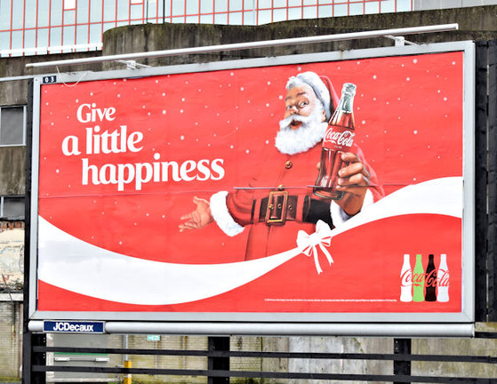


Why ads?
Everywhere
Highly influential
Descriptive form
Raise awareness (gender equality, inclusion...)
Develop critical thinking
Encourage creativity
This Photo by Unknown author is licensed under CC BY-SA.
Notes:
Why can they be a valuable media for your lessons?
Being language teachers, we need a trigger for starting a conversation

Slide 5
Suggested topics:
What is advertising?
The importance of advertising in our lives
An advertisement: information and influence
What elements are involved in advertising?
Target audience
Am I a responsible consumer?
Discrimination in advertisements

Slide 6

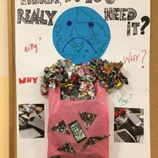
Activities - examples:
What do we need from what we buy?
Objectives:
  To identify the concept of consumerism
  To determine needs vs. wants

Slide 7
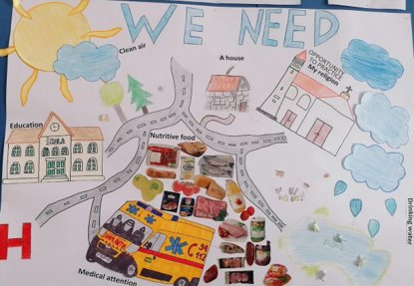
Students divided into groups
Given a list of things
Choose 12, cut down to 7
Debate
Poster
own bedroom, candies, education,
nutritious food,
a TV, money, trips, fashionable
clothes, an MP3 player, a place to play, a bike, the opportunity to
practice your own religion, a computer,
medical attention...

Slide 8

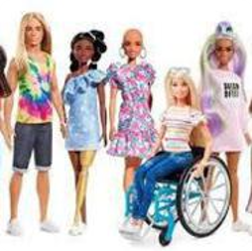
Ads and stereotypes
Objectives:
  To become aware of the stereotypes and roles that
  advertisements assign to certain groups.
  To take a critical attitude towards advertising messages.

Slide 9
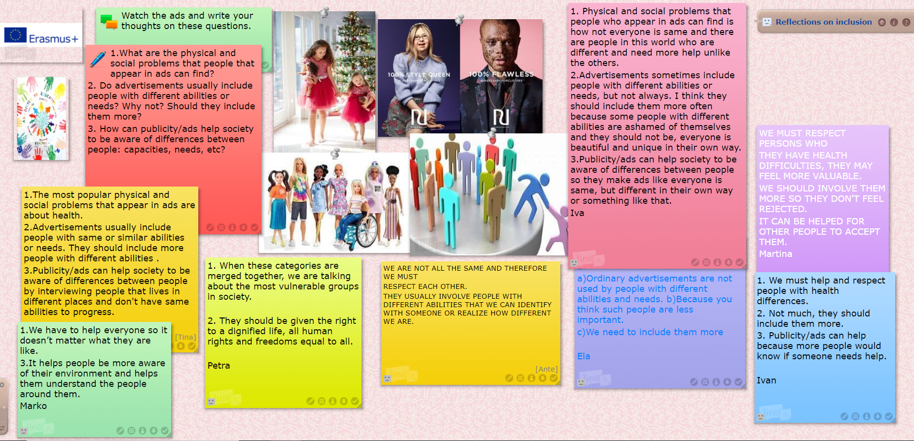
- identifying the situation – brainstorming
- looking for more ads
- reflection on the ads (including different aspects, frequency, influence)

Slide 10
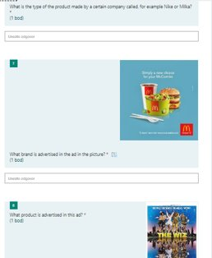
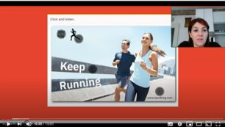
Creating ads
Objectives:
  To distinguish the elements of ads
  To create an ad

Slide 11




Presenting the elements of an advertisement
A quiz
Creating an ad (postermywall.com)

Slide 12
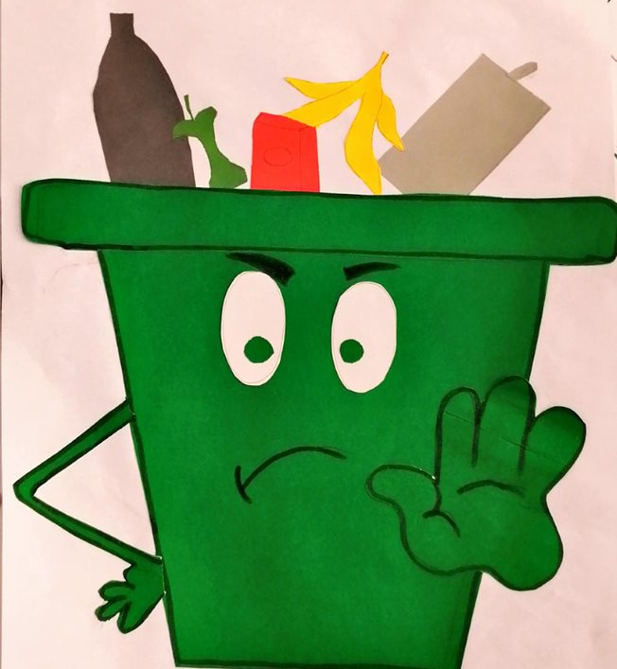
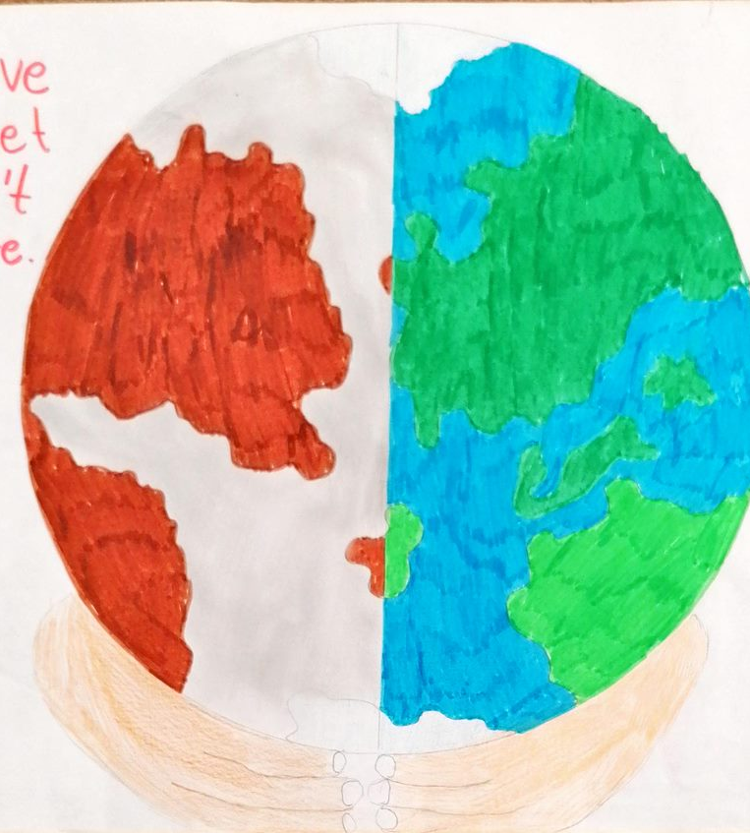


Eco-friendly project
  Objective:
  To create an ad
  To practice presentational skills

Slide 13

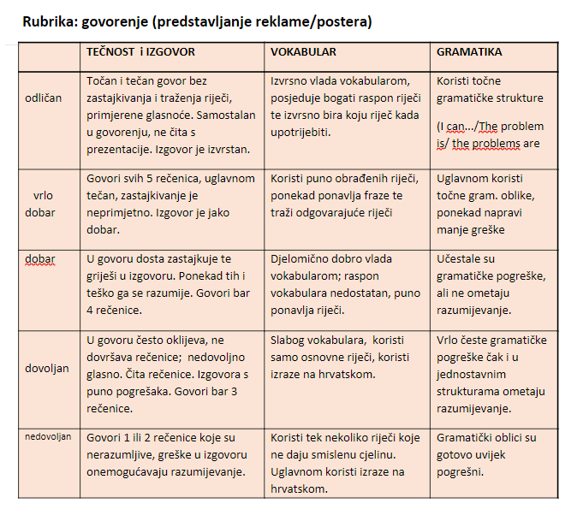
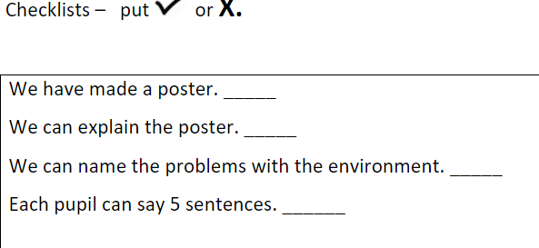
  6th graders
  Group work
  Presentational (speaking) skills

Slide 14
Questions?

Slide 15
Thank you for your attention!

