Slide 1



Digi Kittens in Lions’ World
Poreč, 11 November, 2023
By
Ivana Marinić
Faculty of Education in Osijek
and
Lidija Šaravanja
Vladimir Nazor Primary School in Čepin

Slide 2
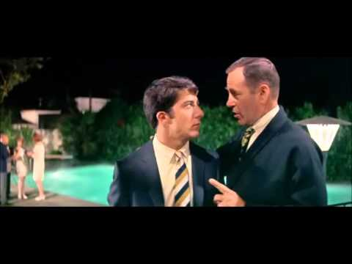

Slide 3


Agree or disagree?
My students are good at using technology.
My students know a lot about online safety.
IT teachers teach them all they need to know about it.
I teach my students about online well-being.
Image by <a href="https://pixabay.com/users/openclipart-vectors-30363/?utm_source=link-attribution&amp;utm_medium=referral&amp;utm_campaign=image&amp;utm_content=160032">OpenClipart-Vectors</a> from <a href="https://pixabay.com//?utm_source=link-attribution&amp;utm_medium=referral&amp;utm_campaign=image&amp;utm_content=160032">Pixabay</a>

Slide 4
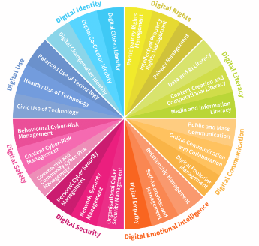
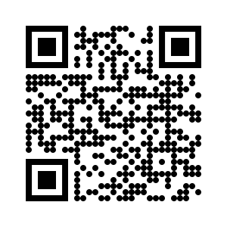

Digital Literacy, Skill and Readiness
DQ
Digital Intelligence
a set of technical, cognitive, metacognitive, and socio-emotional competencies

Slide 5
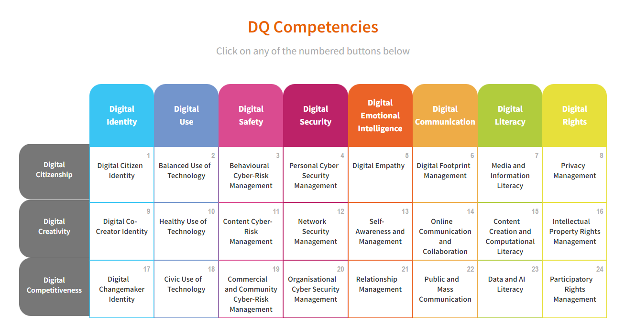

Slide 6
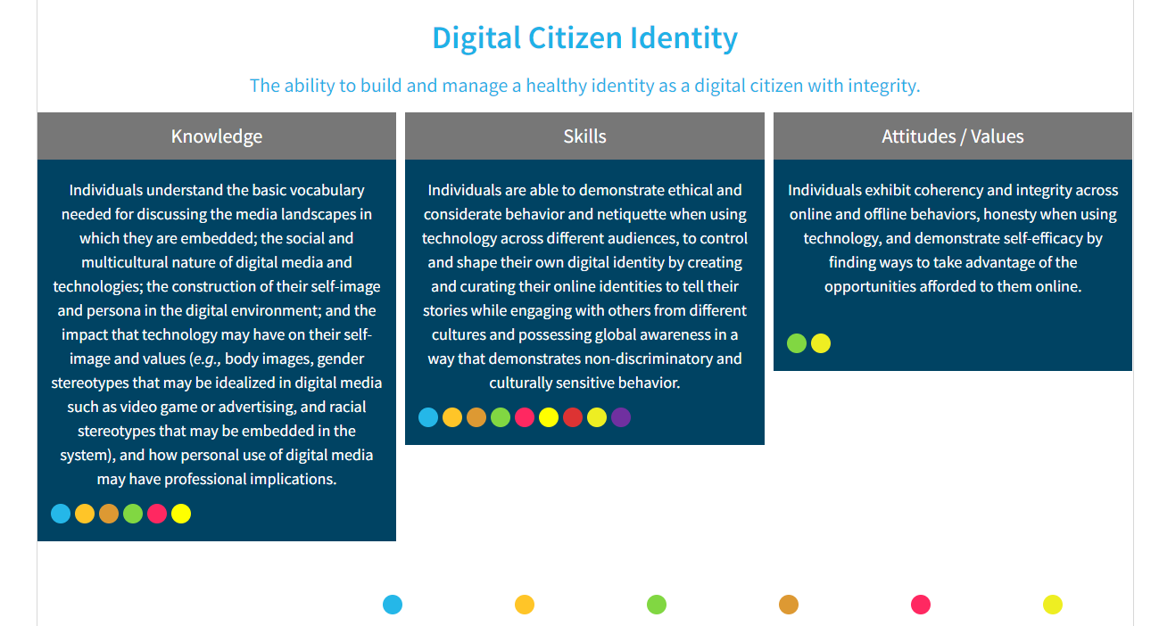

Slide 7
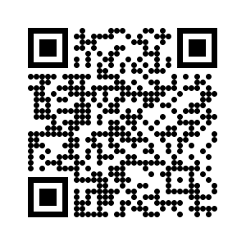
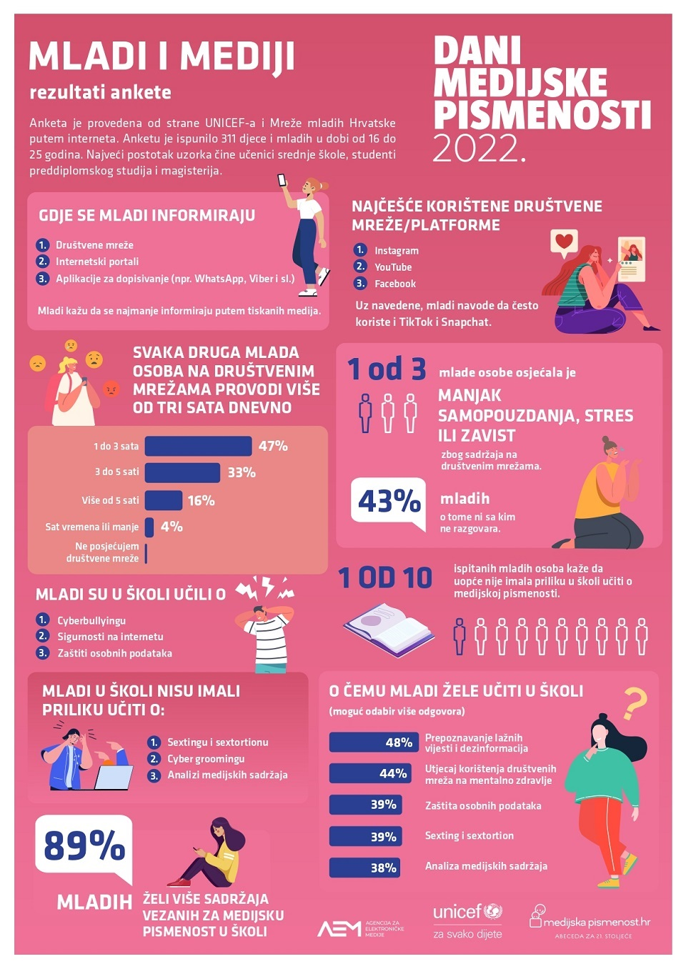
Media Literacy Days 2022
89% want to learn more at school about: - misinformation and disinformation - SM influence on our health - privacy protection - sexting and sextortion - media content analysis | Every third young person: - lacks self-confidence - feels stressed or envious because of SM content Every second young person spends more than three hours a day on SM
81% believe that media literacy should be integrated into curriculum | The main source of information for young people: - SM - web sites - apps such as WhatsApp and Viber
https://www.medijskapismenost.hr/mladi-i-mediji-rezultati-ankete/

Slide 8
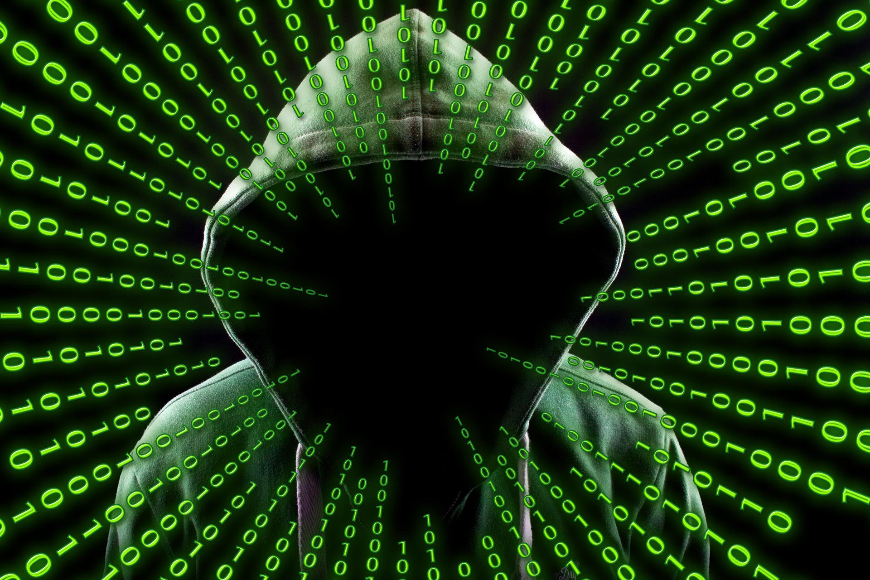
Three topics
Online safety
Digital emotional intelligence
Digital media literacy

Slide 9
Online Safety
Privacy – definition?
Safe browsing
Cookies and caches

Slide 10
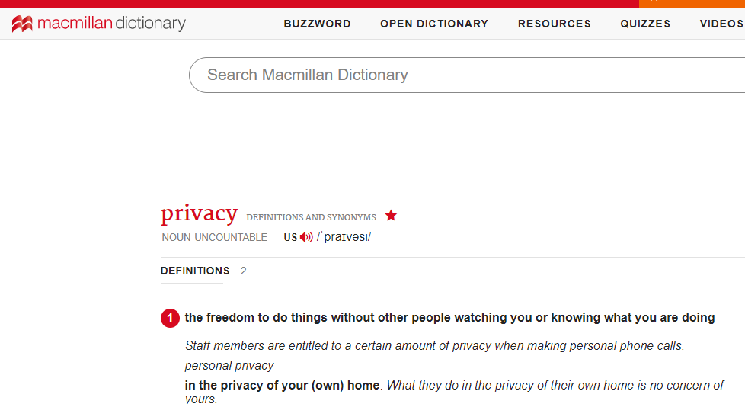
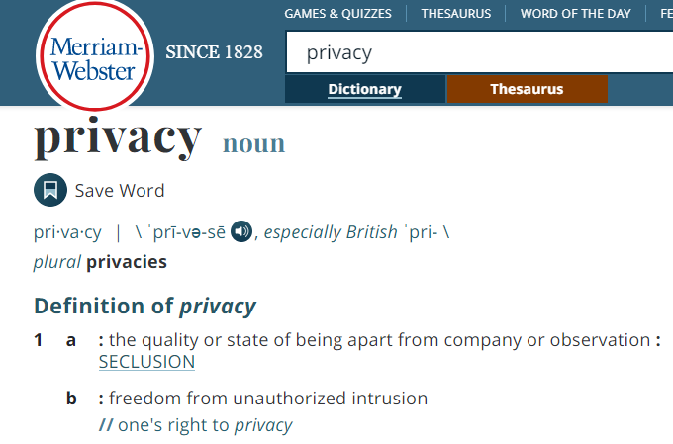
Privacy

Slide 11
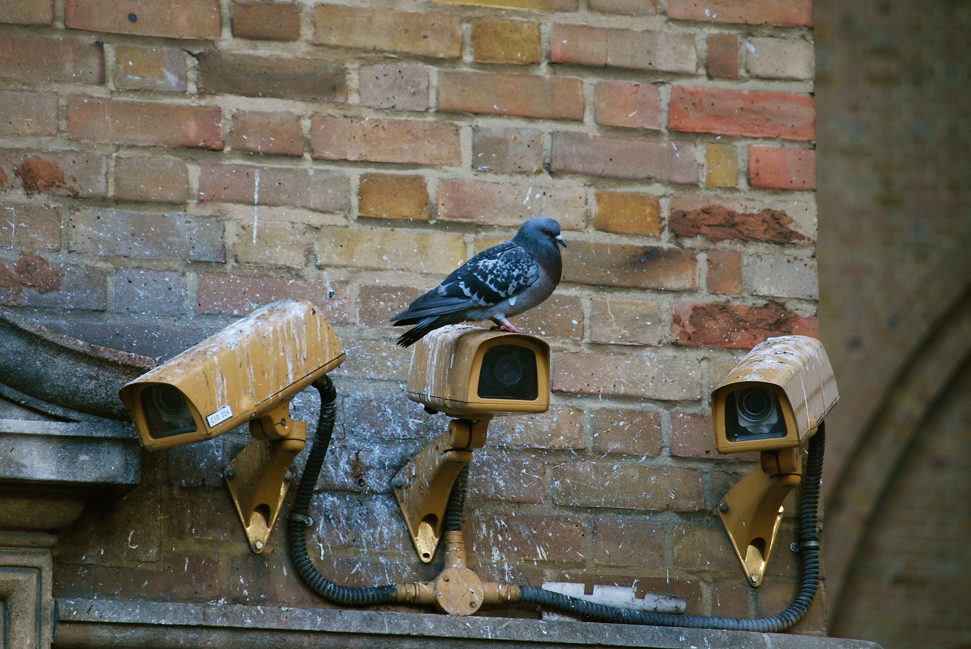
Online privacy – an oximoron?
ATTENTION
commercial
buying
political
mis/disinformation
Is it possible to be
unseen
undisturbed
unmanipulated?

Slide 12

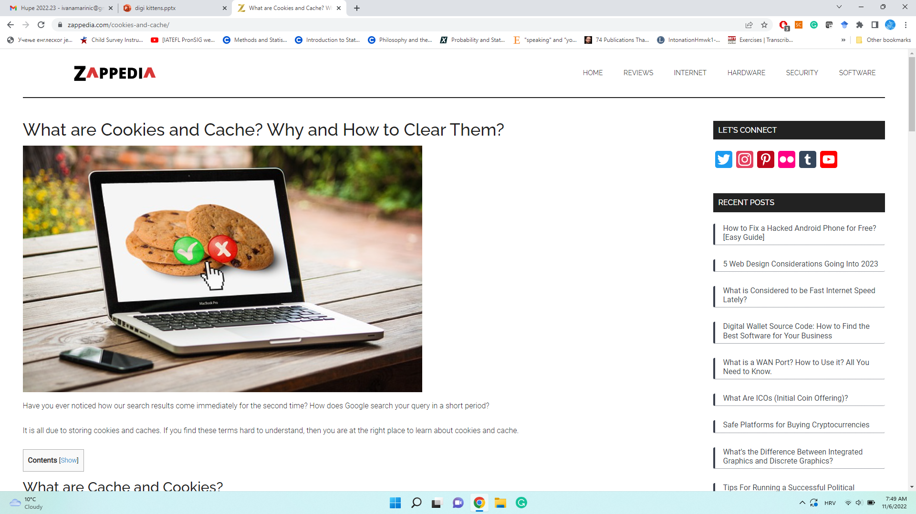
Cookies and bubbles
Epistemic bubbles
Information bubbles
Cookies caches
Notifications

Slide 13









Social media test

Slide 14
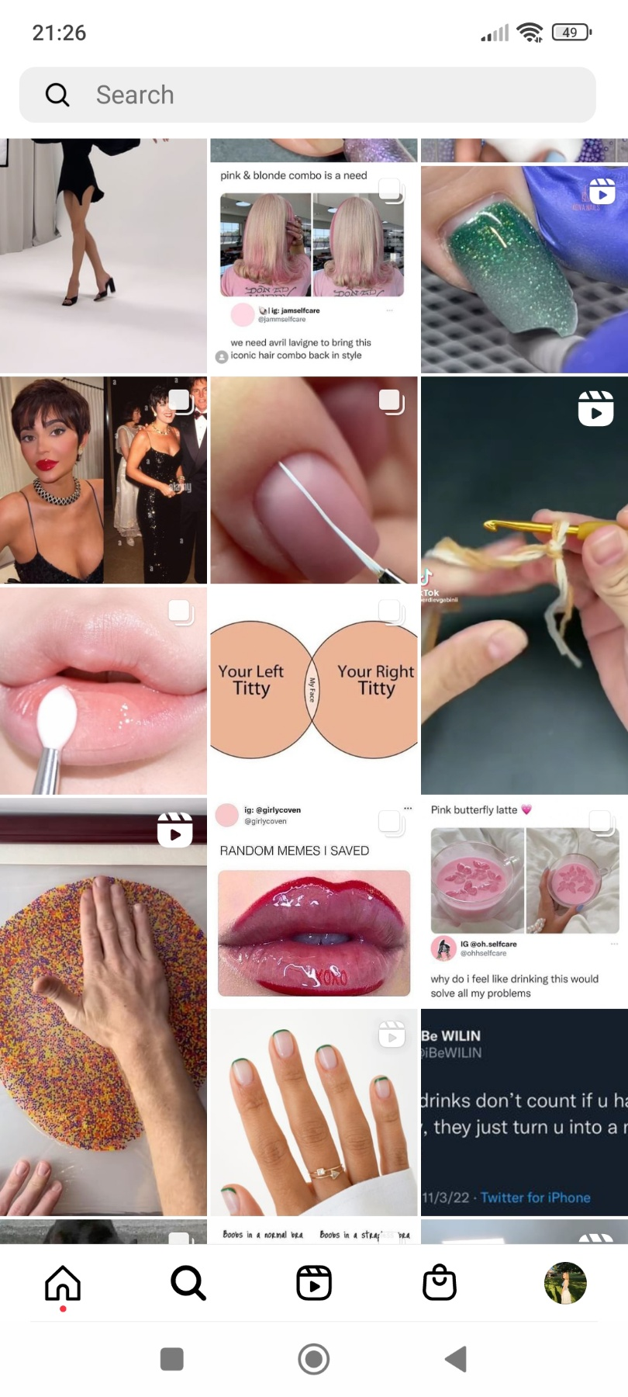
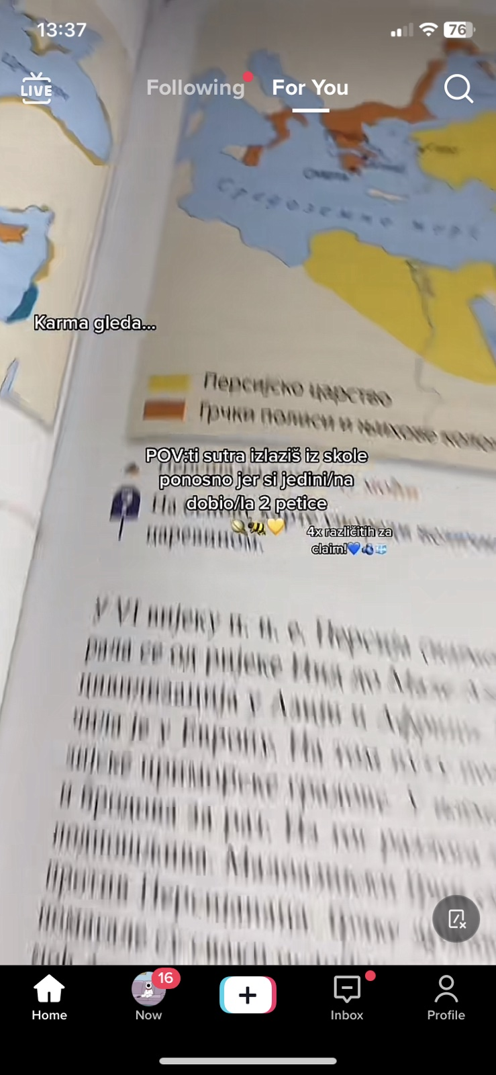
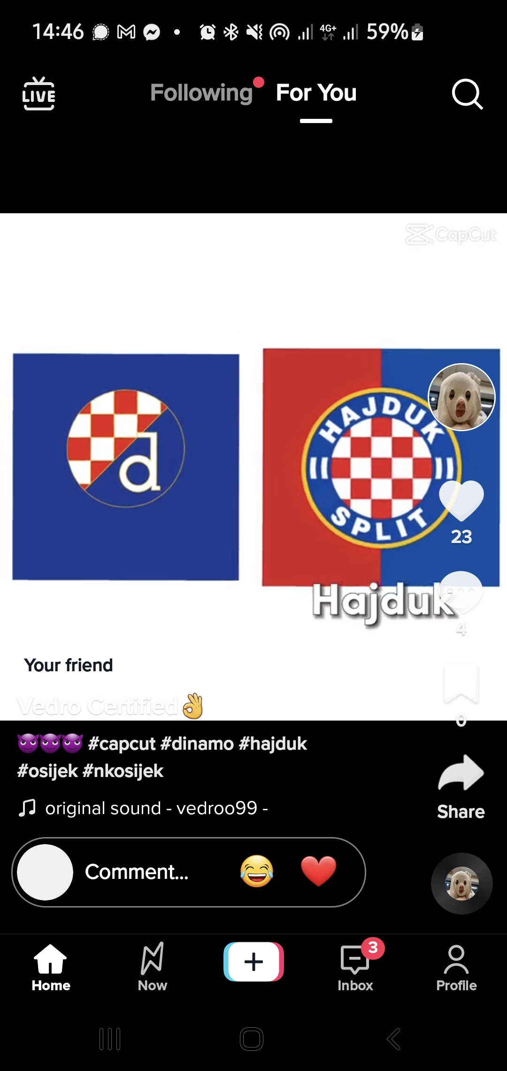
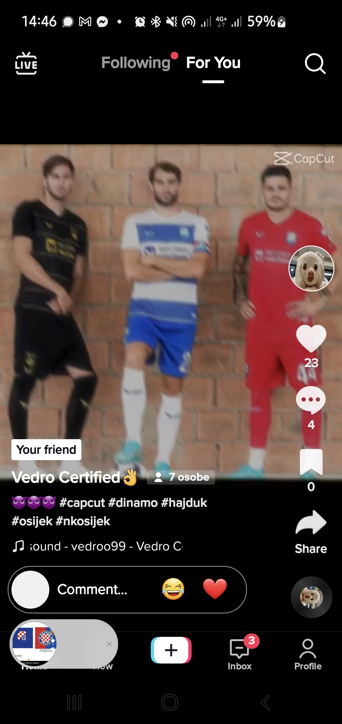

Slide 15
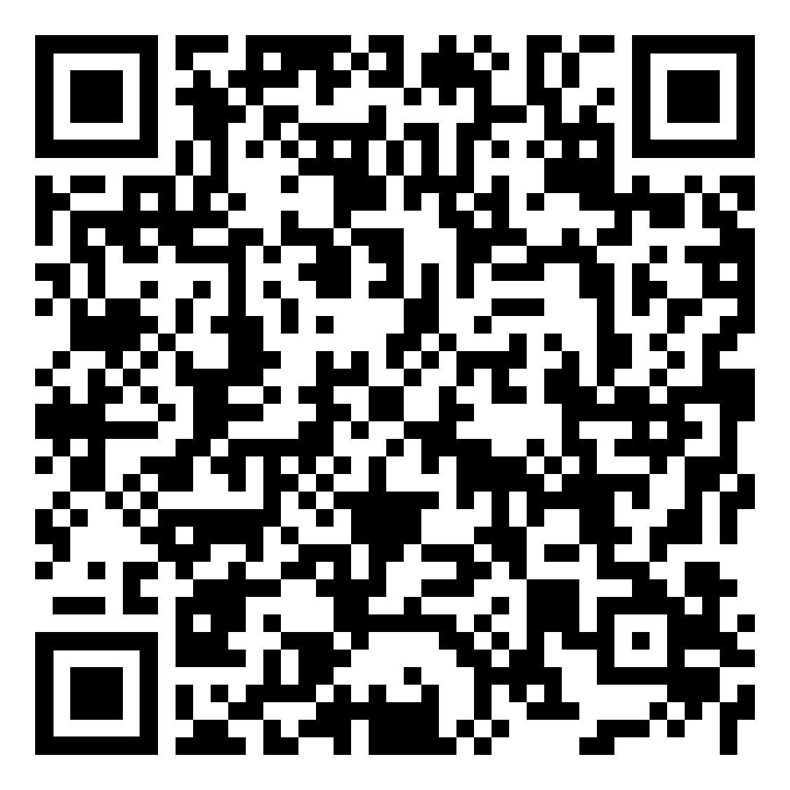
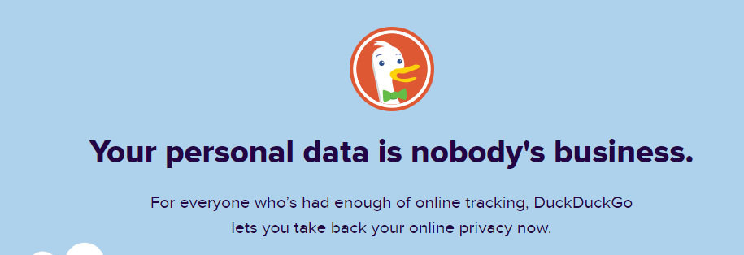
You might wish to
Use duckduckgo.com.
Play Privacy Chicken
Image by <a href="https://pixabay.com/users/geralt-9301/?utm_source=link-attribution&amp;utm_medium=referral&amp;utm_campaign=image&amp;utm_content=3271589">Gerd Altmann</a> from <a href="https://pixabay.com//?utm_source=link-attribution&amp;utm_medium=referral&amp;utm_campaign=image&amp;utm_content=3271589">Pixabay</a>

Slide 16
Strong Password
Letters and numbers
Special characters
Upper and lowercase
12 characters
Make one on your own!
What does it say?
CUl8er
LEg8R
LF@nt
CUl8ergma
LEg8Rins
LF@ntkah

Slide 17


Take a look at your social media page.
What are the topics there?
school
politics
fashion
health
people
celebrities
home
diy
food
How can you teach your students about and ?

Slide 18
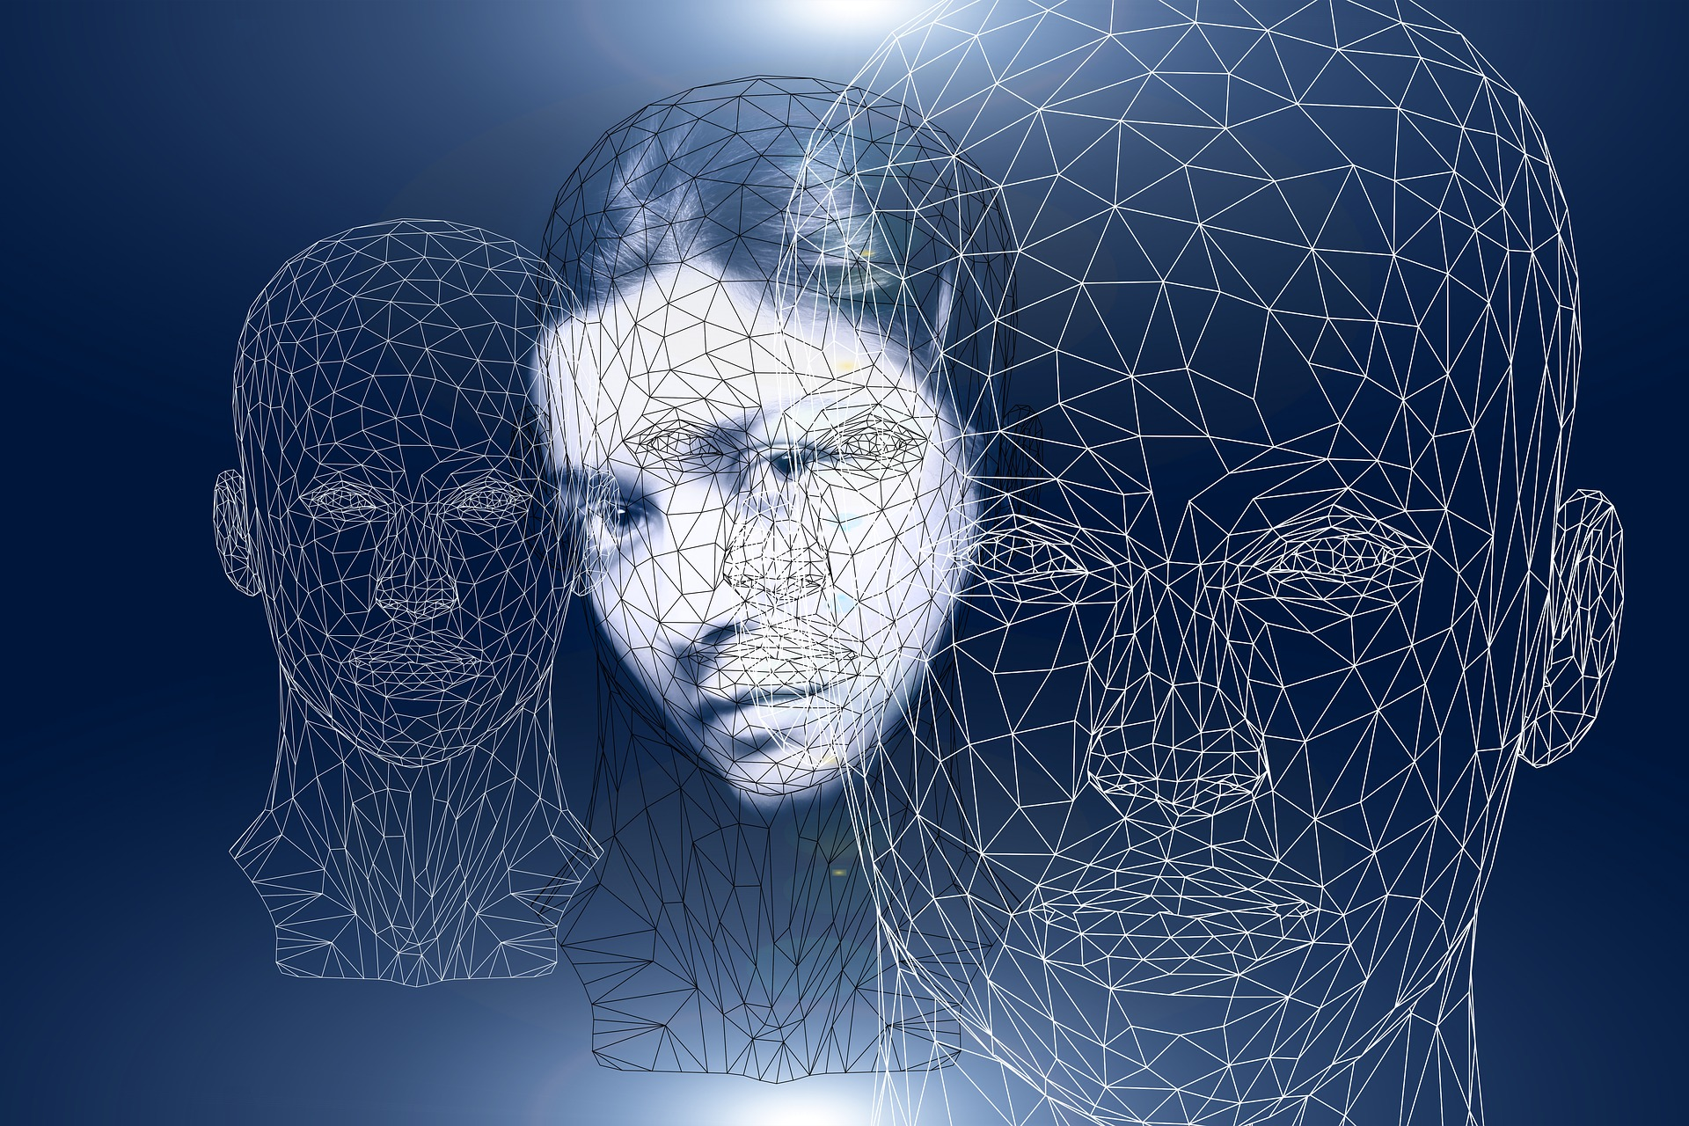
Digital Emotional Intelligence
DQ Competencies:
knowledge; skills; attitudes/values
digital empathy
self awareness and management
relationship management
Image by <a href="https://pixabay.com/users/geralt-9301/?utm_source=link-attribution&amp;utm_medium=referral&amp;utm_campaign=image&amp;utm_content=2706902">Gerd Altmann</a> from <a href="https://pixabay.com//?utm_source=link-attribution&amp;utm_medium=referral&amp;utm_campaign=image&amp;utm_content=2706902">Pixabay</a>

Slide 19


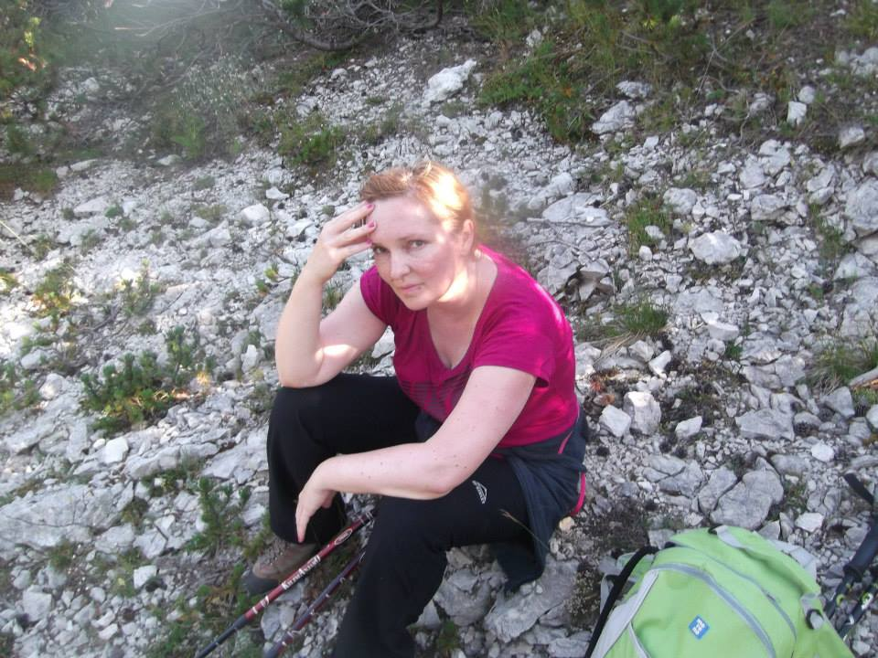
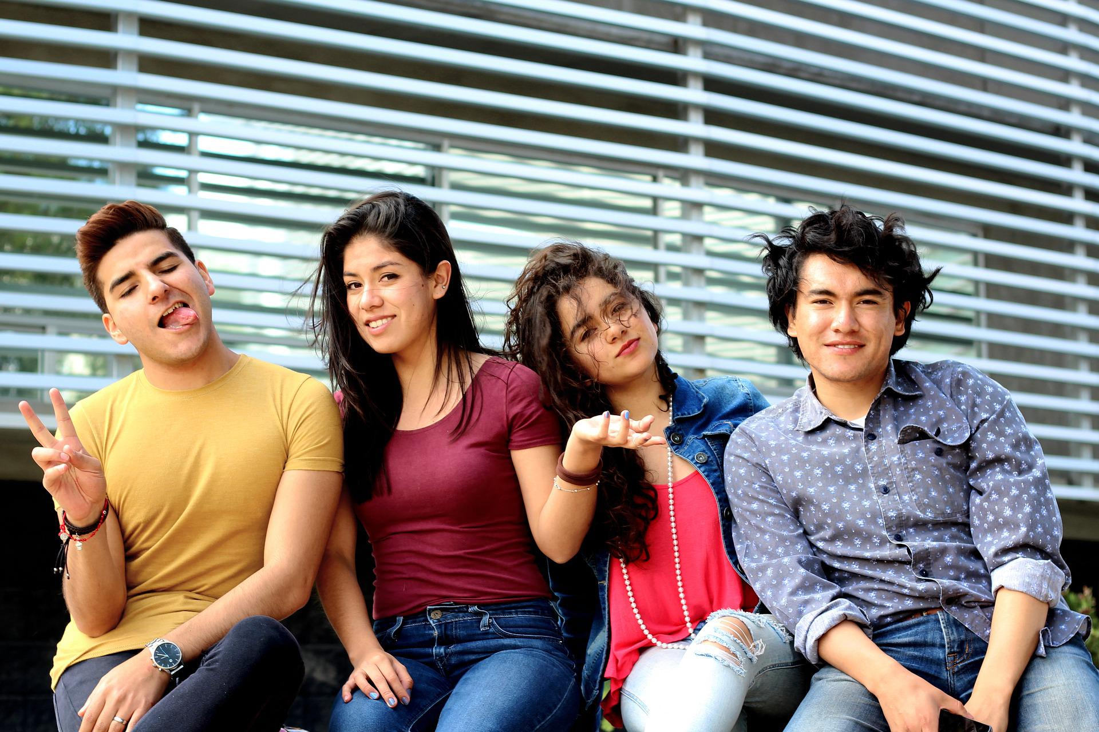
Colours
Emojis
Avatars
Visual literacy
Image by <a href="https://pixabay.com/users/publicdomainpictures-14/?utm_source=link-attribution&amp;utm_medium=referral&amp;utm_campaign=image&amp;utm_content=19156">PublicDomainPictures</a> from <a href="https://pixabay.com//?utm_source=link-attribution&amp;utm_medium=referral&amp;utm_campaign=image&amp;utm_content=19156">Pixabay</a>
Image by <a href="https://pixabay.com/users/principe-sad-6018060/?utm_source=link-attribution&amp;utm_medium=referral&amp;utm_campaign=image&amp;utm_content=2550630">Alfredo Islas</a> from <a href="https://pixabay.com//?utm_source=link-attribution&amp;utm_medium=referral&amp;utm_campaign=image&amp;utm_content=2550630">Pixabay</a>

Slide 20
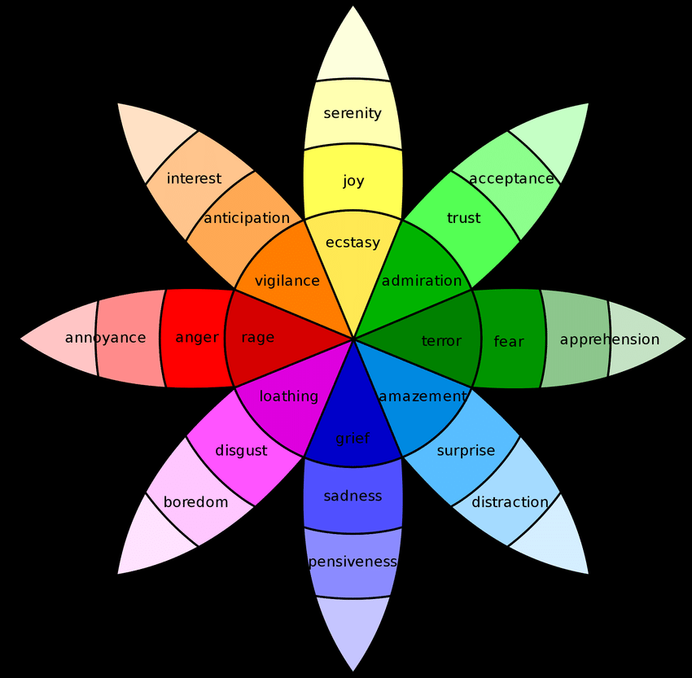
Plutchik’s Wheel of Emotion
https://study.com/learn/lesson/plutchik-emotion-wheel.html
Basic emotions
Combinations
Hypothetical constructs
Opposites
Similarity
Intensity

Slide 21
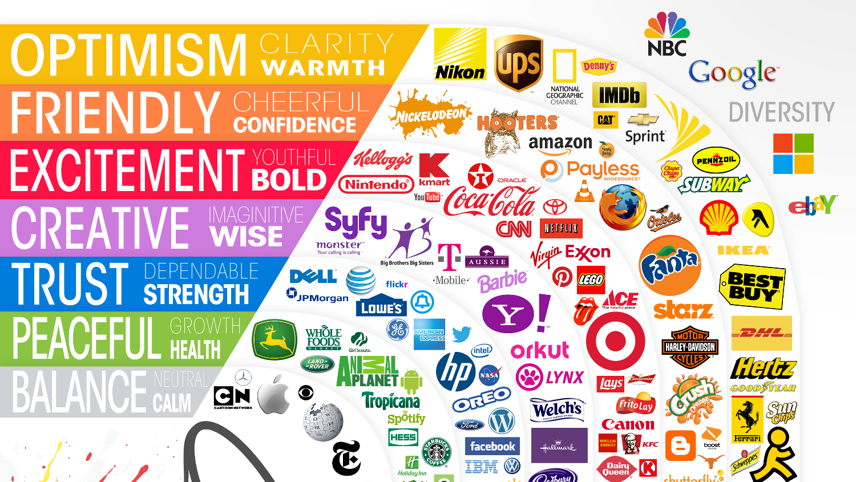

Slide 22
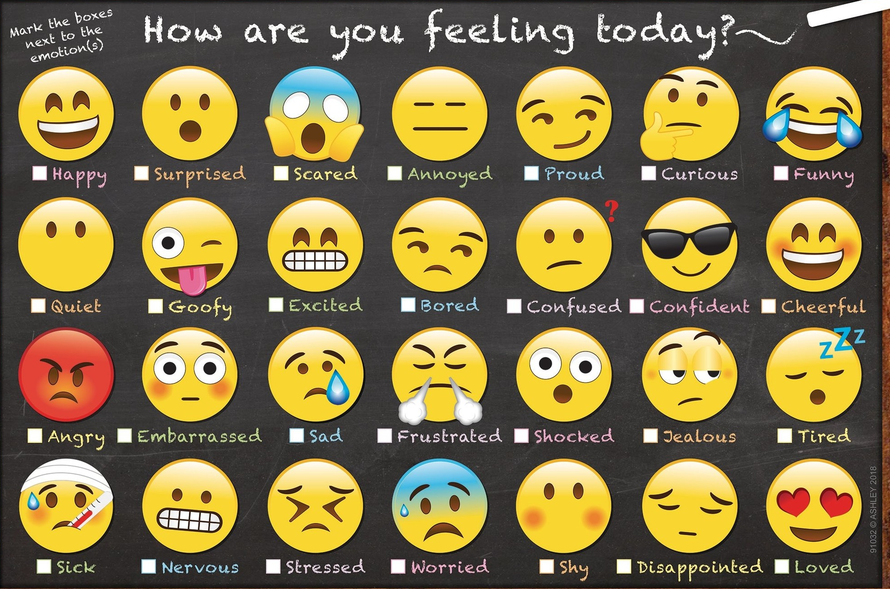
Functions of emoji
tone
body language
facial expression
enhancing conversation
indication of emotion
clarify message intention
emotion modification
Kavanagh, 2010, 2016
https://cdn.shoplightspeed.com/shops/619633/files/22049267/smart-poly-chart-emoji-feelings.jpg

Slide 23

Activities
Guess the name of the movie
  https://quiz-questions.uk/movies-in-emojis/
Random emoji story
  https://spinnerwheel.com/random-emoji-generator
Analyze logos by their colours
Talk about photos
  https://www.facebook.com/wohmofficial/
Be creative
  Artist Turns Shadows Of Everyday Objects Into Funny Sketches (digitalsynopsis.com)
  CEO Falls Asleep At Work, Employees Photoshop Him Into Funny Memes (digitalsynopsis.com)
  https://digitalsynopsis.com/design/famous-landmarks-photos-paper-cut-outs-rich-mccor/

Slide 24
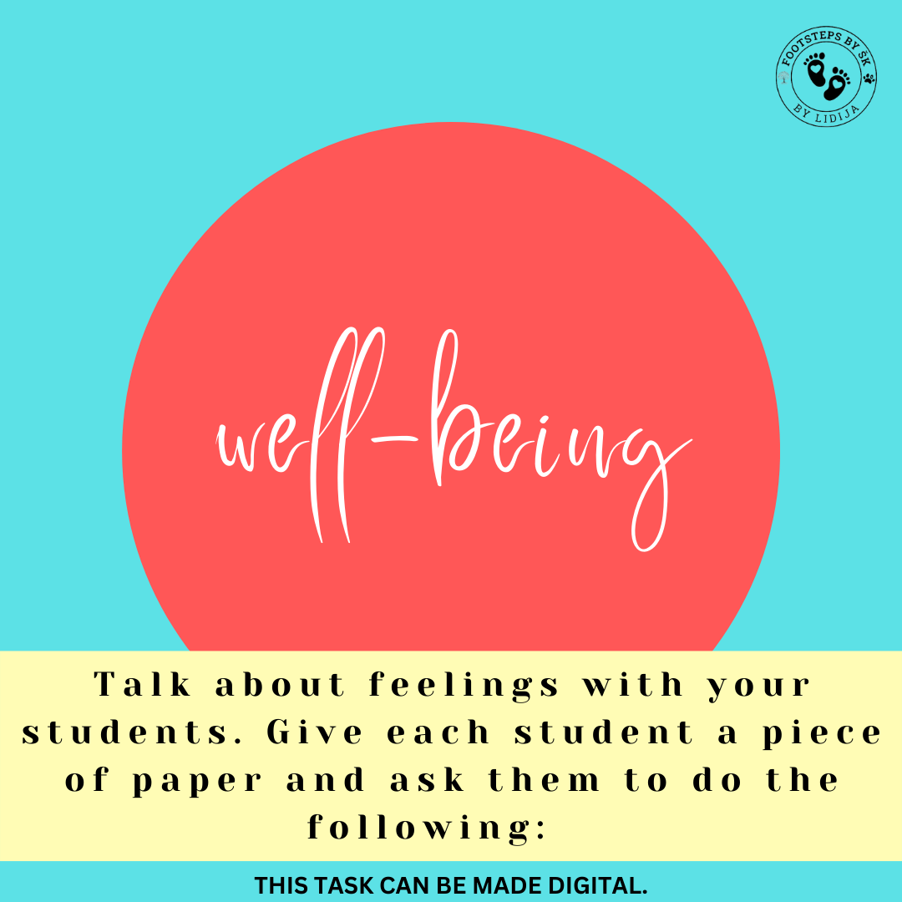
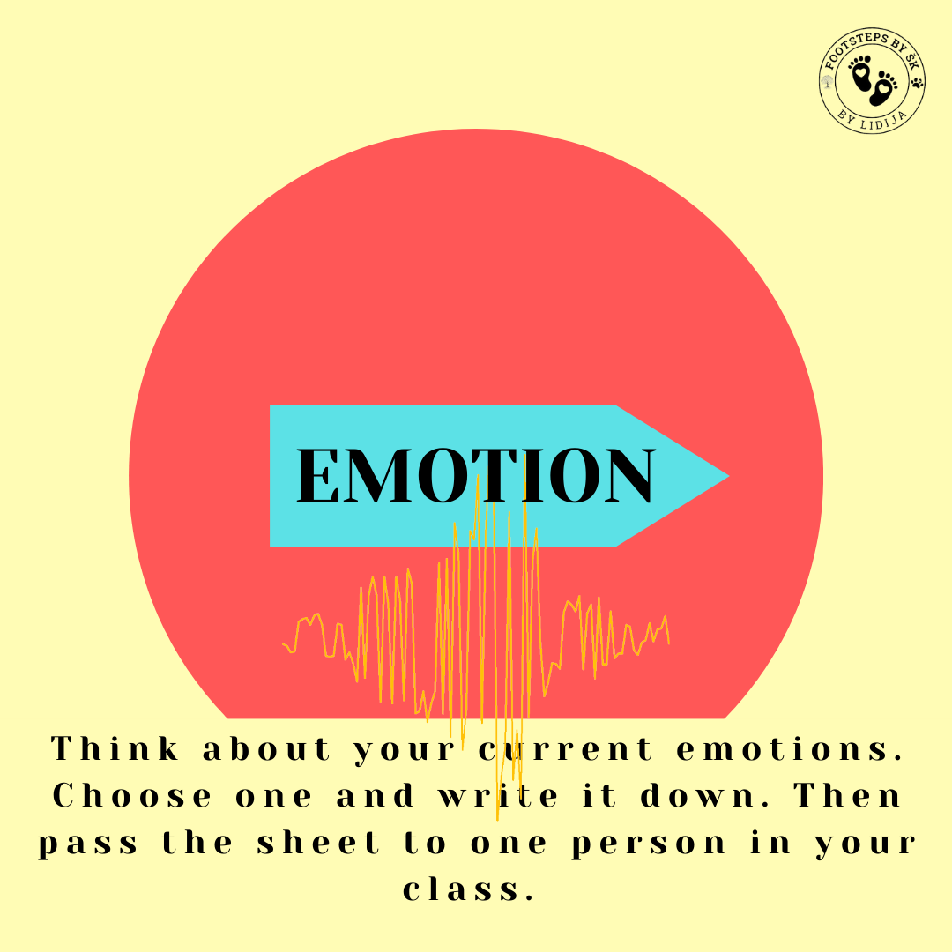

Slide 25
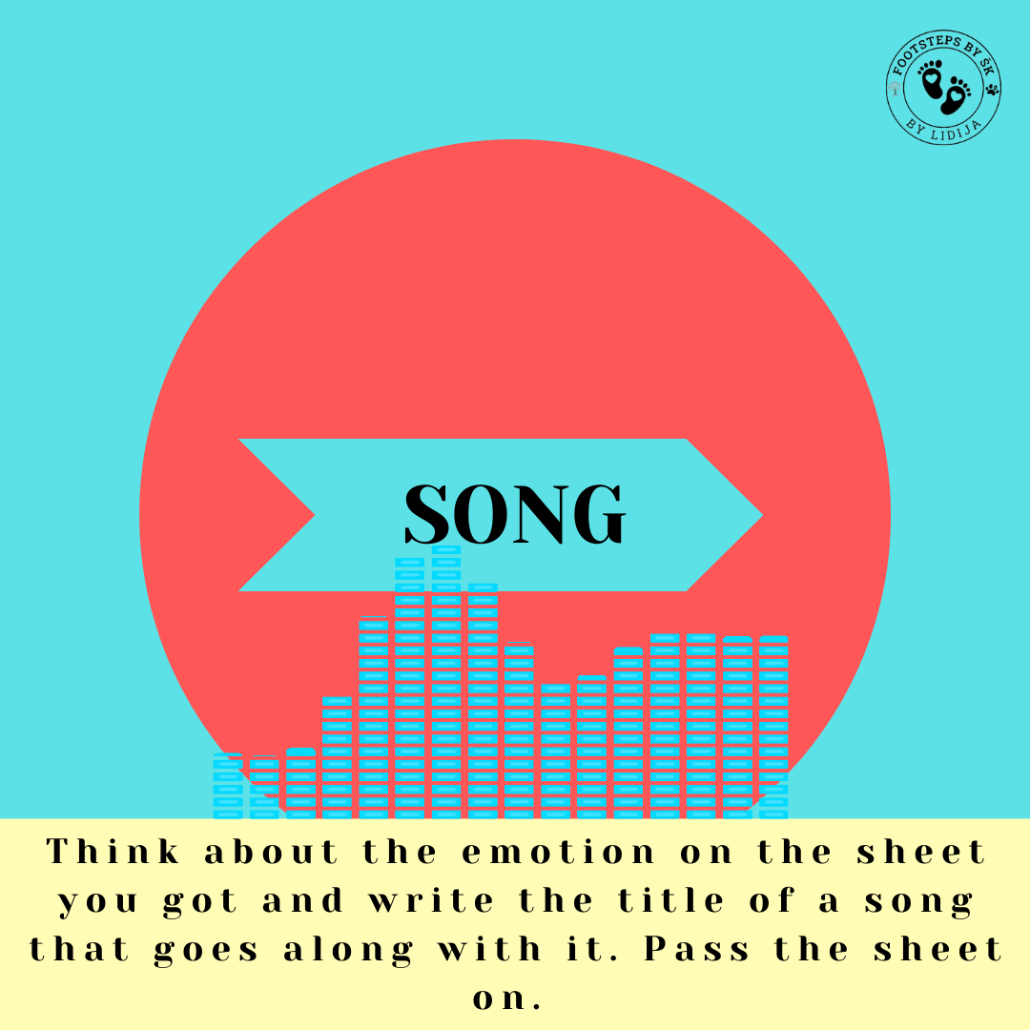
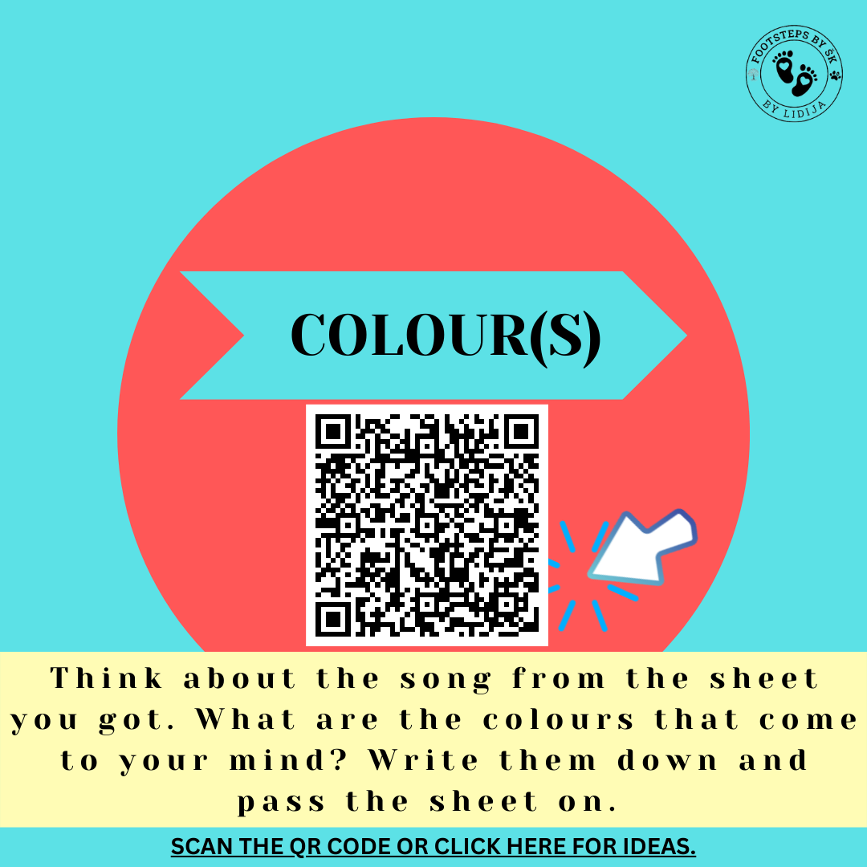

Slide 26
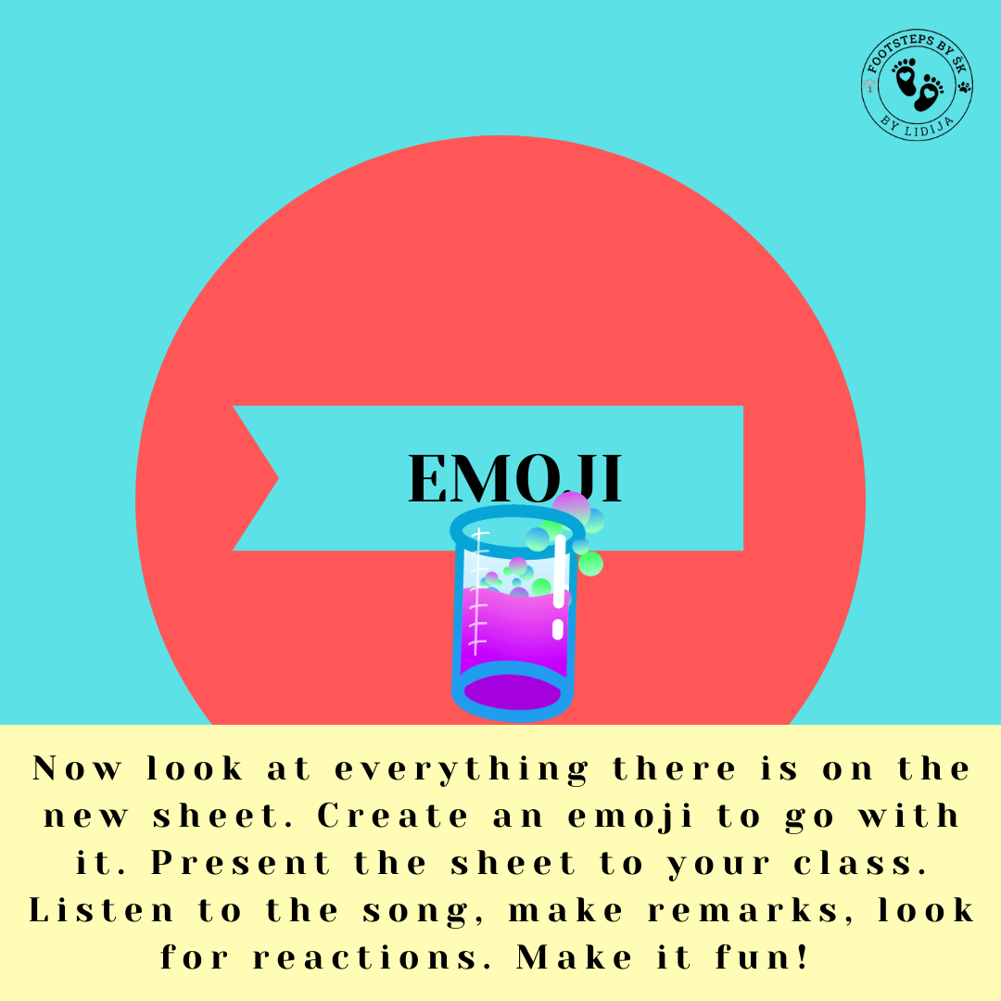

Slide 27
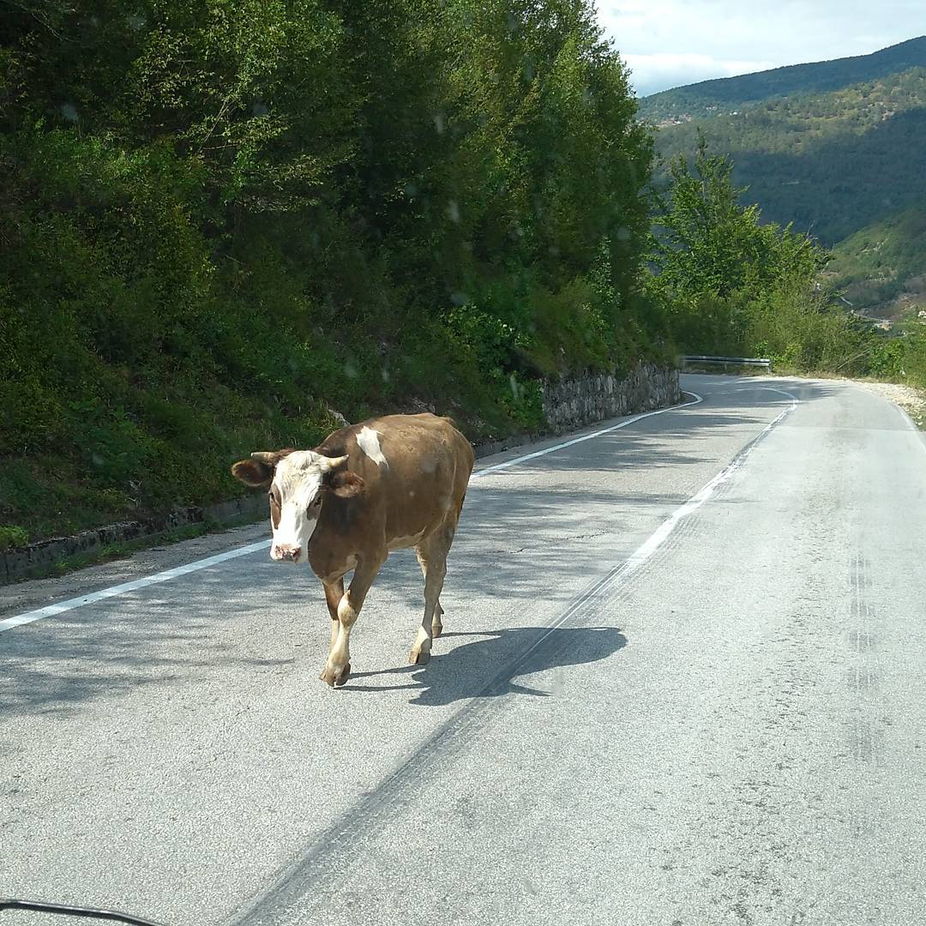
Digital media literacy
Clickbaits
Fake news
Deep fake videos
Media manipulations – numerous tricks by journalists, cameramen, editors

Slide 28
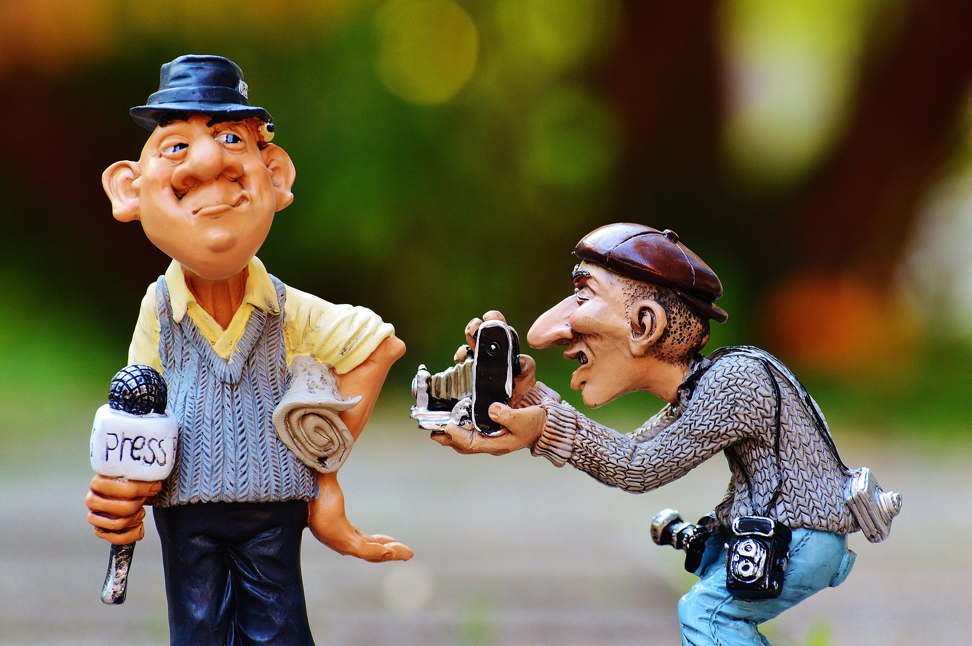
OLD MEDIA
printed press, TV, radio
editorial board
"About us"
contact
NEW MEDIA
Internet based, social media, websites, blogs, vlogs
no editorial board
no contact
revealing "secrets"

Slide 29
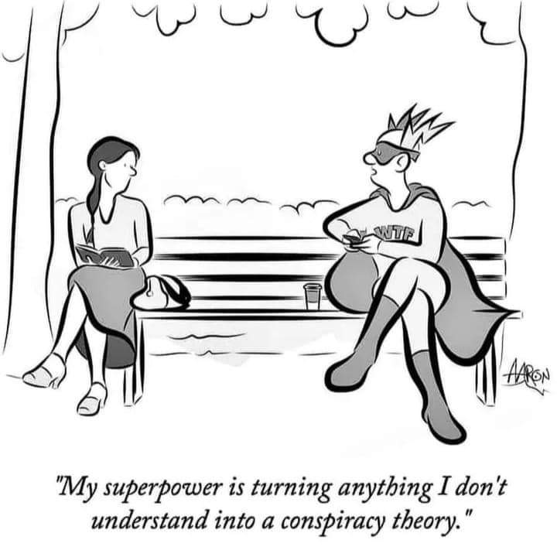
Conspiracy mind
contradictions
both a victim and a hero
doubt and scepticism
immune to proofs
hostile intentions
„no such thing as coincidence”
„there must be sth wrong”
https://www.medijskapismenost.hr/konspir-sedam-znacajki-zavjerenickog-razmisljanja/

Slide 30
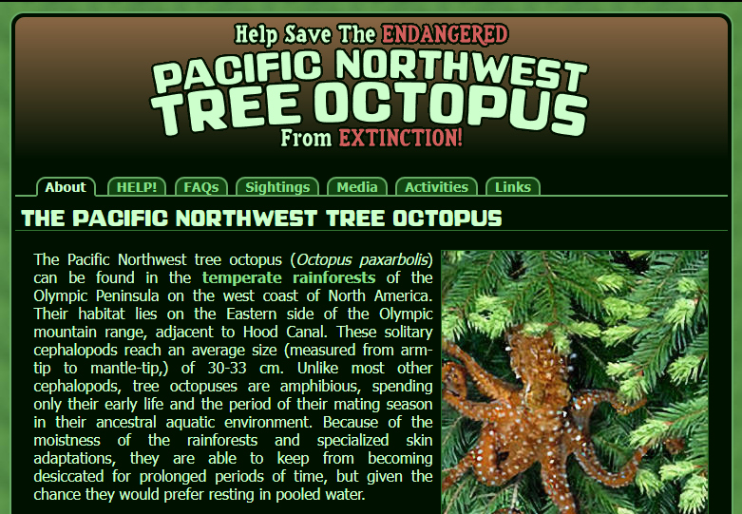
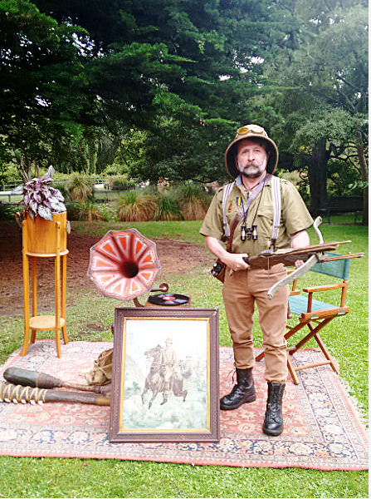
Fake news
Tree octopus hunt and other activities
https://zapatopi.net/treeoctopus/

Slide 31
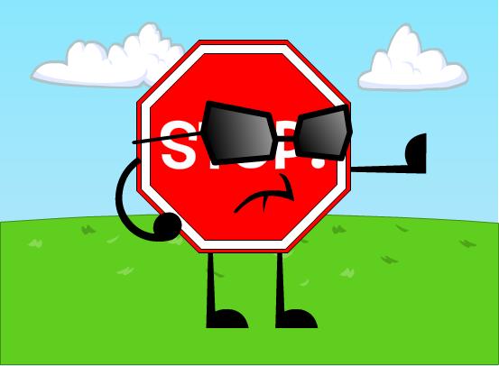

Is it authentic?
Have you heard of the website where the story appears?
Is there a clear About Us page with contact information available?
Does the story contain a clearly attributed source or sources?
Is the story being reported by other, reputable media outlets?
Does the story have significant misspellings and/or grammatical errors?
Does the story have a date on it?
Is there something odd about the url?
If there is a photo accompanying the story, is it credited to someone?
Is the story’s writer clearly identified with a byline and contact information?
Are official documents or specific citations in a story actually about the subject attributed to them?
Ta fotografija korisnika Nepoznat autor: licenca CC BY-NC

Slide 32
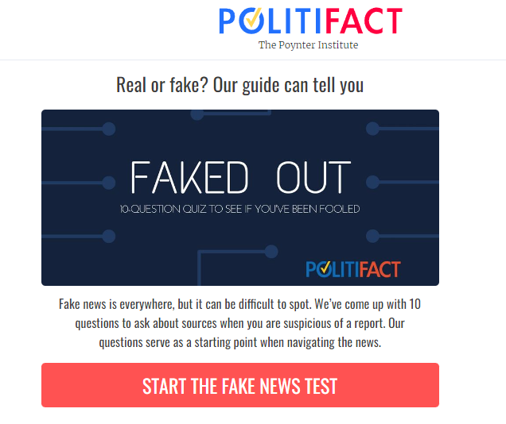
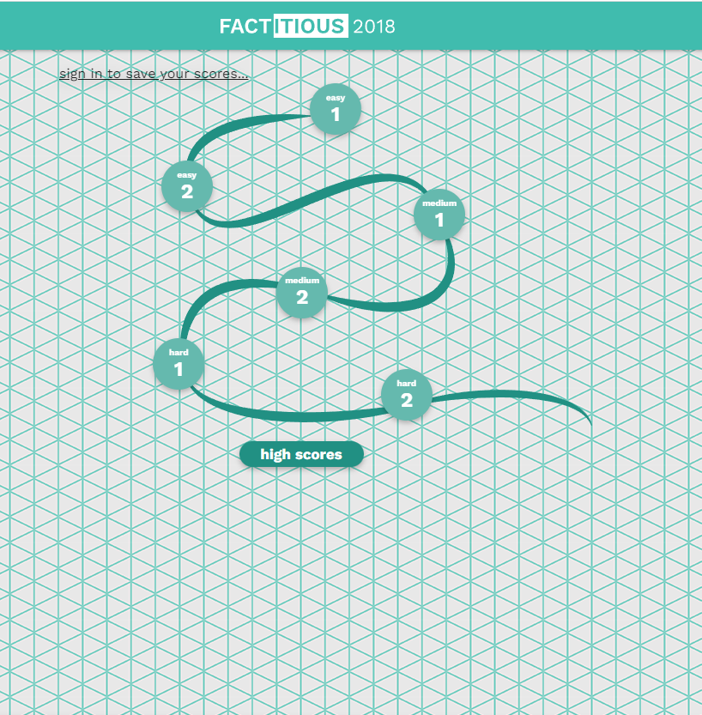
Fake news test
Factitious

Slide 33
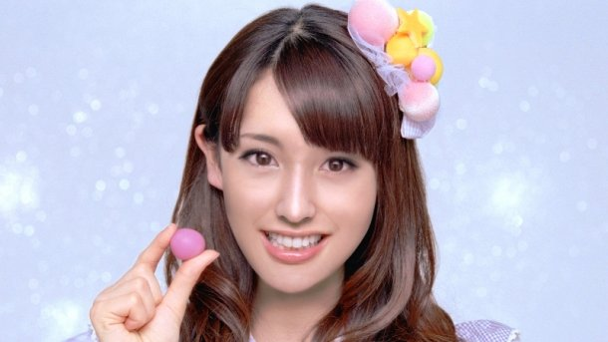
GCI
Aimi Eguchi
Ta fotografija korisnika Nepoznat autor: licenca CC BY-SA-NC

Slide 34
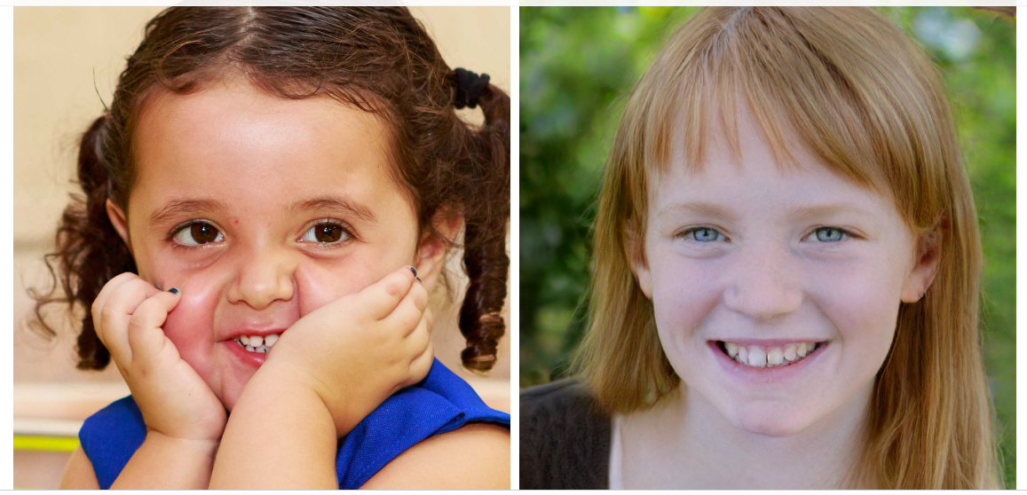
Which face is real?
Play it here!

Slide 35
Signs of computer-generated faces
Look for imperfections​, e.g. water splotches and asymmetries​
Glasses​, teeth, hair​, and backgrounds are all more difficult to render
Earrings, too, especially intricate ones​
If the person in the image is wearing intricate, identical earrings, it’s likely that person is real (Lytvynenko 2020)​

Slide 36
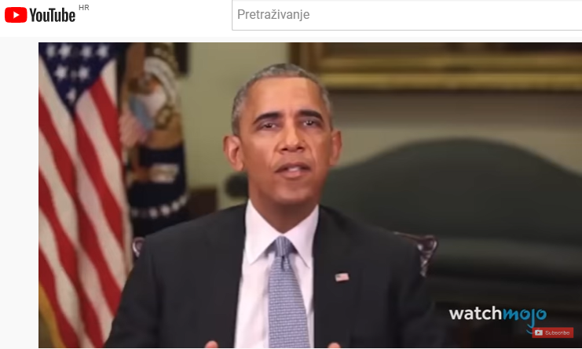
Deepfake videos

Slide 37
How to detect deepfake videos?
the picture and sound are not in perfect sync
the movement of the speaker's mouth is unnatural
unusual pixel patterns on the edges of objects or people
the speaker's face is unnaturally still
the subject does not blink at all or blinks unnaturally
the speaker's eyes are dull
(urbanlegends.hu)

Slide 38
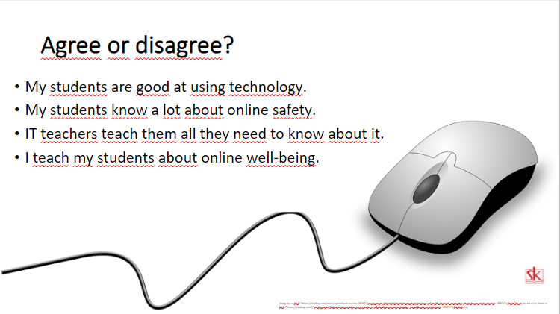
What can I do about it in my class?
Topic you would choose
Activity that comes to your mind

Slide 39


Thank you!!!
Poreč, 11 November, 2023
Lidija and Ivana

