Slide 1

3 Ways for Your Students to Go Green
30th HUPE Annual International Conference
November 11-13, 2022
Mirta Kos Kolobarić

Slide 2
01
Background
02
Activity 1 – Tiny houses
CONTENTS
03
Activity 2 - Biomimicry
04
Activity 3 – Do you care what you wear?
05
Reflection and discussion
06
Questions

Slide 3
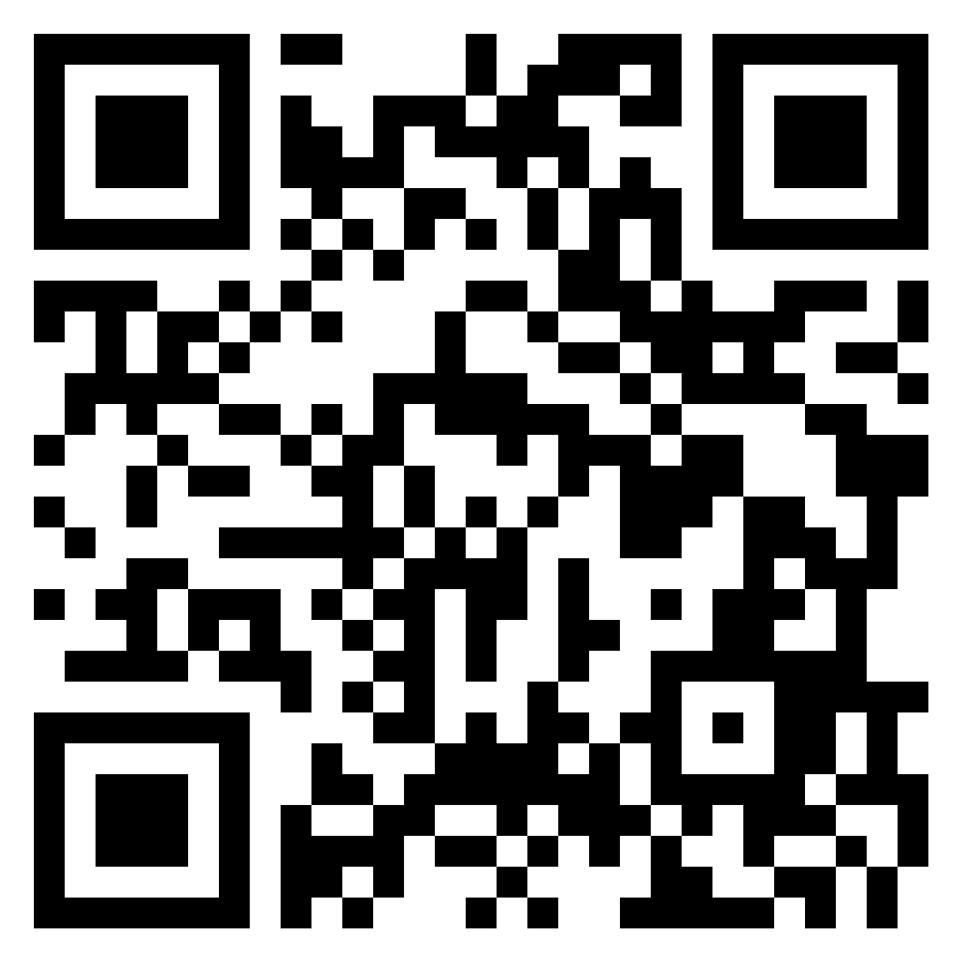
Padlet for today: https://padlet.com/mirtakk/1503po6x30qostat

Slide 4

01
BACKGROUND
OR
WHY TEACH ABOUT SUSTAINABILITY?

Slide 5


THE WAY WE LIVE
ACTION THEY CAN TAKE
Our students’ lifestyles
Do they think about their actions?
STUDENTS’ KNOWLEDGE
OF THE TOPIC
NOT ALONE
We all mutually dependent
Do they read about it?
GLOBAL ISSUES
SPEAK, SPEAK, SPEAK
Keeping up to date
Talk constantly about environmental issues

Slide 6
02
ACTIVITY 1
Tiny houses

Slide 7

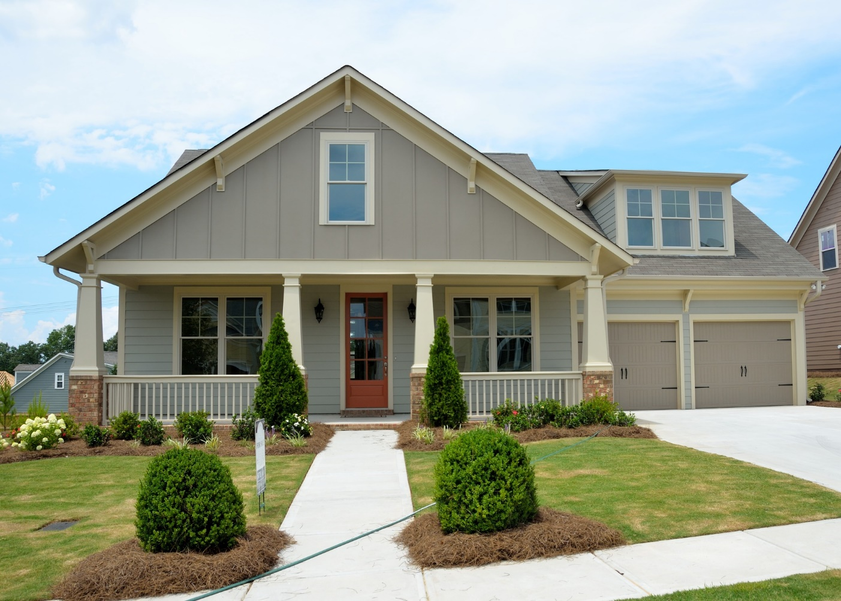
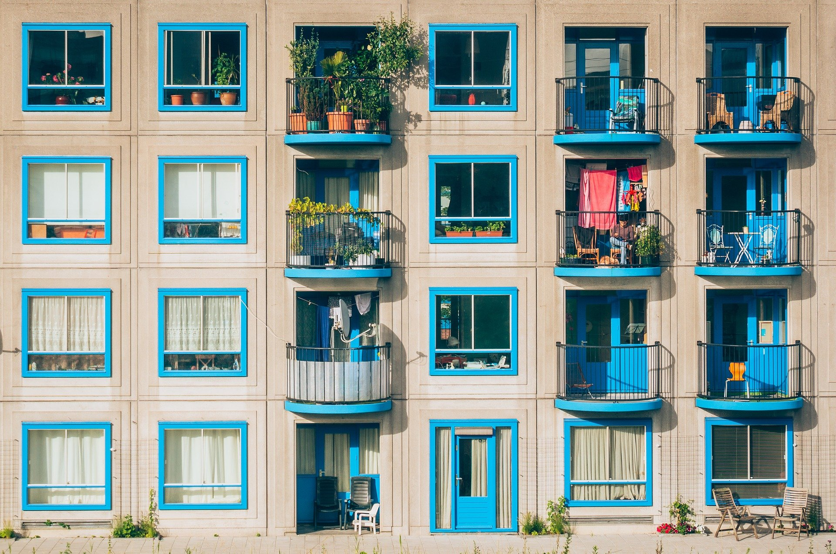
Which of these housing options would you choose – 1 or 2?
Why?
1
2

Slide 8
Which of these things would you consider luxuries, and which do you think are necessities (in your home)?
Your own room
A large wardrobe
Lots of clothes
Your own bathroom
Shoe storage
A shared room

Slide 9
Discussion questions for students
What would your ideal home look like?
How much space do you need?
Are you happy with the home you live in now?
How many things do you have?

Slide 10
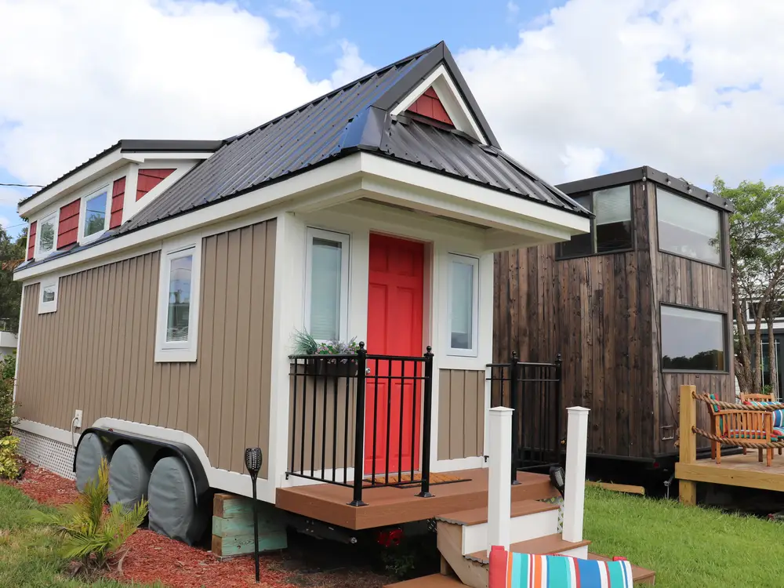
What about this? Could you live in one?
Could they be our future?
https://www.insider.com/things-you-didnt-know-tiny-houses-2019-9

Slide 11

TED talk and lesson

Slide 12

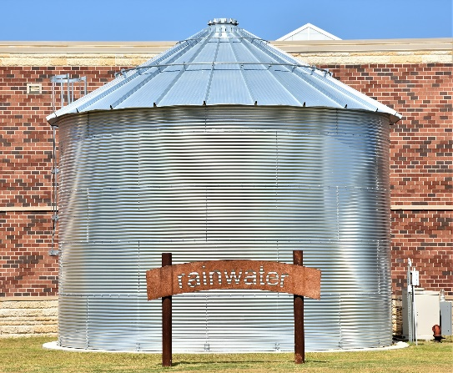
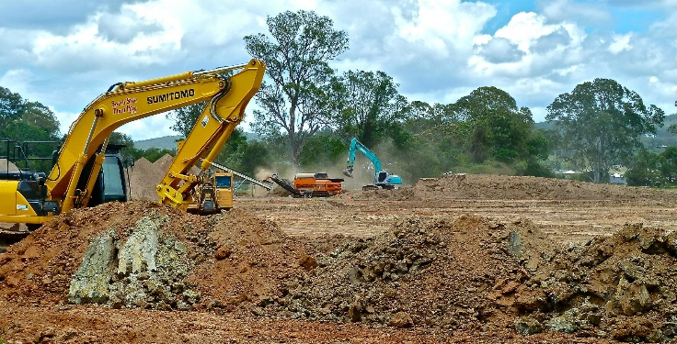
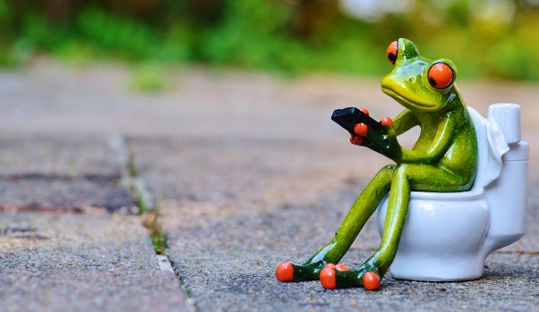
KEY POINTS FROM THE TED TALK:
ENERGY AND THE ENVIRONMENT
LAND
CLEARING
WASTE AND
RECYCLING
TARGET
POPULATION
FINANCES
FLEXIBILITY
Where are the new houses usually built?
- management - processing
- materials
- income
- mortgage
- lifestyle
- grid
- collection
- consumption
- saving
- house on wheels
- the elderly
- students
- live-in workers
- disaster relief housing

Slide 13
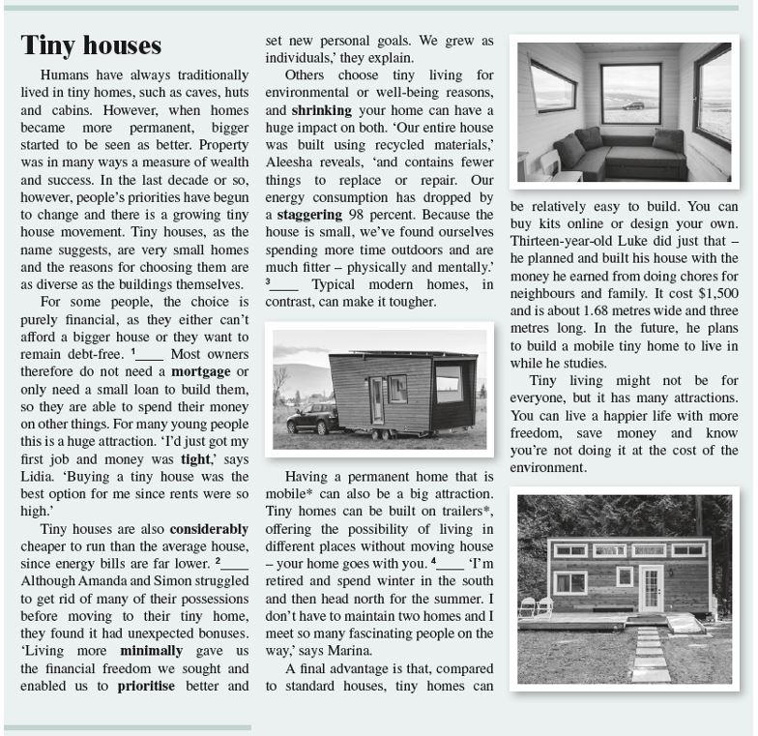
READING TASK:
Now that you have found out more about tiny homes, take a look at the text in your digital workbook (Focus 4, 2nd edition, by Pearson), Unit 3, Reading section, 3.4. Do the reading comprehension tasks (gap-filling, discussion).

Slide 14

A tiny house project – disaster relief housing
task-based learning

Slide 15
You own a small company which produces environmentally friendly housing - tiny homes. Originally, you designed these tiny homes as replacement for building expensive summer houses/cottages.
A few months ago, the terrible earthquake that hit Petrinja, Sisak and the surrounding places left many people homeless.
The Government of the Republic of Croatia has issued a public open tender and all Croatian companies are free to submit their bids. They are inviting companies (both big and small) to present their tiny homes in public presentations. Each company representative needs to bring a model/diorama of their tiny house, made of wooden sticks, cardboard, cardboard boxes, Lego bricks, etc. You have to be able to open one side of your house model so it is presented clearly to the audience.
They need ideas for tiny homes designed for different population categories:
Singles, small families, biger families with children, elderly people, live-in workers, university students.

Slide 16
Choose one of the above mentioned categories of population for which you can make a tiny home.
In your presentation you have to use the vocabulary to describe the interior of the house (words to describe the rooms and furniture), and vocabulary covered in Unit 3 in general. Mention the area of the tiny home (in square metres), where it can be placed and its environmentally friendly features (ecological footprint, ways of collecting energy, ways to process waste, waste management, water recycling, waste water management, water and electricity supply, composting toilets, recycled materials), etc.
Mention:
the type of the house – is it mobile (that is, a house on wheels, since sinkholes are opening in the ground)
the time do you need to make and install it
unit price
Also, make sure to include some environmentally friendly features in your tiny house!
IMPORTANT NOTE: Although the model of the house will not earn you many points, you must have it in order to get a passing grade, since IT IS the product you are presenting.

Slide 17
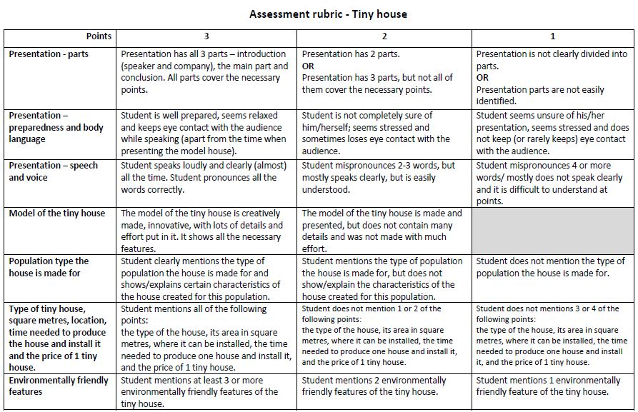
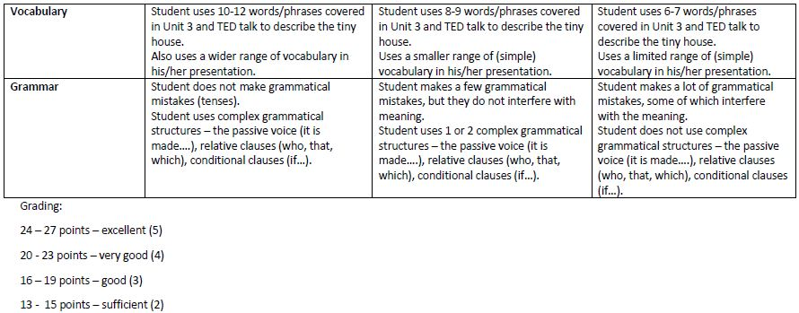

Slide 18
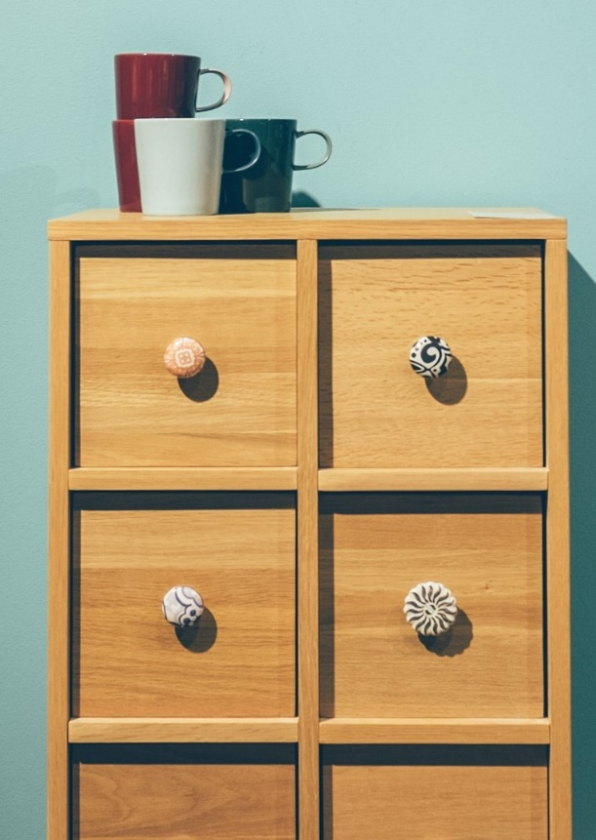
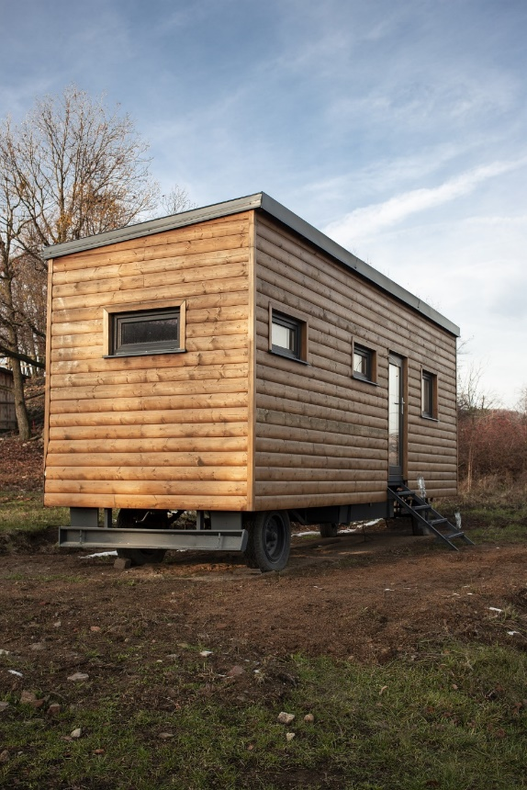
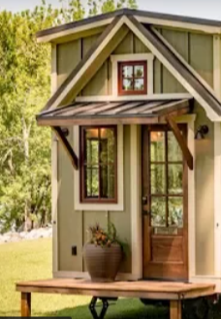
VOCABULARY – SOME HELPFUL RESOURCES
LINK
INSPIRATION
A BIT MORE

Slide 19
WRITING TASK - now that you have watched the TED talk and read the text on Tiny houses, think carefully about advantages and disadvantages of living in a tiny house. Make a list of the arguments and write a for-and-against essay with the following title:
Tiny houses may seem like a perfect housing solution for many young people, but for some of them they are not a desirable solution.
Additional tasks:
Wakelet collection
STUDENTS’ WORK

Slide 20
03
ACTIVITY 2
Biomimicry

Slide 21
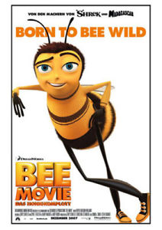
WATCH THE VIDEO CLIP.
WHAT DOES THE BEE WHO IS TALKING TO BARRY THINK WHEN HE SAYS:
‘’Think like a bee!”?
WHAT CAN WE LEARN FROM THE BEES?
LINK

Slide 22


Do your answers include:
TITLE HERE
Example 1
Example 2
cooperation
communication
hierarchy
protection of the species
working together for the common good
A complex idea can be conveyed with just a single still image, namely making it possible to absorb large amounts of data quickly.
A complex idea can be conveyed with just a single still image, namely making it possible to absorb large amounts of data quickly.

Slide 23
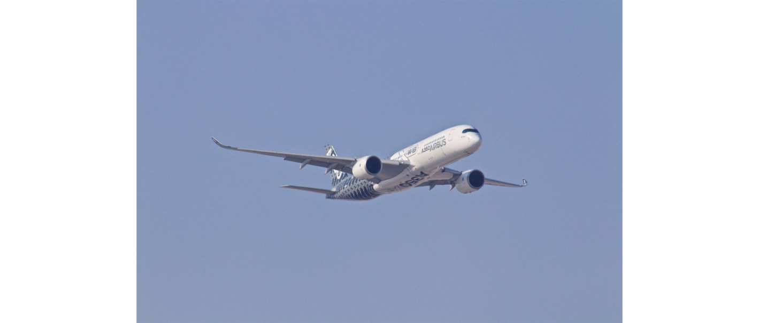
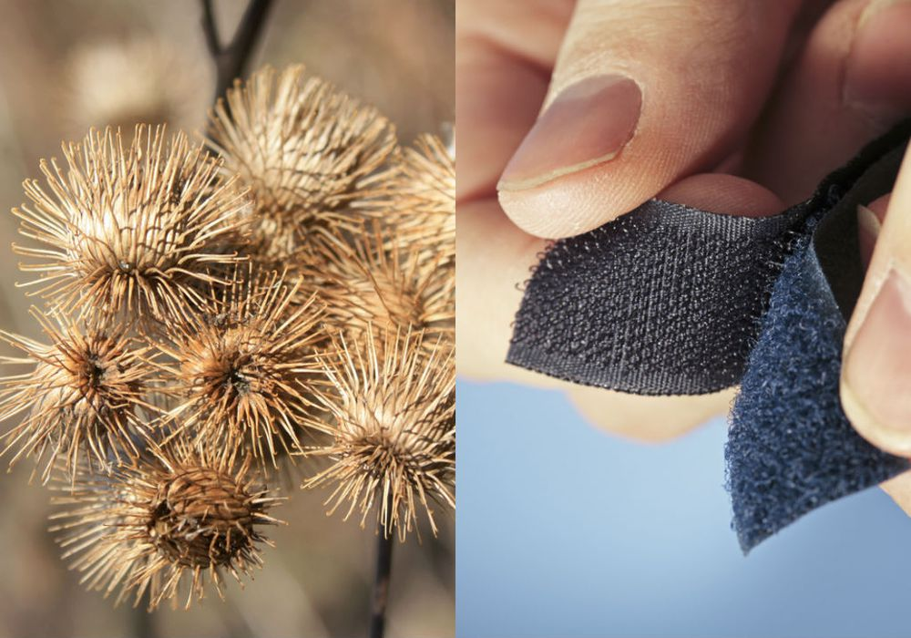
Can you think of any inventions we use in our everyday life that were created by imitating nature?
https://asknature.org/resource/hooked-on-you/

Slide 24
BIOMIMICRY
‘Biomimetics or biomimicry is the imitation of the models, systems, and elements of nature for the purpose of solving complex human problems.’ [Wikipedia]
Biomimicry in action, Janine Benyus

Slide 25
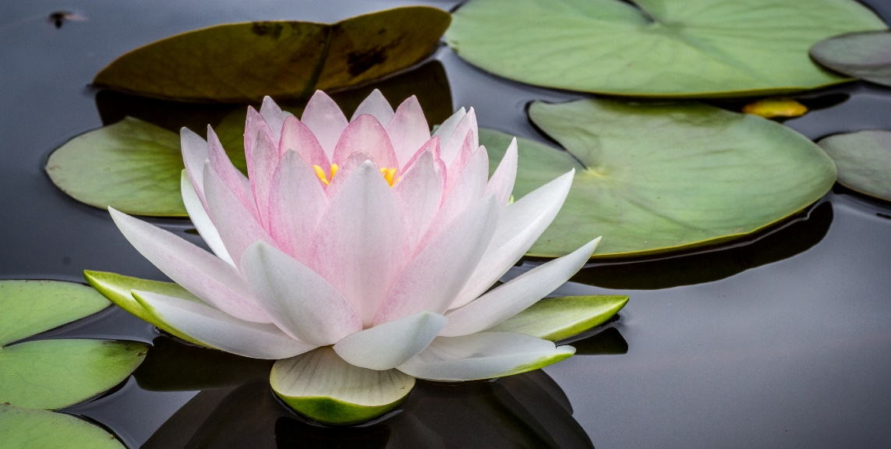
PROBLEM: Can we imitate nature in order to preserve it?
Its special feature – repels water and self-cleans
Application – car paints
Benefit – reduces need for frequent washing and detergents
Other benefits – facade paints
Take a look at the lotus leaf.
Have you ever seen a dirty one?
video

Slide 26
Problem-solving task for students … and for YOU
- A Jigsaw Activity
Work in groups of 5 students.
Each group member chooses 1 animal.
Google it by typing in, for example, lotus biomimicry.
Read about your chosen topic and make notes.
Form EXPERT GROUPS - students who have chosen the same topic compare notes.
Think of other possible applications of that particular feature.
Explain how they support sustainability/quality of life.

Slide 27
Problem-solving task for students … and for YOU
- A Jigsaw Activity
Go back to your HOME GROUP.
Share your examples of biomimicry.
Each group decides on the most useful example of biomimicry.
Provide arguments for your choice.

Slide 28
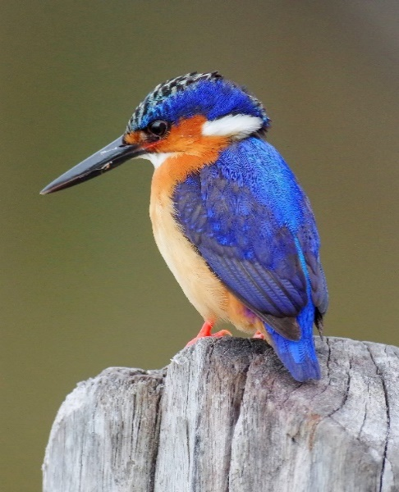
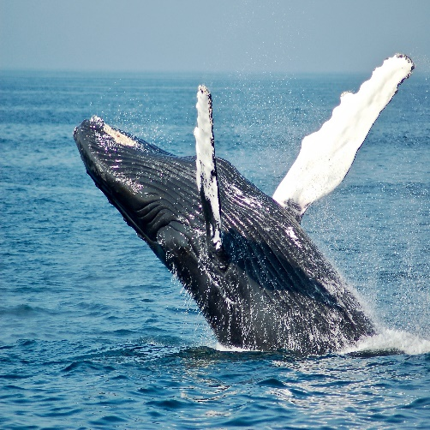
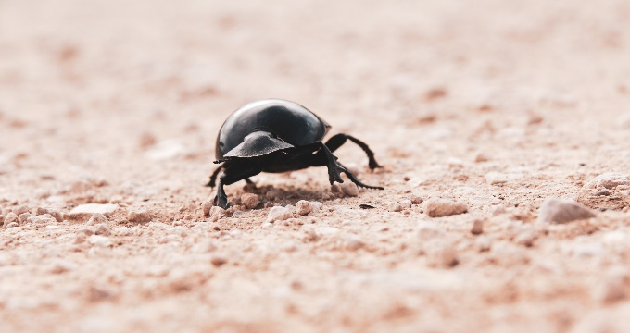
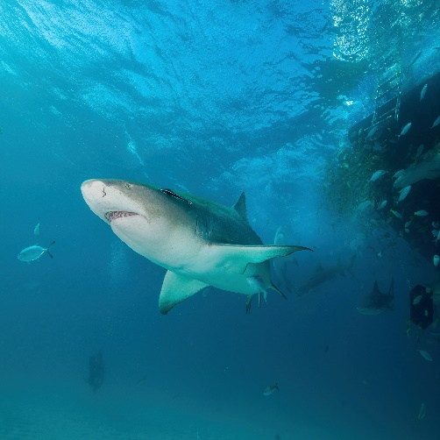
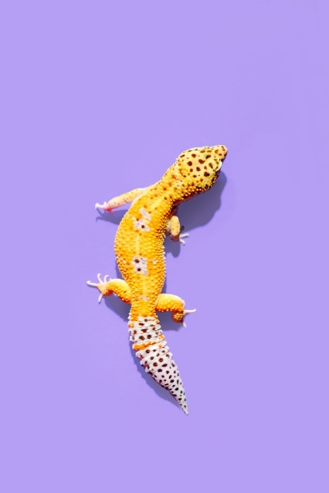
Choose one of the following animals/insects
SHARK
HUMPBACK
WHALE
GECKO
NAMIBIAN
BEETLE
KINGFISHER
YT: 3 cool materials that mimic shark skin

Slide 29
Problem-solving task for students … and for YOU
You should include the following in your answer:
the name of the animal
its special feature
Where can it be applied?
How does it promote sustainability?
Can you think of some other applications?
go back to your group, talk about your example, listen to others
as a group, decide on the most useful example.

Slide 30
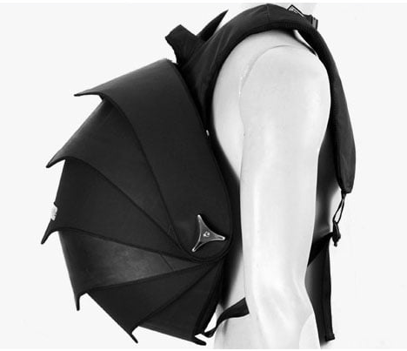
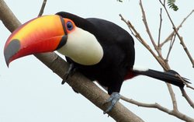

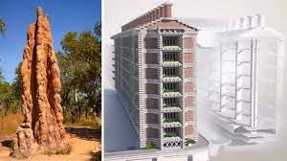
Other examples

Slide 31
04
ACTIVITY 3
Do you care what you wear?

Slide 32
An eTwinning project (whole class)
during regular English lessons (4 per week)
relevant topic
collaboration with foreign students
Genially presentation

Slide 33
Students’ videos
Formal jacket
Converse

Slide 34
05
Reflection and discussion

Slide 35
Students impressions – Tiny houses
General interest
Few would accept that kind of life
Not thrilled with the practical task (but did find purpose in it later – investigated space-saving furniture, watched videos about tiny houses, were exposed to English)
Presentations – students were more relaxed, audience focused on the product, not on them

Slide 36
Students impressions – Biomimicry
Highly interested
Had to go through various pages on Google to find the necessary information
CLIL – they combined the content with that of other subjects
Decisions on the usefuleness of biomimicry examples – lively discussion

Slide 37
Students impressions – Do you care what you wear?
Interested in the topic
Acquired new consumer habits
Encouraged to think about their purchases
National quality label

Slide 38
General
Making your work publicly known
European Sustainable Development Week
School web page
DTG competition; European Sustainable Development Week 2022; School web page

Slide 39
06
Questions and evaluation - Padlet

Slide 40
Links to ready-made lesson plans:
Biomimicry
https://padlet.com/mirtakk/1503po6x30qostat/wish/2364569747
https://express.adobe.com/page/37KzFYDdysgmb/
Do you care what you wear?
https://view.genial.ly/62a732642efcfe0017509ed3/presentation-do-you-care-what-you-wear
Tiny houses
https://express.adobe.com/page/aSgFDOUExLjSA/

Slide 41
THANK YOU!
mirtakk@gmail.com
Natural Leaves Powerpoint Template
www.freepptbackgrounds.net

