Slide 1



Slide 2

Adapt Escape Room Ideas for your Teaching Context
HUPE 2022, Poreč
Branka Katalinić

Slide 3
Escape room
adventure
teamwork
time limit
clues

Slide 4

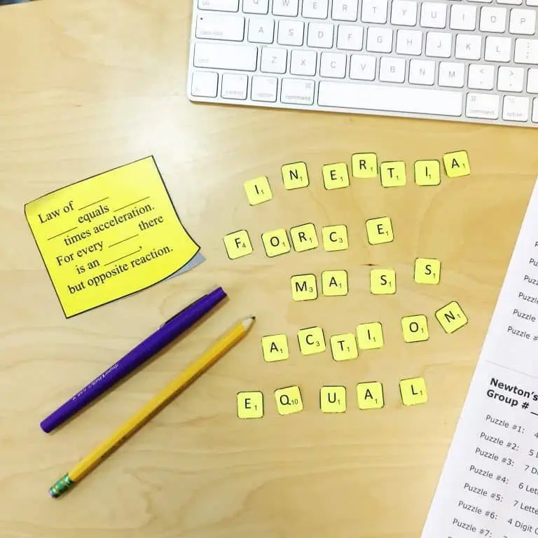

background story
puzzles and coded messages

Slide 5
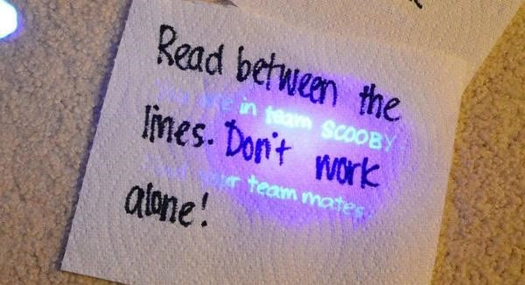

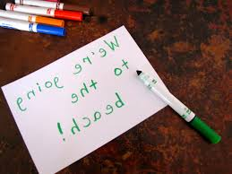
game design

Slide 6

It tells time day and night
If you see double it’s just alright

Slide 7
ESCAPE THE MAZE
prepositions of movement

Slide 8

.
It’s night. When you open your eyes you find yourself in the middle of a maze. Last thing you remember is the news about the Minotaur going on his regular medical check-up. You know that he always returns at dawn.
As it is nearly dawn, you have only a little time to escape from his habitat.

Slide 9
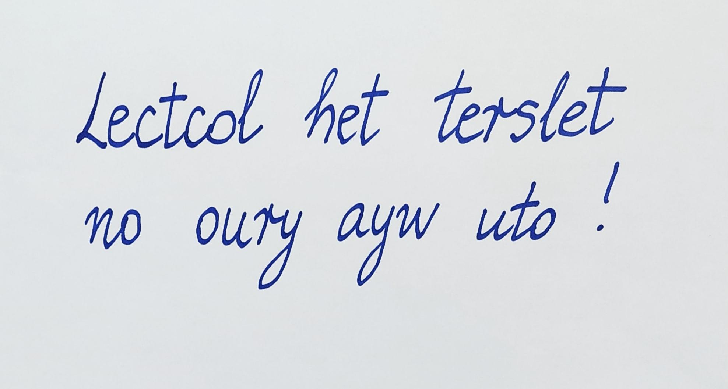
You look around and find a torch and hedge shears.
Then you spot a piece of paper. It says:

Slide 10
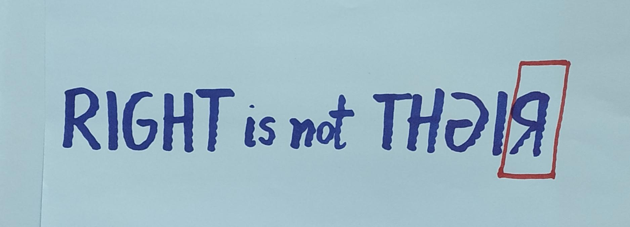
Up on the hedge you see the sign:
Which way would you turn: left or right?

Slide 11
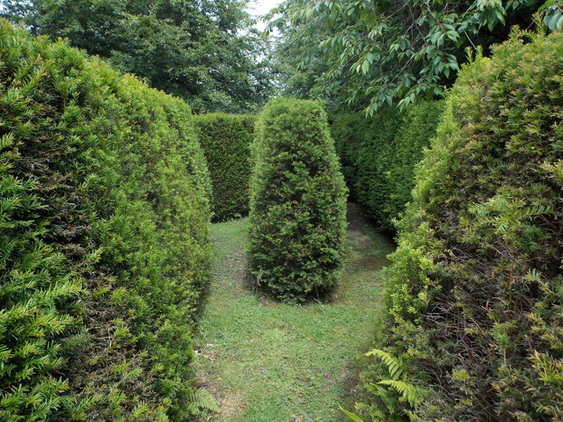
You walk along the path and then it splits into two pathways.

Slide 12
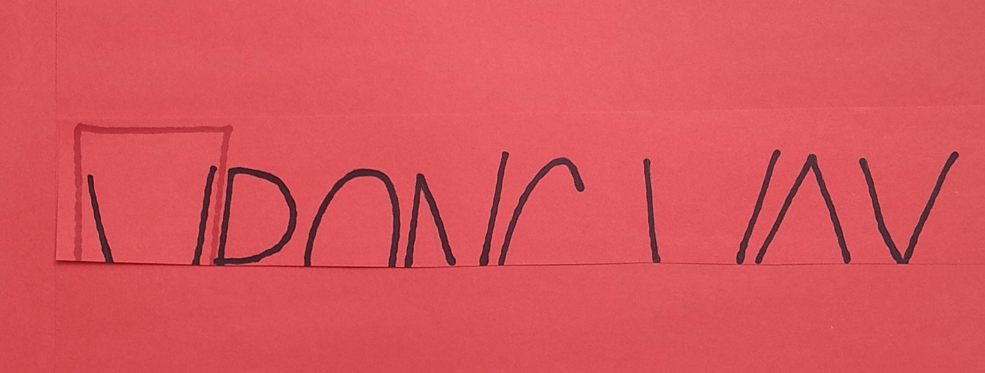
On the left there is a notice

Slide 13
You move on and you notice a big X in the hedge and a paper attached
CUT THE HOL_ AND
GO _ _ _ _ _ _ _ THE HEDGE !

Slide 14
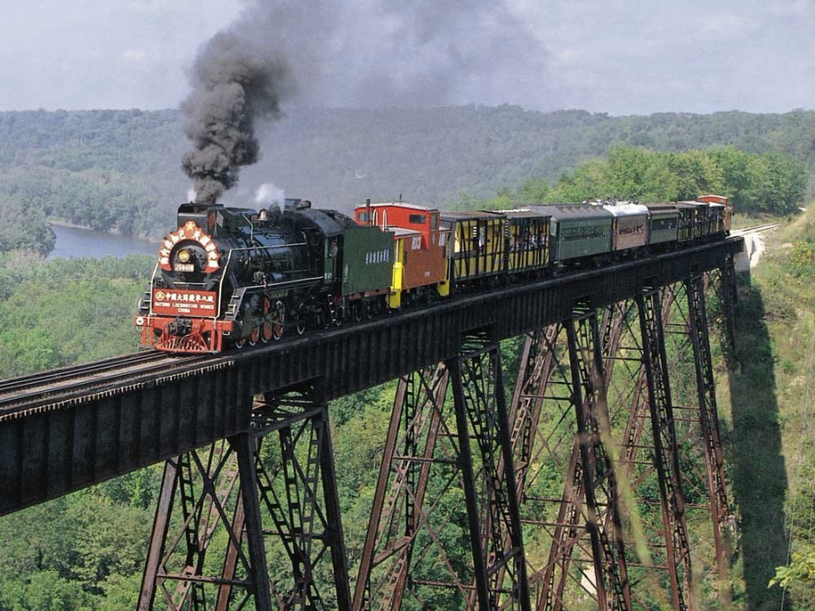
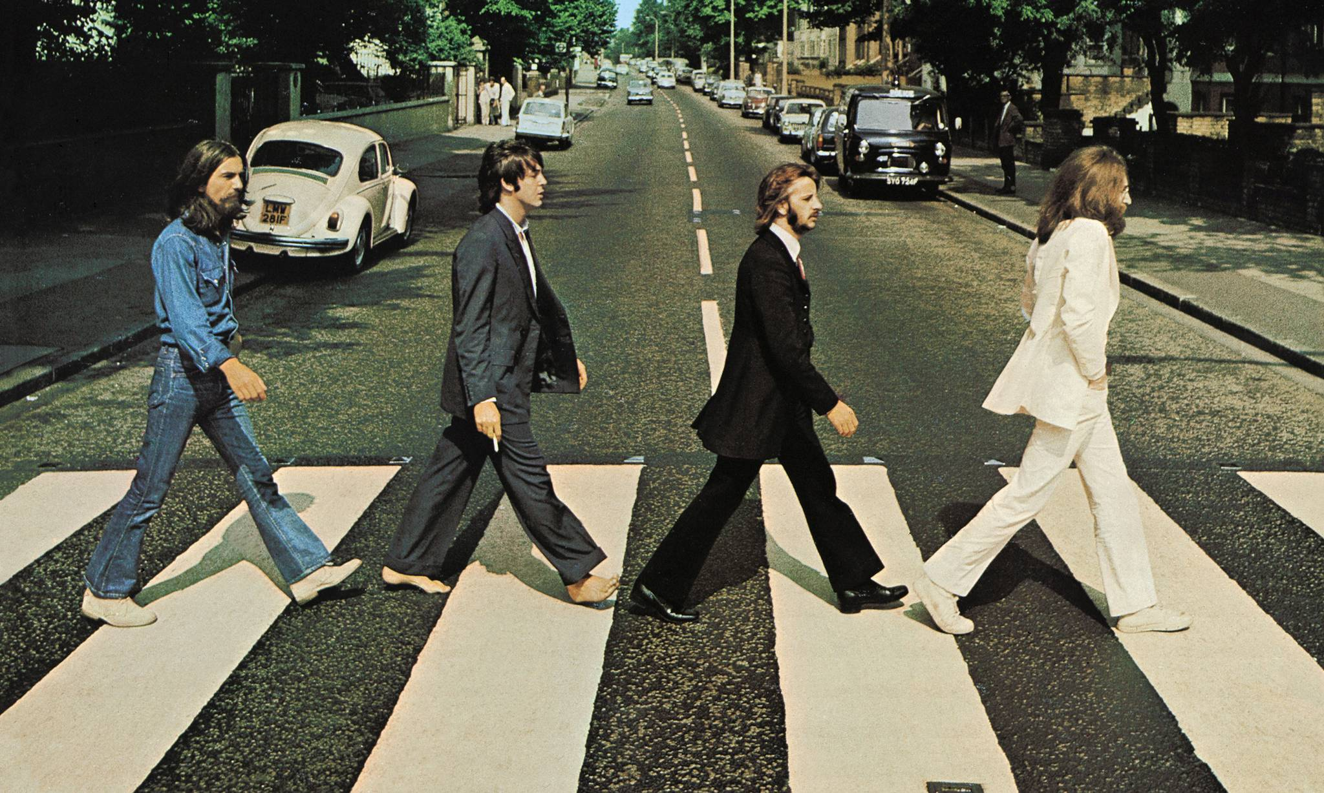
On the other side you find two photos
They are walking _ _ _ _ _ _ the road. The train is going _ _ _ _ the bridge.

Slide 15

You continue walking and suddenly
a dead end

Slide 16
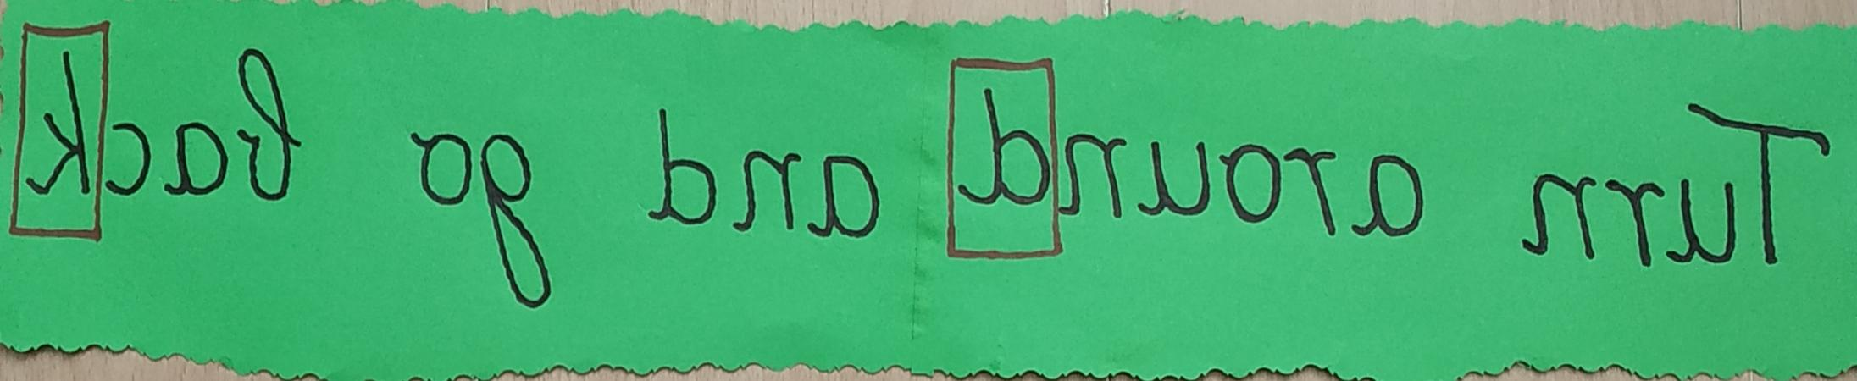
A big sign says:

Slide 17

You spot a ladder with a note
BMILC _ _ !

Slide 18

You look around. You see that the gate is near. You start hearing a strange
sound. Is it someone’s voice? Is it human or not?
You cross over and follow the sign
GO _ _ _ _ _ _ _ _ AHEAD!

Slide 19
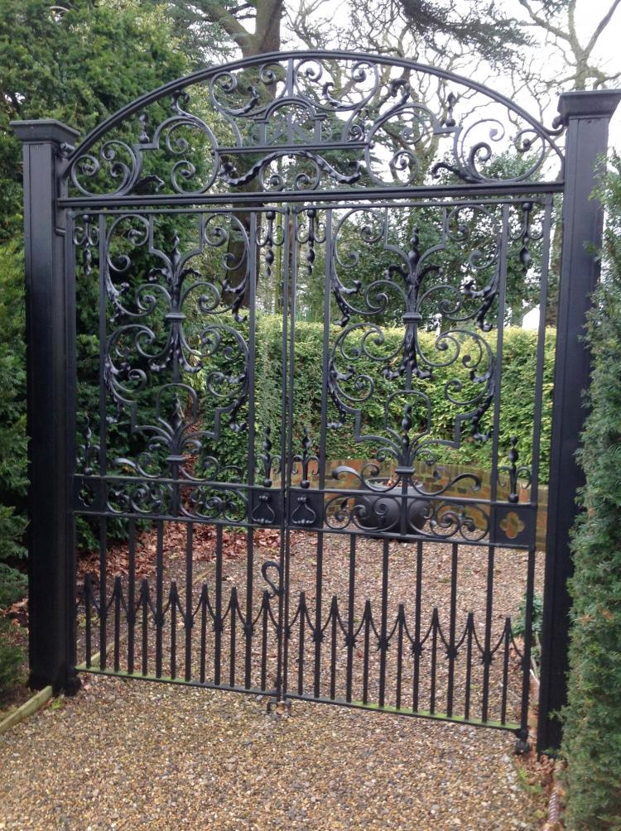
You are at the gate.
The sound is getting louder and louder.
You can clearly hear the familiar voice saying:
__ __ __ __ __ __ __ __ __ __ !

Slide 20
Wake up dear!
WELL DONE !
YOU HAVE ESCAPED
FROM A NIGHTMARE!

Slide 21
Escape the Maze – follow-up
speaking & writing
pair work
pick a sentence and write a coded message
give it to your classmate to read
find an image and say a sentence – use a preposition of movement

Slide 22
write a short lead-in story
what vocabulary & grammar structures to revise

Slide 23
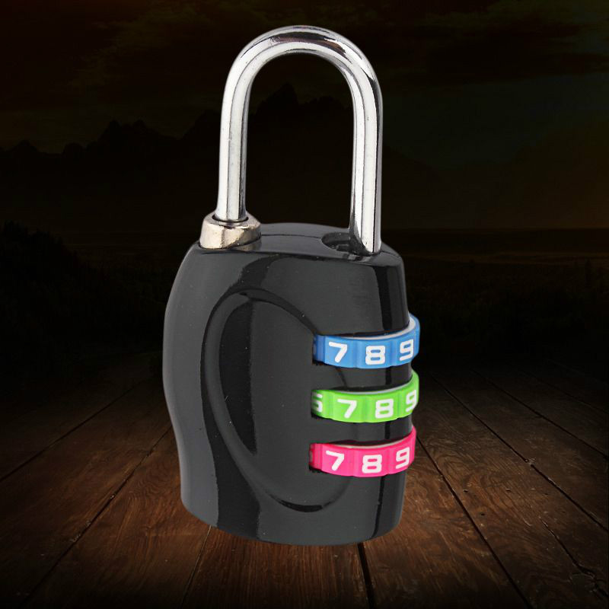
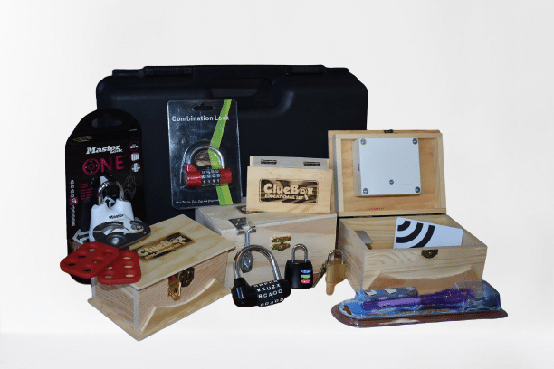
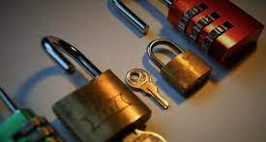

THEFT AT GRAND HOTEL
Live Escape Room

Slide 24
food vocabulary (menu, recipe)
everyday English (checking into a hotel)

Slide 25
Lead-in story
A diamond necklace was stolen during the banquet celebrating the 10th anniversary of the hotel.
Police suspect one of the guests is the thief.

Slide 26
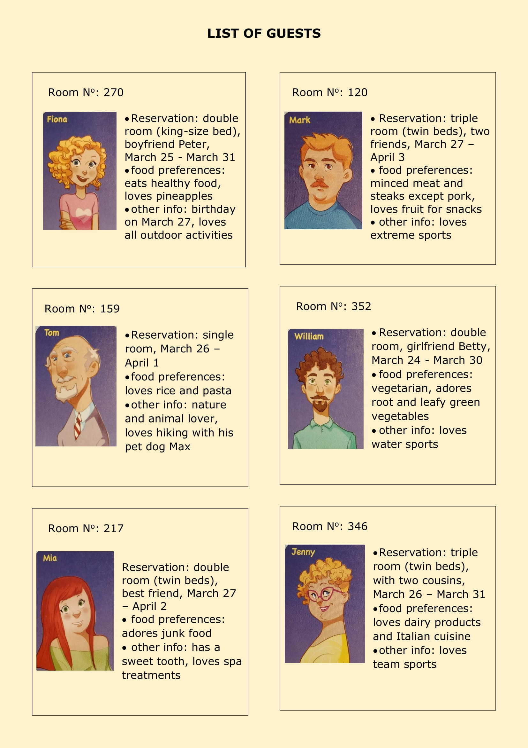
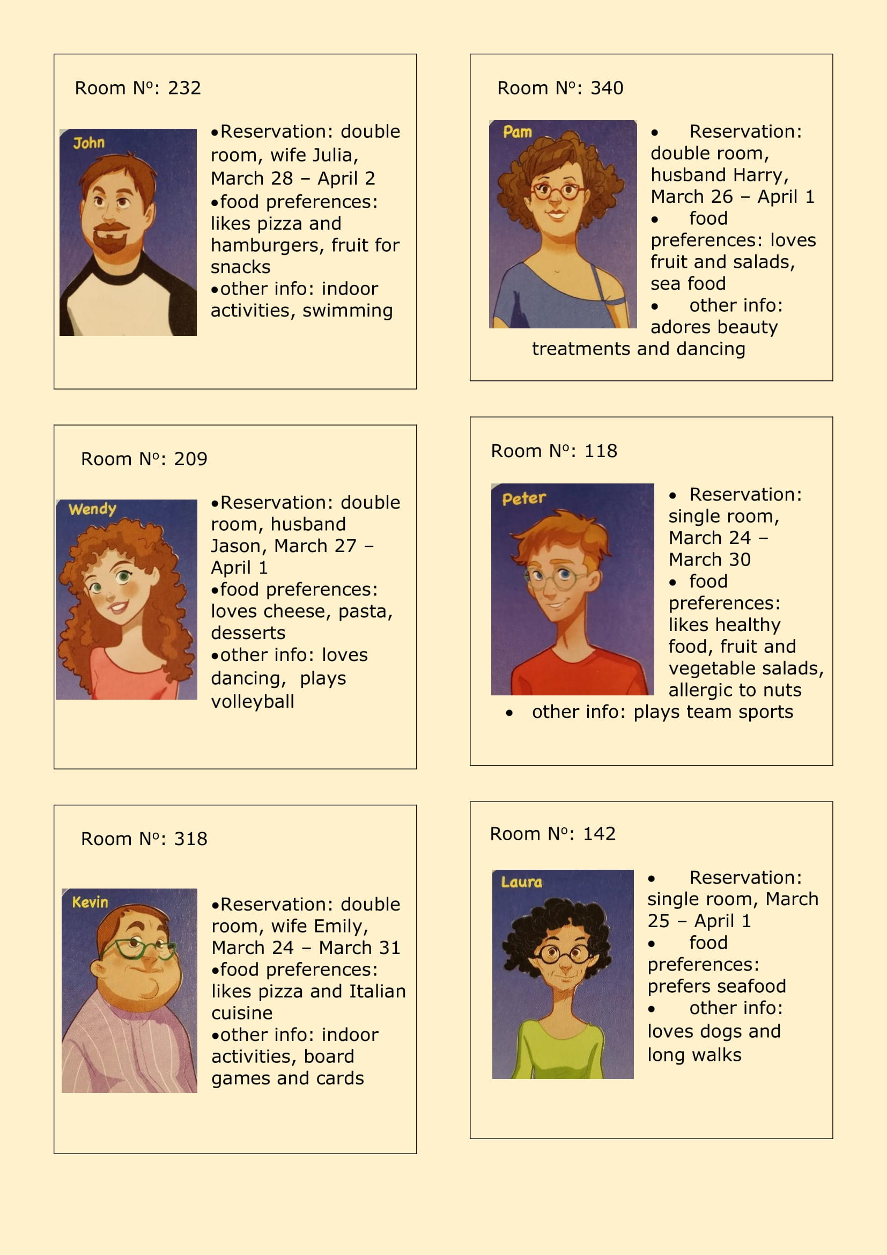
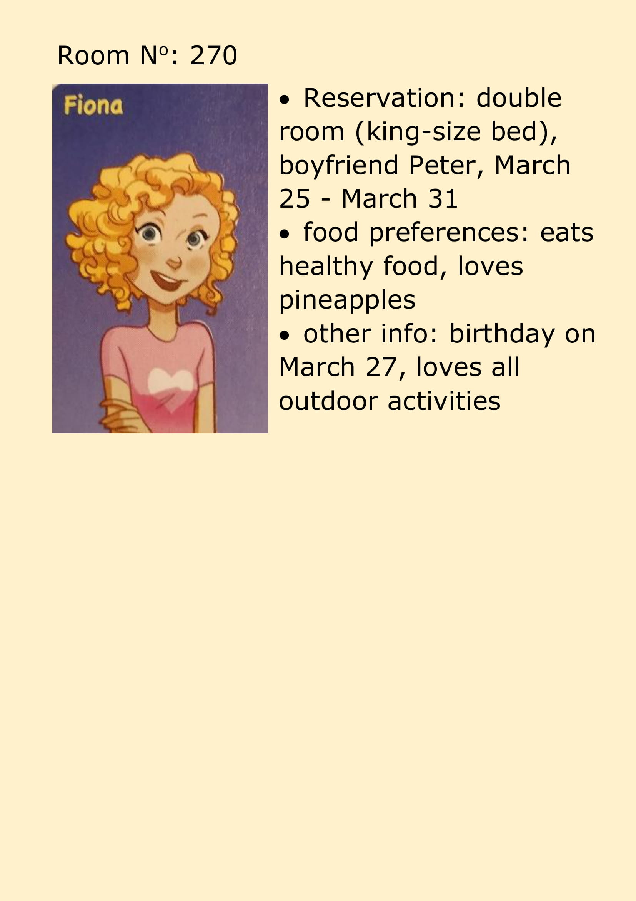

Slide 27
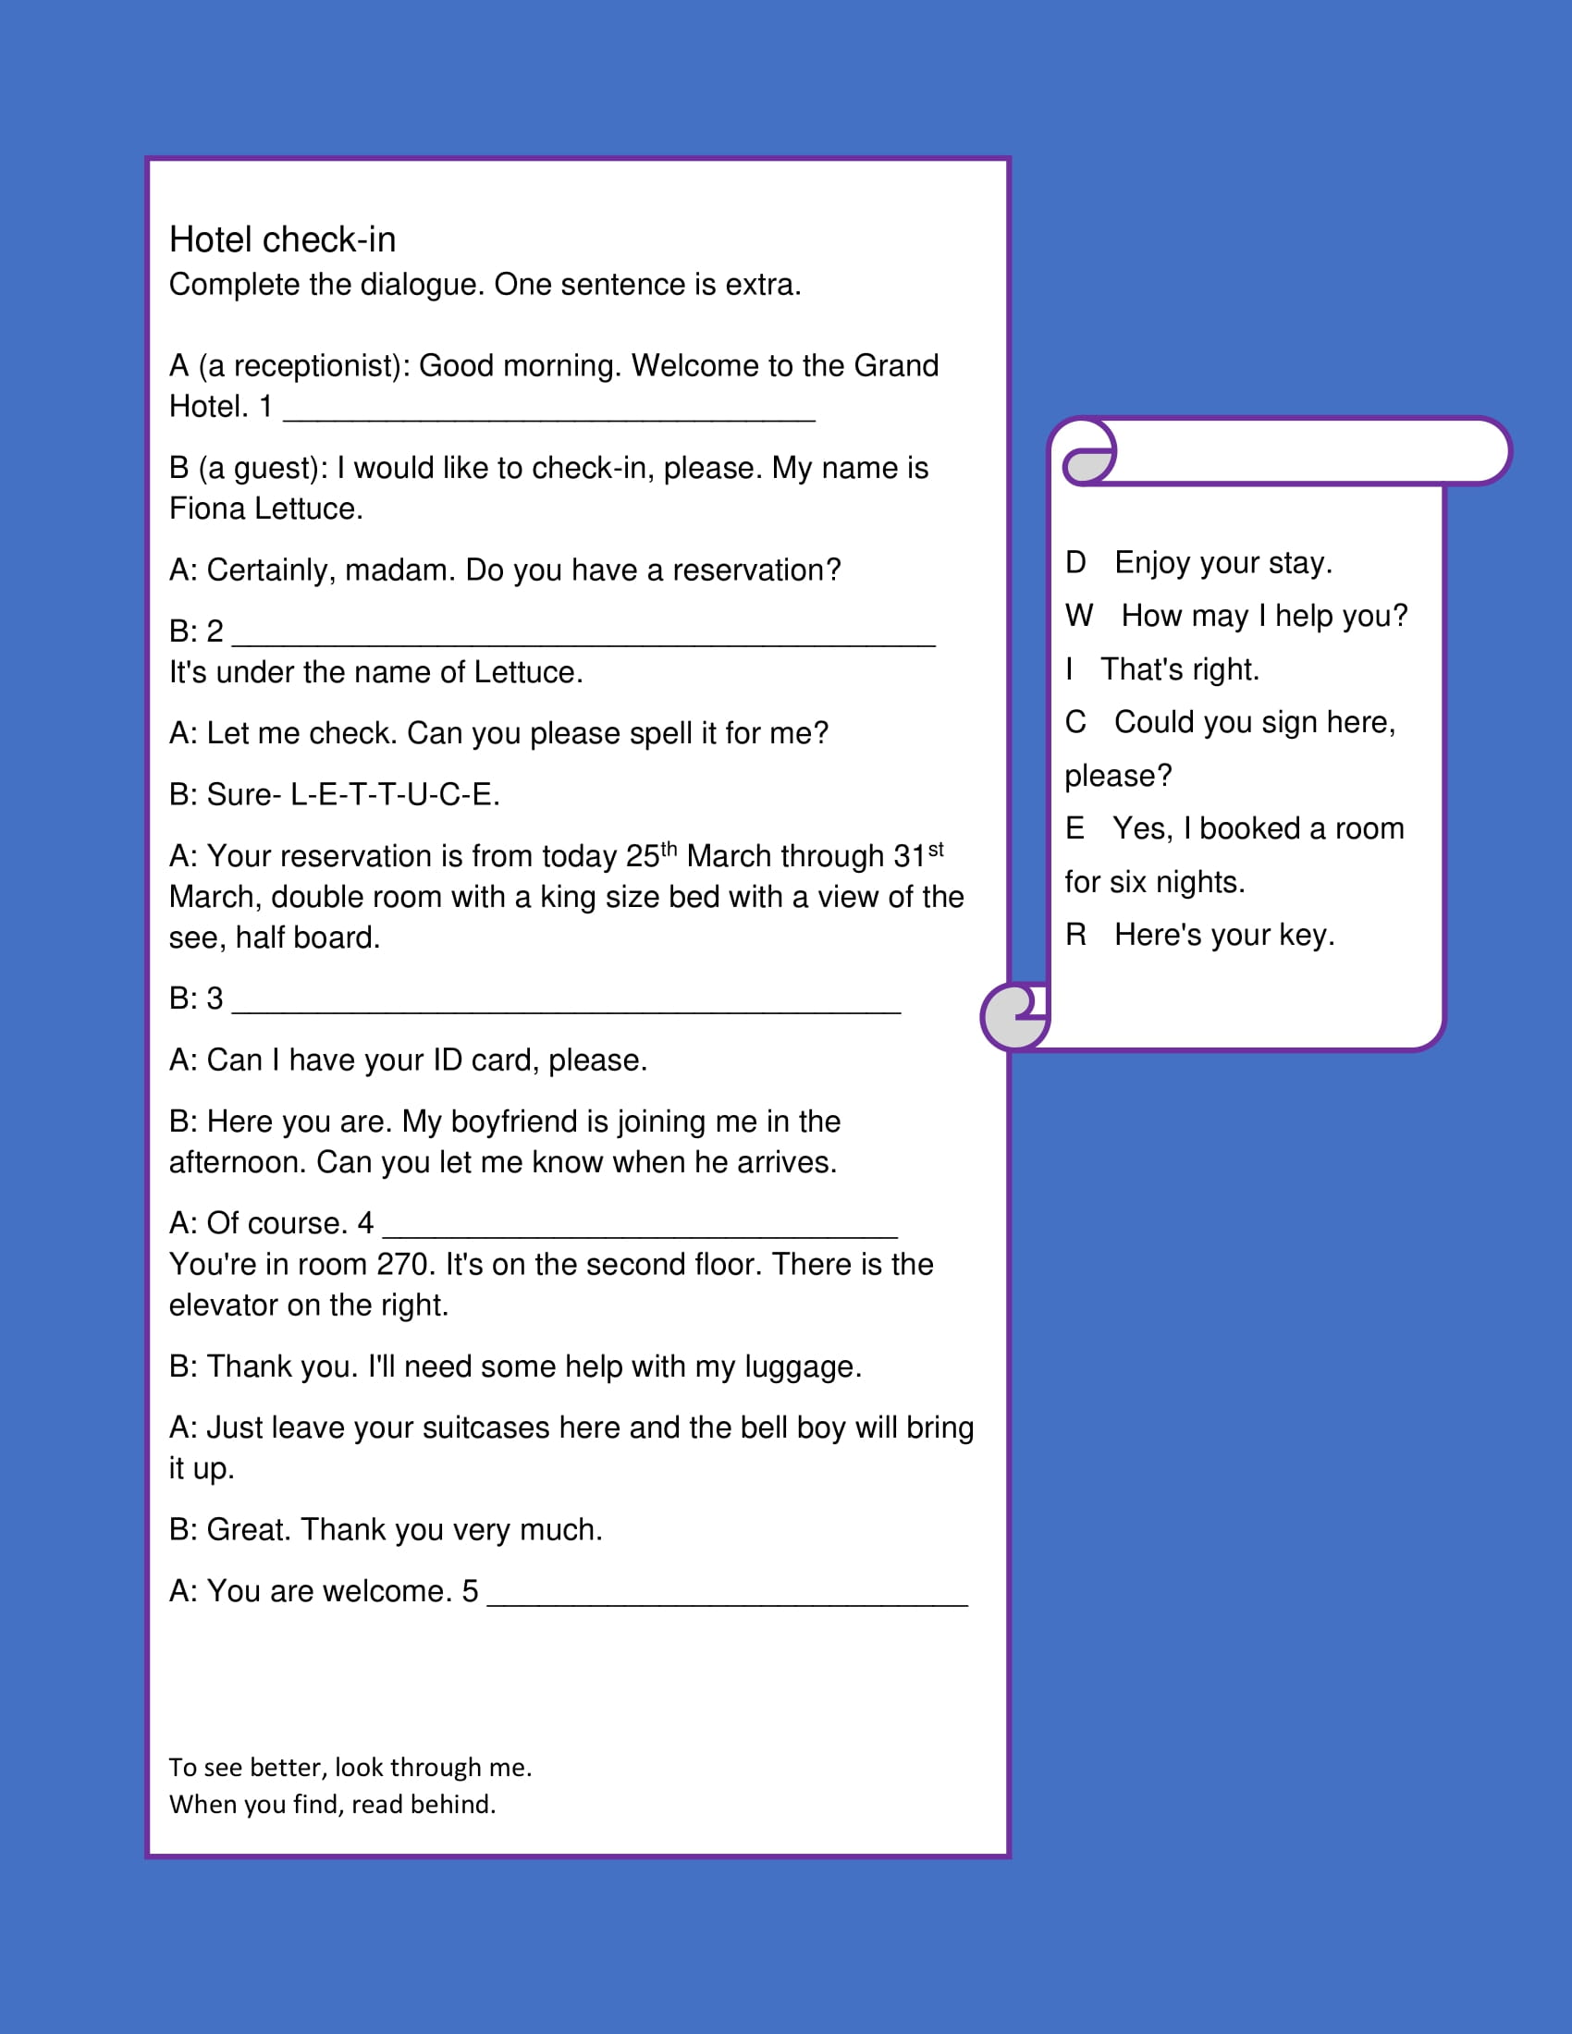
follow-up:
speaking:
role play - pick
another guest and check into a hotel

Slide 28
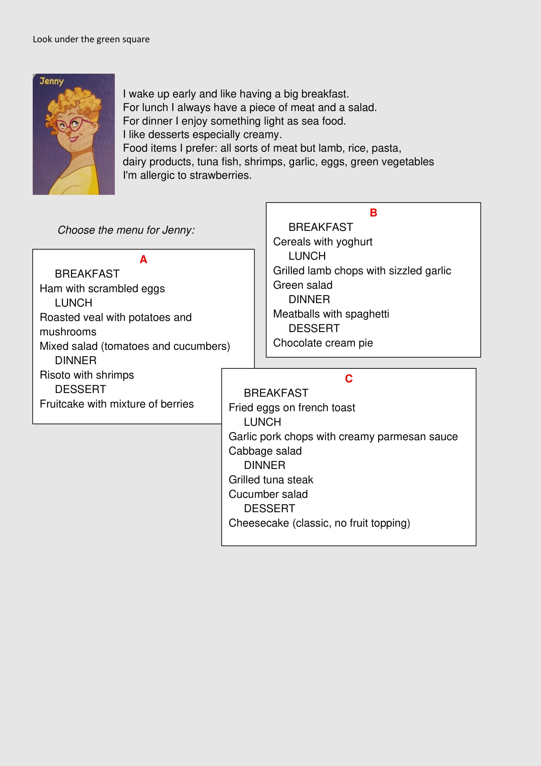
speaking:
explain the reason for
the menu choice
writing:
write a menu for one
of the guests

Slide 29
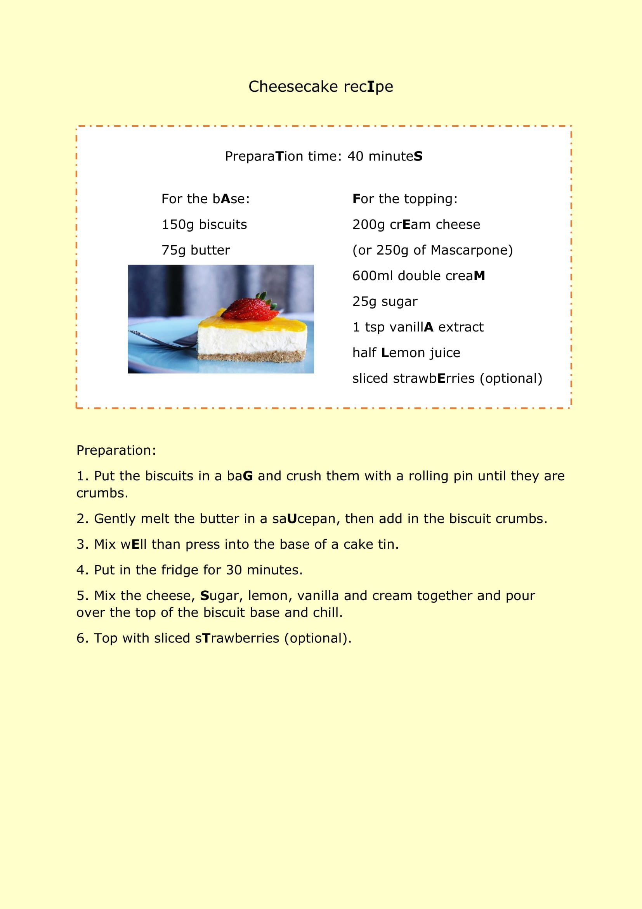
writing:
write a recipe for
a birthday cake

Slide 30
TSUNAMI ESCAPE
Past tenses (narrating a past event)
feelings idioms
disasters/weather conditions/holiday problems

Slide 31
Tsunami Escape – follow-up:
speaking & writing
- talk about your feelings (use idioms)
- act out a dialogue about a holiday problem
- narrate a similar experience during a disaster

Slide 32
Thank you for your attention!
mskatalinic@gmail.com

Slide 33
Sources and credits:
images: personal, pixabay, cluebox.eu
intro video: cluego.eu

