Slide 1

Padlet ­ - ICT Tool of the Future:
Recycle, Reuse and Recreate
Barbara Bošnjak, Isidor Kršnjavi High School of Našice
Mirela Rukavina-Sabo, Isidor Kršnjavi High School of Našice
30th Annual International HUPE Conference
Poreč, 11th – 13th November 2022

Slide 2
Outline
What is Padlet?
How to Use Padlet?
Ways to Use Padlet in the Classroom
Sharing Good Practice - Padlet Examples
Advantages of Using Padlet in the Classroom

Slide 3
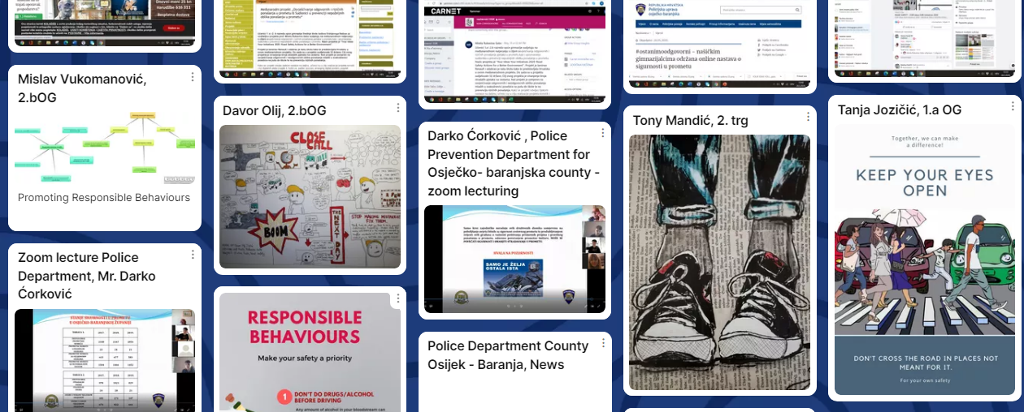
What is Padlet?
a technological tool that works like a cork board
posting notes
sharing notes with others in the form of links, images, videos and different documents

Slide 4
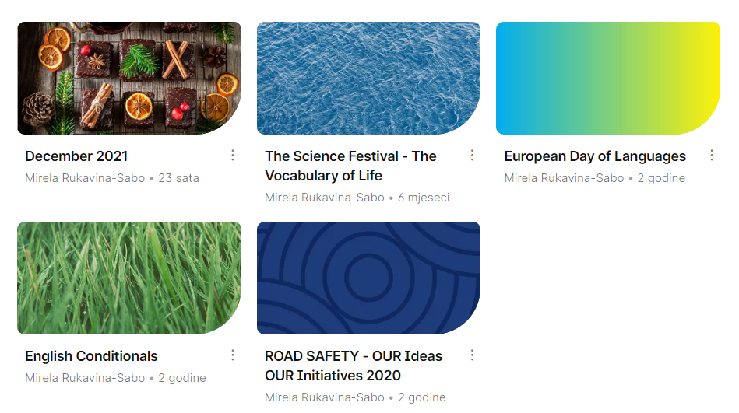
How to Use Padlet?
install the Padlet app or on your phone
go to the Padlet website
create an account
make your first board
share a Padlet board by a QR code or a link

Slide 5







Creative Ways to Use Padlet
Brainstorming on a topic, statement, project or idea
Live question bank
Online student portfolio
Exit ticket padlet
Beginning of the schoolyear – Icebreaker
End of the schoolyear - Give a compliment
Book discussions
Complete the story

Slide 6
Sharing Good Practice
https://padlet.com/mirelarukavinasabo/mouev6roc0qr542u
https://padlet.com/barbarabosnjak1/3qy5vpwt2by1ghxg
https://padlet.com/mirelarukavinasabo/gdn5lugavw3hoj9w
https://padlet.com/mirelarukavinasabo/k0jgp7opg86mgb31
https://padlet.com/mirelarukavinasabo/sk49y4yeon0gu6n2
https://padlet.com/mirelarukavinasabo/lyeu18rcbk3l6lyi
https://padlet.com/mirelarukavinasabo1/xfgi9khmk7t8mb9x

Slide 7

Benefits of Using Padlet
Easy and Intuitive
Group Research
Brings Creativity
Class Participation
Class Updates

Slide 8



Thank You for Your Attention!
Don`t Forget to Use
Padlet in the Classroom!
30th Annual International HUPE Conference
Poreč, 11th – 13th November 2022

Slide 9
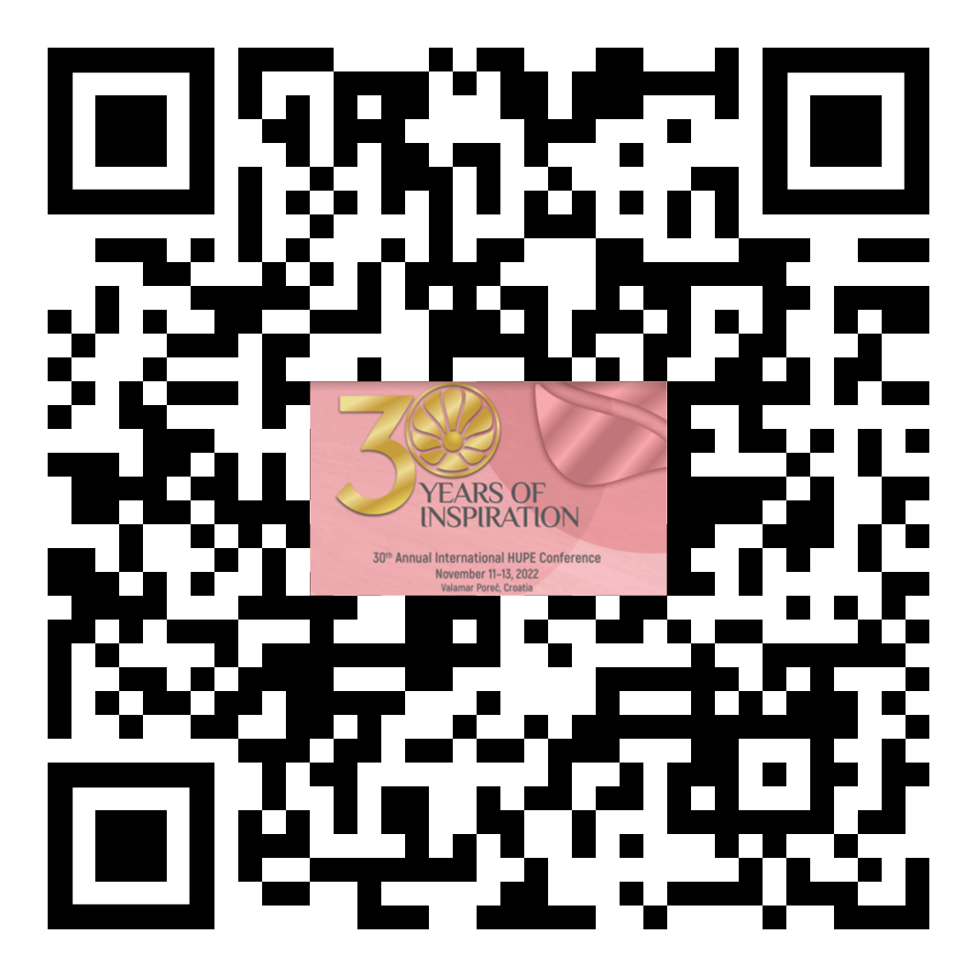
Evaluation
Don`t Forget to Use
Padlet in the Classroom!
https://bit.ly/HUPEpadlet
30th Annual International HUPE Conference
Poreč, 11th – 13th November 2022

