Slide 1
Divide and conquer the English matura essay
The matura essay made easy
Dunja Krpanec, V. gimnazija, Zagreb – The 30th HUPE conference – Poreč, 13 November 2022

Slide 2
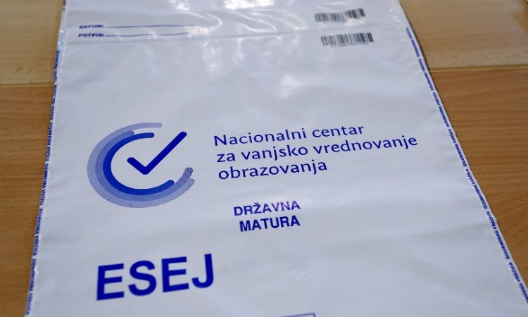
Divide and conquer approach
five activities that can help you teach the elements of matura essay writing in an interesting and effective way:
Quiz kids / how to be more confident and score better in the matura exam
The key question is… / how to write the thesis and the summary
100-point game / how to improve on coherence and cohesion of the text
Jigsaw puzzles / how to structure the essay
World Schools Debate / how to construct arguments and give
examples and support for them

Slide 3

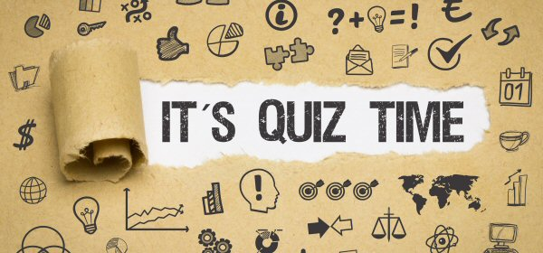
1) Quiz kids
General information on the matura exam
turn the exam guide (Ispitni katolog) into a multiple choice quiz
a competitive or a cooperative game
a worksheet, a PPT or a Kahoot quiz

Slide 4
Style
The style of the matura essay should be:
a) formal (you have to use a serious tone and full forms of verbs)
b) semi-formal (you can use contractions (don’t, won’t, aren’t) and phrasal verbs)
c) informal (you can use short sentences and some slang)

Slide 5
Types of sentences
Sentences in the essay have to be:
a) mostly simple (containing 1 verb)
b) a mixture of simple and complex sentences
c) mostly complex (containing 2 or more verbs)

Slide 6
The number of words in the matura essay
In the matura essay, you will lose points if you write:
a) fewer than 200 words
b) between 200 an 250 words
c) more than 250 words

Slide 7
Common topics
A typical matura essay would NOT be entitled:
a) Some people say that being a teenager is the most beautiful time in life, others disagree.
b) Some people say that life without social networks would be impossible. Others say that it would be better.
c) Some people say that capital punishment is just.

Slide 8
Corrections
If you want to change something in the final version of your essay you should:
a) mask the errors with correction fluid
b) cross the errors out and put them in brackets
c) cross the errors out, put them in brackets and write your initials (D.K.) next to them

Slide 9
Style
The style of the matura essay should be:
a) formal (you have to use a serious tone and full forms of verbs)
b) semi-formal (you can use contractions (don’t, won’t, aren’t) and phrasal verbs)
c) informal (you can use short sentences and some slang)

Slide 10
Types of sentences
Sentences in the essay have to be:
a) mostly simple (containing 1 verb)
b) a mixture of simple and complex sentences
c) mostly complex (containing 2 or more verbs)

Slide 11
The number of words in the matura essay
In the matura essay, you will lose points if you write:
a) fewer than 200 words
b) between 200 an 250 words
c) more than 250 words
Losing points:
160 – 190 words: -1 point
130 – 159 words: -2 points
100 – 129 words: -3 points
50 – 99 words: -4 points

Slide 12
Common topics
A typical matura essay would NOT be entitled:
a) Some people say that being a teenager is the most beautiful time in life, others disagree.
b) Some people say that life without social networks would be impossible. Others say that it would be better.
c) Some people say that capital punishment is just.

Slide 13
Corrections
If you want to change something in the final version of your essay you should:
a) mask the errors with correction fluid
b) cross the errors out and put them in brackets
c) cross the errors out, put them in brackets and write your initials (D.K.) next to them

Slide 14
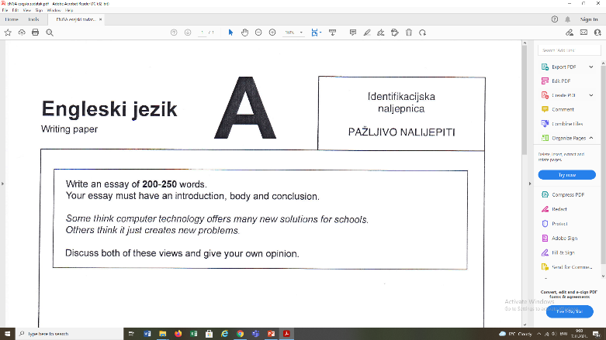
2)The key question is…
Drilling indirect questions
The key question is … What it comes down to is … What needs to be decided is … Many people are starting to wonder …
1) Should all people be paid a regular monthly income?
2) Does advertising have a negative influence on our lifestyle?
3) Are young drivers a threat to road safety?
4) Would it be better if there were only one language in the world?
5) Is it important to explore space?

Slide 15
Answers:
1) The key question is if all people should be paid a regular monthly income.
2) What it comes down to is whether advertising has a negative influence on our lifestyle.
3) What needs to be decided is whether young drivers are a threat to road safety.
4) The key question is whether it would be better if there were only one language in the world.
5) Many people are starting to wonder if it is important to explore space.

Slide 16
Follow-up activity: Paraphrasing
Paraphrase (express the same idea using different words) the yellow part of the sentence.
Then add the opposite or second idea.
The key question is if all people should be paid a regular monthly income.
The key question is if each citizen is entitled to get minimum wage each month or the budget must not be wasted in such a way.
What it comes down to is whether advertising has a negative influence on our lifestyle.
What it comes down to is whether being exposed to commercials and billboards can damage our life or improve it greatly.

Slide 17
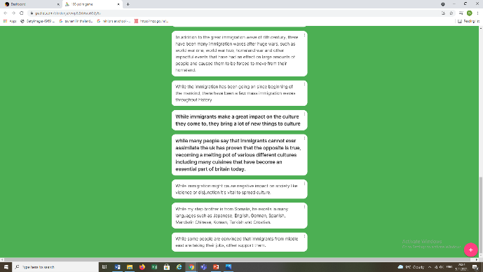
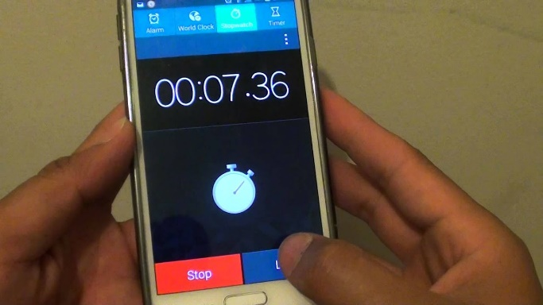
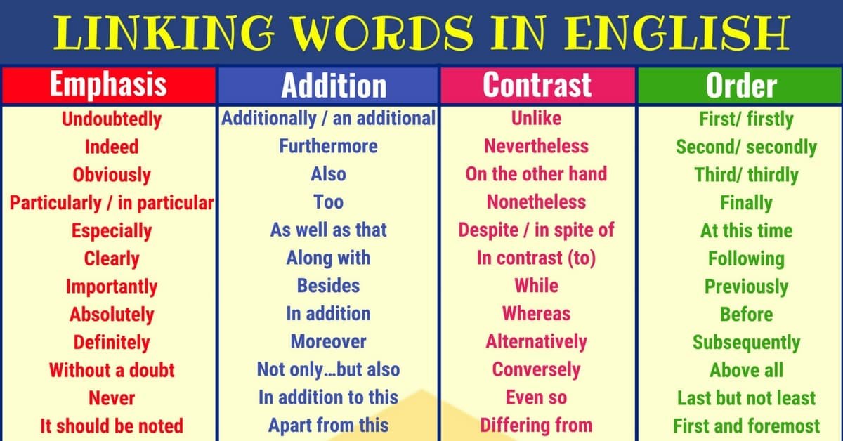
3)100-point game
Linking words
aim: writing the longest sentence about a certain topic in a limited period of time starting with a given linking word
set the time limit depending on your students’ level of language and the available time
all students have to begin their sentences with the same linking word(s), e.g. While, Owing to, In addition to, Even though, In spite of

Slide 18
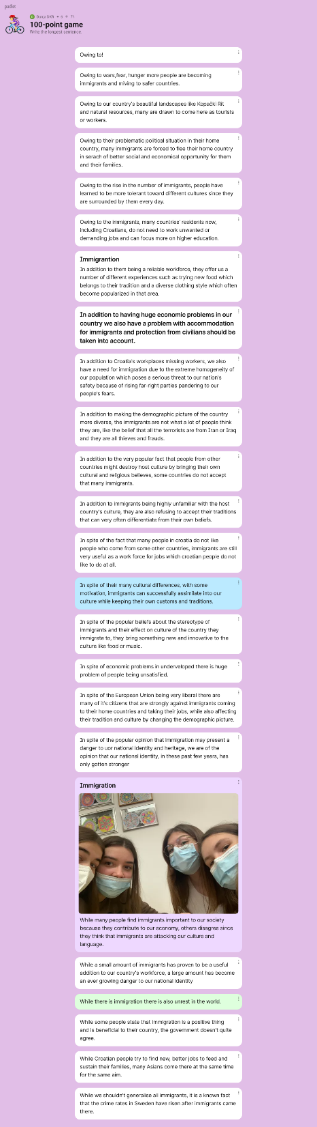
Use Padlet
the game can be played on Padlet / students have to use their mobile phones
the teacher opens a page on Padlet and sends a link to students
groups of four students should take turns to play four rounds of the game so that each student types one answer and other students help him
when the time is up students have to send their sentences to Padlet
everyone can see if the sentences are correct

Slide 19
Scoring
establish a scoring system in advance with your students
wrong construction-all words lost
a misspelled word – minus one
a missing full stop or comma – minus one
making lists of words (e.g. swimming, football, handball, running) – minus all the words in the list
etc.

Slide 20
Scoring
students count the number of correct words and take the number away from one hundred
the group that reaches zero first are the winners
 | Group A 100 | Group B 100 | Group C 100 | Group D 100 | Group E 100
Round 1 | 82 | 85 | 79 | 90 | 100
Round 2
Round 3
Round 4

Slide 21
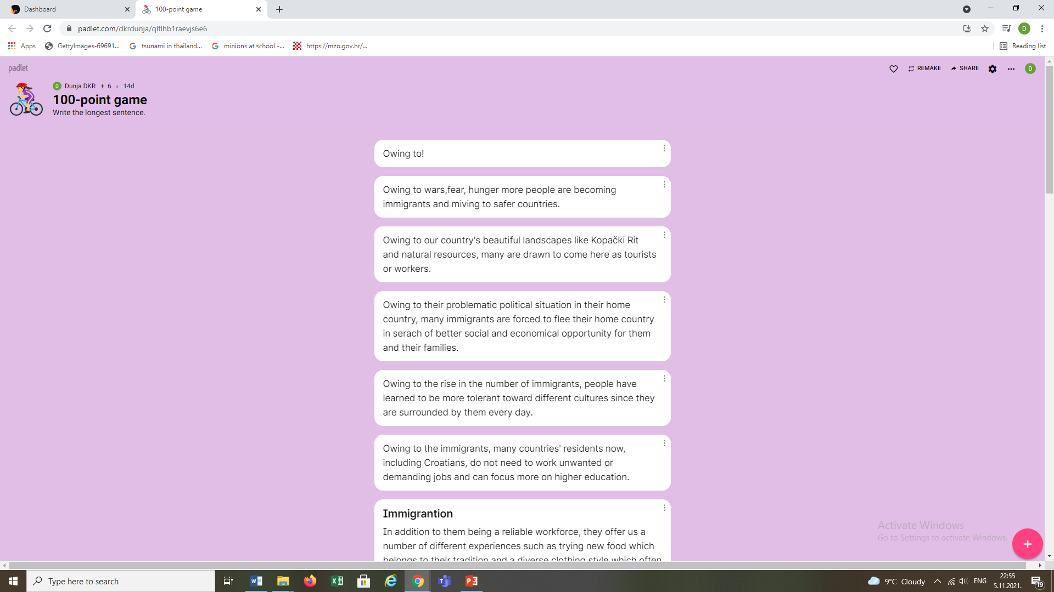

Slide 22


Slide 23
Correcting mistakes
Topic: Immigration
Full stop: While the immigration has been going on since beginning of the mankind, there have been a few mass immigration waves throughout history
Capital letters and spelling: while many people say that immigrants cannot ever assimilate the uk has proven that the opposite is true, vecoming a melting pot of various different cultures including many cuisines that have become an essential part of britain today.
Lists are forbidden: While my step brother is from Somalia, he excells in many languages such as Japanese, English, German, Spanish, Mandarin Chinese, Korean, Turkish and Croatian.
Linker: While immigrants make a great impact on the culture they come to, they bring a lot of new things to culture.

Slide 24
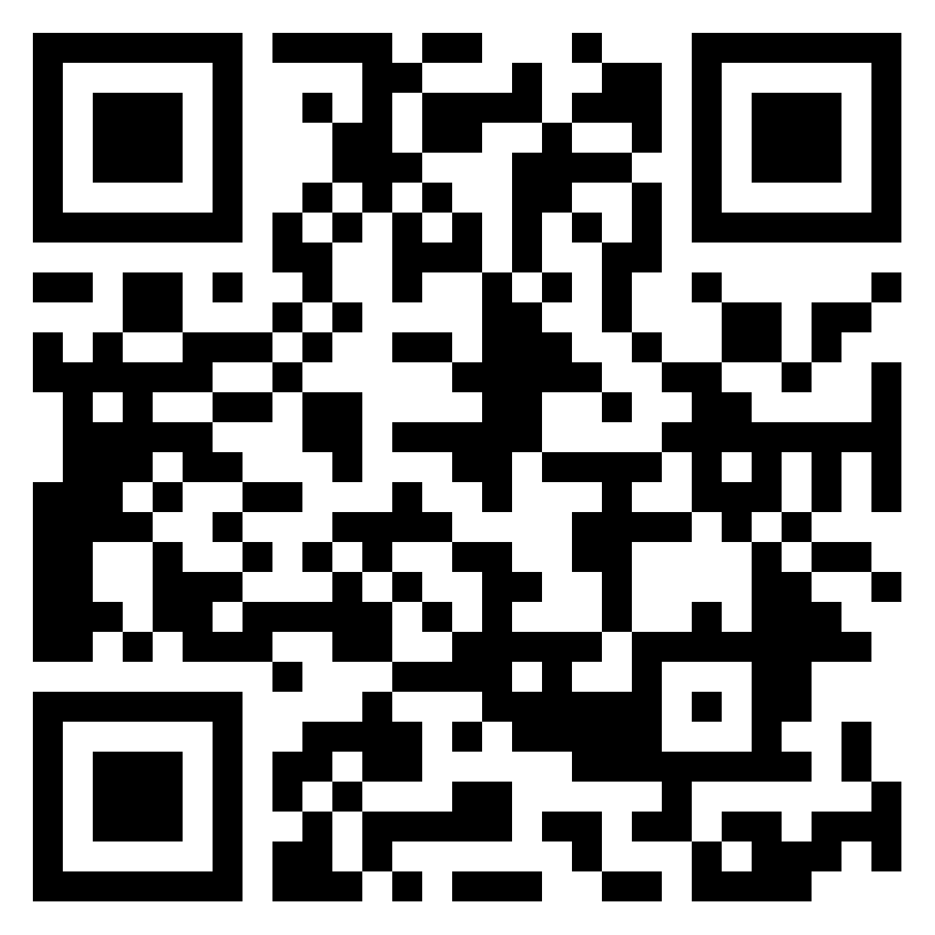
Play one round of 100-point game
topic:
30 years of HUPE
linking words: In spite of
write the longest sentence
the link to Padlet:
https://padlet.com/dkrdunja/l0lf790gjsltwes8

Slide 25
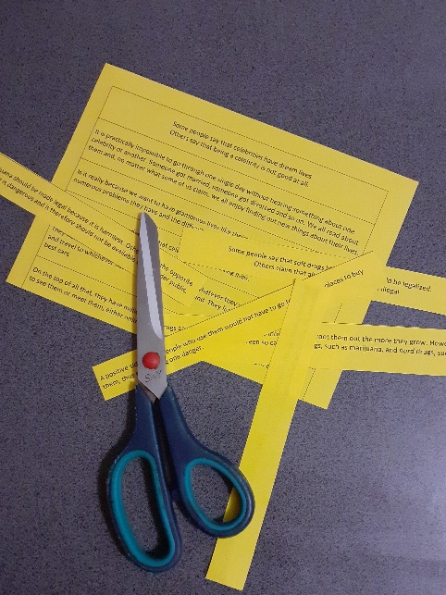
4) Jigsaw puzzles
How to structure an essay
copy and cut two well-written matura essays into 11 pieces each covering one main part of the matura essay:
1) title, 2) introduction, 3) thesis, 4) the first topic sentence, 5) the first argument with support, 6) the second argument with support, 7) the second topic sentence, 8) the first argument with support, 9) the second argument with support, 10) summary, 11) personal opinion
one set (22 pieces) for 4 students
students first have to find the titles
then they have to separate the two texts
in pairs, students put the pieces in the correct order

Slide 26
Is it really because we want to have glamorous lives like theirs or we are well-aware of the numerous problems they have and the difficulties common people do not encounter?
Drugs are everywhere. It seems the more we try to root them out the more they grow. However, people often distinguish between so called soft drugs, such as marijuana, and hard drugs, such as heroin.
Secondly, many people hate them. They often get hate mail and a lot of them need to be accompanied by bodyguards every waking moment.
First of all, they do cause some kind of psychological dependence. Long term users vey often become lethargic and emotionless.
Some people say that celebrities have dream lives. Others say that being a celebrity is not good at all.
As I see it, we all dream about living like famous people but maybe it is better to leave it at that.
However, there is the other, darker side of their lives.
They have a lot of money which enables them to do whatever they want, buy whatever they like and travel to whichever destination comes to their mind. They live in big houses and drive the best cars.
Many believe marijuana should be made legal because it is harmless. Others claim the opposite and say that any drug is dangerous and it therefore should not be available to a broader public.
Also, some people see legalisation of marijuana as the beginning of a long road to hell of “real” drugs. They say legalisation is the same as opening the door to drugs and inviting them in.
The main advantage, however, would be for the state – it could collect taxes on drugs and ultimately, citizens would benefit from this.
On the negative side, one must say that although soft drugs might not be as addictive as heroin, they are still a danger to society.
On the top of all that, they have millions of fans who are willing to do everything in their power to see them or meet them, either online or in public events.
Numerous people say soft drugs do not damage a person’s psyche or body and they do not cause addiction, so, what is the harm in legalising them?
All in all, to be a celebrity is not the most amazing thing. It would be nice to have all the positive sides of their lives such as money and fans, but with the positive necessarily comes the negative, for instance, lack of privacy and stalkers.
If you ask me, there are many dangers that await people in the world today so there is no need to add one more to the list. Some doors should remain closed for good.
In the end, I wish to emphasize that although there are several positive sides of the legalisation of soft drugs such as the potential reduction of crime and larger state budget, they are outnumbered by the negative ones such as loss of health and the rising need for more dangerous opiates.
It is practically impossible to go through one single day without hearing something about one celebrity or another. Someone got married, someone got divorced and so on. We all read about them and, no matter what some of us claim, we all enjoy finding out new things about their lives.
On the one hand, it is undeniable that celebrities lead exciting lives.
Some people say that soft drugs like marijuana should be legalized. Others claim that all drugs should remain illegal.
Firstly, they have no privacy. They cannot go for a coffee with their friends without someone asking them for an autograph or a selfie.
A positive side is that people who use them would not have to go to suspicious places to buy them, thus eliminating one danger.

Slide 27
Some people say that celebrities have dream lives. Others say that being a celebrity is not good at all.
It is practically impossible to go through one single day without hearing something about one celebrity or another. Someone got married, someone got divorced and so on. We all read about them and, no matter what some of us claim, we all enjoy finding out new things about their lives.
Is it really because we want to have glamorous lives like theirs or we are well-aware of the numerous problems they have and the difficulties common people do not encounter?
On the one hand, it is undeniable that celebrities lead exciting lives.
They have a lot of money which enables them to do whatever they want, buy whatever they like and travel to whichever destination comes to their mind. They live in big houses and drive the best cars.
On the top of all that, they have millions of fans who are willing to do everything in their power to see them or meet them, either online or in public events.
However, there is the other, darker side of their lives.
Firstly, they have no privacy. They cannot go for a coffee with their friends without someone asking them for an autograph or a selfie.
Secondly, many people hate them. They often get hate mail and a lot of them need to be accompanied by bodyguards every waking moment.
All in all, to be a celebrity is not the most amazing thing. It would be nice to have all the positive sides of their lives such as money and fans, but with the positive necessarily comes the negative, for instance, lack of privacy and stalkers.
As I see it, we all dream about living like famous people but maybe it is better to leave it at that.
Some people say that soft drugs like marijuana should be legalized. Others claim that all drugs should remain illegal.
Drugs are everywhere. It seems the more we try to root them out the more they grow. However, people often distinguish between so called soft drugs, such as marijuana, and hard drugs, such as heroin.
Many believe marijuana should be made legal because it is harmless. Others claim the opposite and say that any drug is dangerous and it therefore should not be available to a broader public.
Numerous people say soft drugs do not damage a person’s psyche or body and they do not cause addiction, so, what is the harm in legalising them?
A positive side is that people who use them would not have to go to suspicious places to buy them, thus eliminating one danger.
The main advantage, however, would be for the state – it could collect taxes on drugs and ultimately, citizens would benefit from this.
On the negative side, one must say that although soft drugs might not be as addictive as heroin, they are still a danger to society.
First of all, they do cause some kind of psychological dependence. Long term users vey often become lethargic and emotionless.
Also, some people see legalisation of marijuana as the beginning of a long road to hell of “real” drugs. They say legalisation is the same as opening the door to drugs and inviting them in.
In the end, I wish to emphasize that although there are several positive sides of the legalisation of soft drugs such as the potential reduction of crime and larger state budget, they are outnumbered by the negative ones such as loss of health and the rising need for more dangerous opiates.
If you ask me, there are many dangers that await people in the world today so there is no need to add one more to the list. Some doors should remain closed for good.

Slide 28
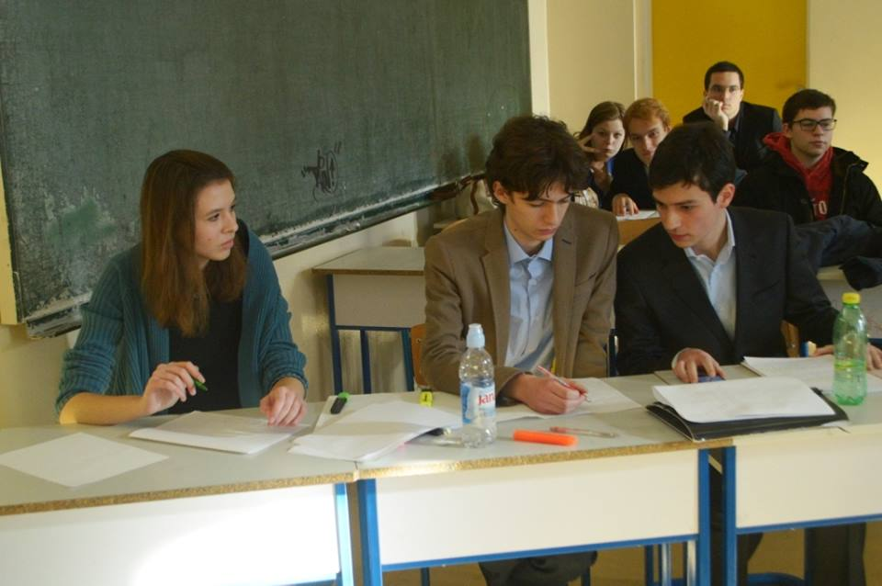
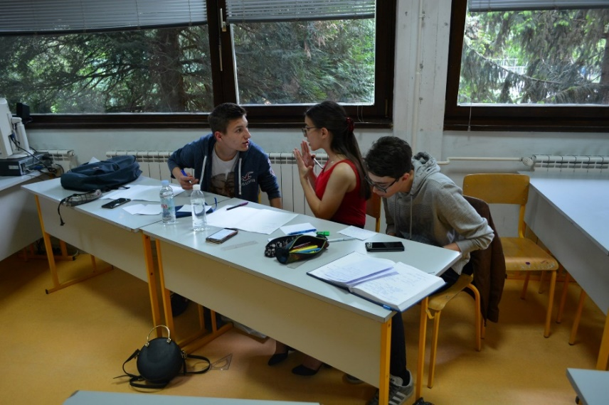
5) World Schools Debate
Constructing arguments
the motion is a sentence about a debatable topic which has to be proven or disclaimed - any topic of a matura essay is debatable
there are 6 participants or 3 speakers in both groups, the proposition and the opposition
the proposition defends the motion, while the opposition attacks it

Slide 29
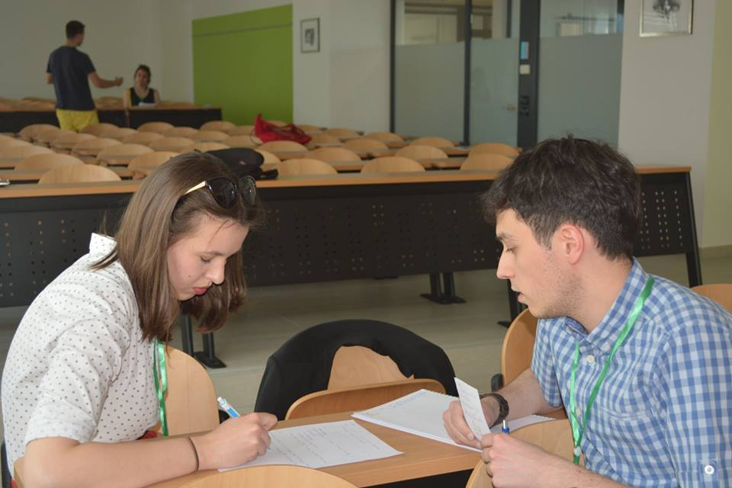
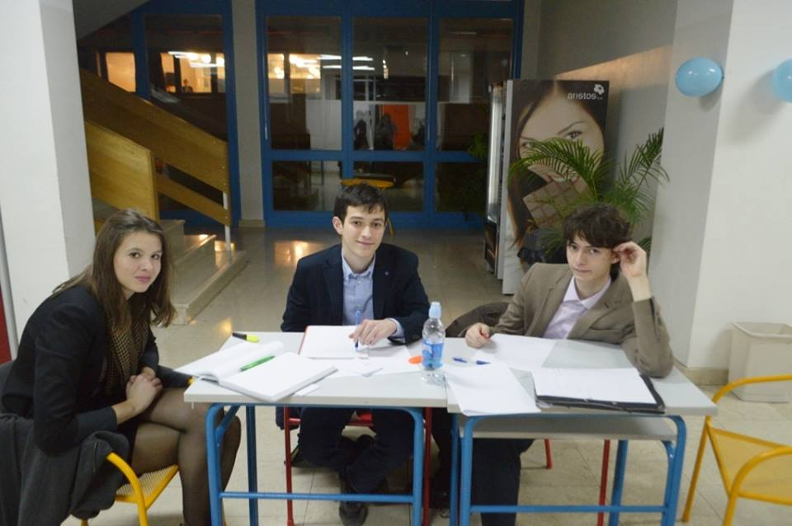
Preparing a debate
groups prepare their arguments as well as the strategy how to deal with the other group’s ideas in advance
the first speakers of both groups are supposed to present their group’s arguments
the second speakers should refute the other group’s arguments
the third speakers have to sum up the debate in order to show that their group has won

Slide 30
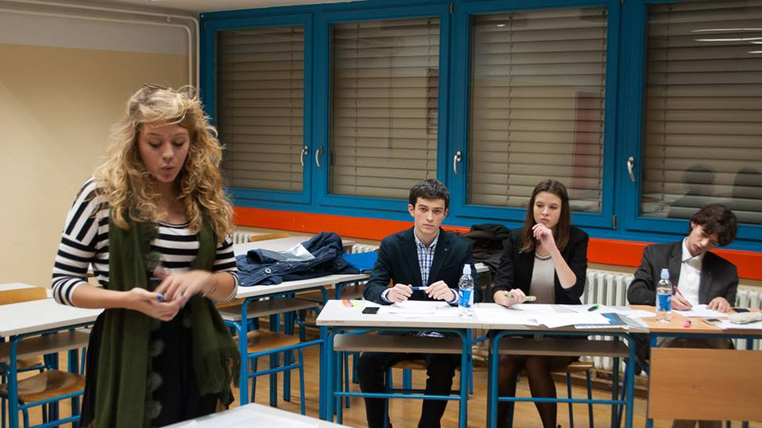
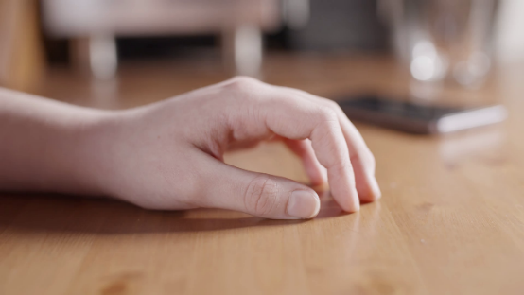
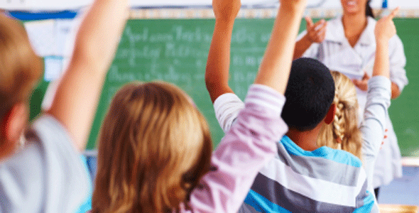
5) World Schools Debate
Constructing arguments
each speaker has 3-5 minutes for their speech
after each speech the audience show their approval by tapping, not clapping hands
after the debate the class takes a vote to choose the winner - better speakers
peer assessment - individual students can be asked to analyse the quality of the speeches using the rubric
the teacher grades the students’ speeches

